Slide 1
Effectively engaging with artificial intelligence to formulate assessment strategies for minimising academic misconducts
Dr Shiva Sivasubramaniam
University of Derby, UK
3rd ENAI Academic Integrity Summer School 2023, 21st – 25th August 2023, Faculty of Electrical Engineering and Computer Science, University of Maribor, Slovenia

Slide 2
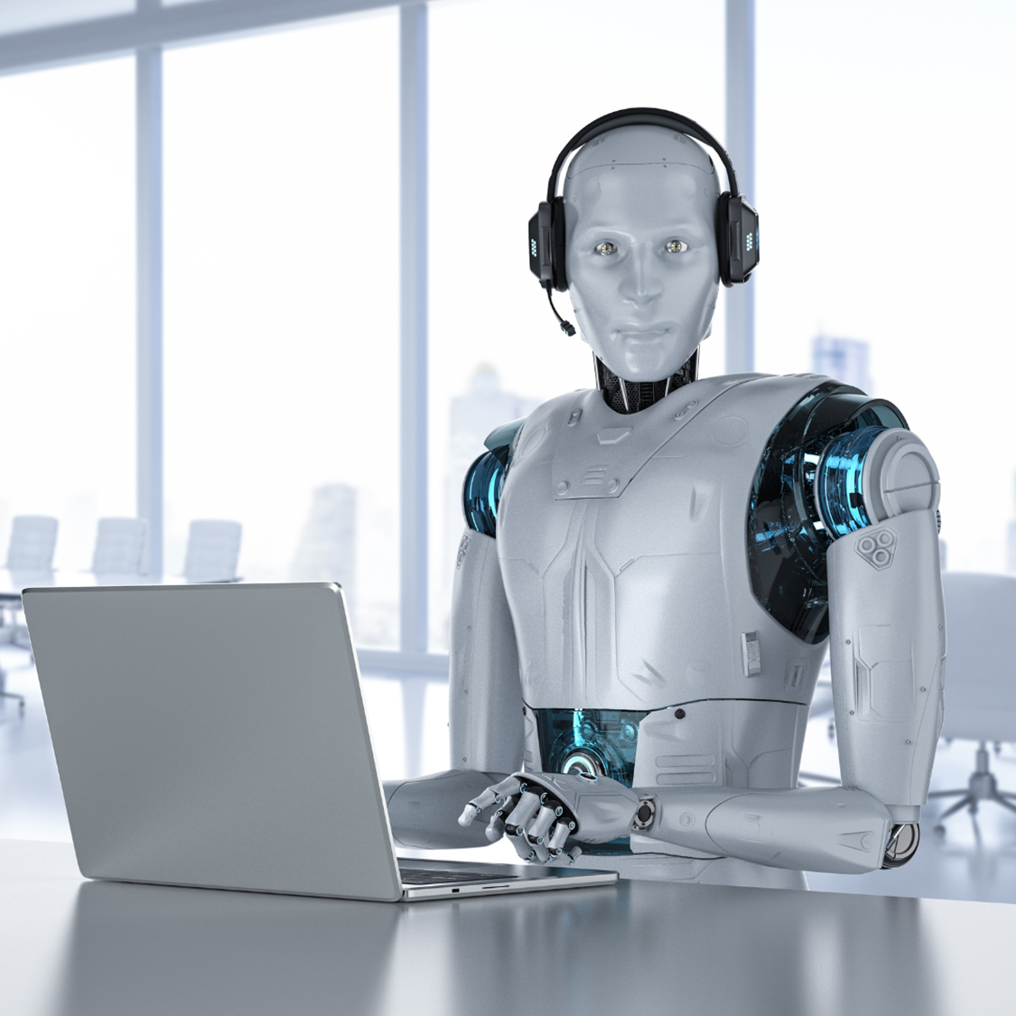
Malapropism: Artificial Intelligence
“All forms of Chat-GPT’s are Generative Pre-trained Transformers but all Generative Pre-trained Transformers are not Chat-GPT!”

Slide 3
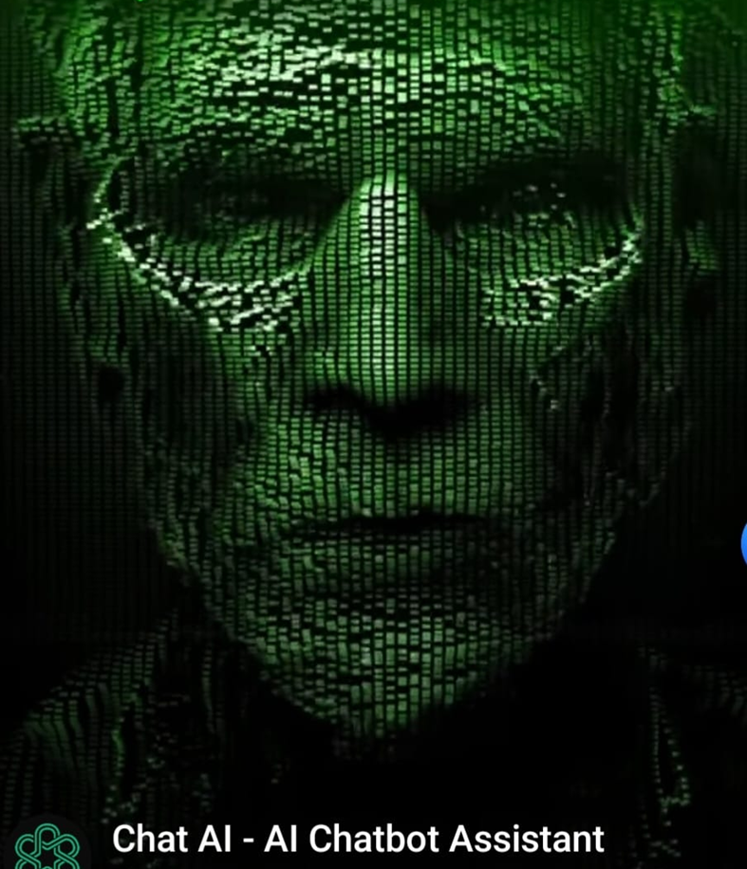
Aims and Objectives
To explore the ways to modify assessments to minimise students over relying on GAI (Chat-GPT).
To generate discussion amongst participants about its impact on education.
Adopted from Chat-GPT Social Media advertisement

Slide 4
UK Universities’ Policies on AI (19th June 2023)
61% - No clear guidance or policy
8% - The tools are banned outright
9% - the tools are banned by default unless instructors say otherwise.
Universities (%)
10% - Individual instructors decide their own policy for now.
12% - The tools are allowed (with citation) unless instructors prohibit them.
Caulfield, J. (2023, June 12). University Policies on AI Writing Tools | Overview & List. Scribbr. Retrieved 27 June 2023, from https://www.scribbr.co.uk/using-ai-tools/chatgpt-university-policies-uk/

Slide 5
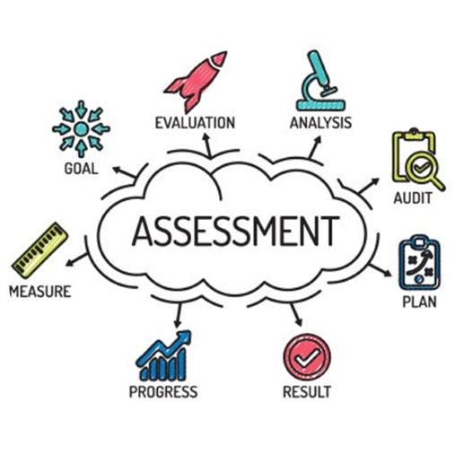
The Purpose of Assessments
To gauge student learning
By a
Series of measurements
using
Various methods & techniques
To
Refine & improve student learning capabilities.

Slide 6
Role of Assessments in Learning?
Learning
Scaffolded progression
Reproduction?
Application?
Feedback
Revision

Slide 7
Different types of Assessments?
Assessment of Learning
Assessment for Learning
Assessment as Learning
Ensures learning via assessment
Both formative and summative
Test understanding and application
Usually given as laboratory work
Focussed questions
E.g:-
Quizzes, concept maps, essays, laboratory reports etc
Provide opportunities monitor
Involves activities and application
Ensures learning via assessment
Both formative and summative
Test understanding and application
E.g:-
Self/peer assessments, portfolios etc.
Summative in nature
To measure student’s understanding
Often test memory & reproduction
Usually given as end-exams
Less productive
E.g:-
Unit tests, essays, end module exams etc

Slide 8
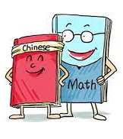
It’s time to think?
“If our assessment of students’ learning and skills is based on assessments that ask them to regurgitate easily tested facts and processes, we’re not testing anything of value”.
- Dr Linda McIver

Slide 9
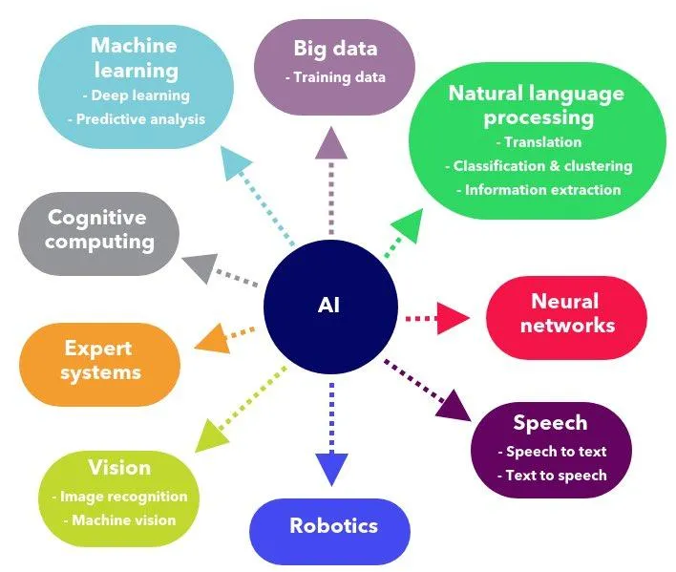
Branches of Artificial Intelligence
Generative AI
Generative AI (GAI) is only a division within a wider AI capabilities!
https://oilgains.medium.com/why-machine-learning-is-not-artificial-intelligence-61b174a3c9a2

Slide 10
GAI: Threats to assessments
Essay-based assessment
- Knowledge reproduction tasks
- Students can obtain the whole essays
- Nearly perfect answers
Redefining marking rubrics
How to award lower grades
Redundancy of marks for communication
Subject-based difficulties
Online assessments
How to effectively conduct these?
Ease of processing, marking, and authentication.
Creative thinking to ensure authentic assessments

Slide 11
Strengths of GAI
Strengths
Generating plausible responses | Provides coherent, relevant and seemingly more credible responses. (Li et al., 2019)
Self-improving capability | Uses reinforcement learning from human feedback to inform its language model (Mann, 2023)
Provides personalised responses | Has the potential to provide personalised responses based on the context of a given prompt (Haque et al, 2023)
Provides real-time responses | Understands complex inquiries and provide relevant answers in real-time (Deng & Lin, 2022).
Increases the accessibility of information | Offers a written-out answer rather than just a list of sources
Based on Mohammadreza Farrokhnia et al (2023) https://doi.org/10.1080/14703297.2023.2195846

Slide 12
Weaknesses of GAI
Weaknesses
Superficial understanding | Does not fully grasp the concepts behind the words (Bogost, 2022)
Inability to check the quality / validity | Lacks the human ability to assess the credibility of the data
Risk of biases and discrimination | Lacks the ability to consider unintended consequences such as reinforcing existing biases (O’neil, 2017).
Lack of higher-order thinking skills | less competent when it comes to content that requires higher-order thinking skills, such as critical and analytical thinking (Rudolph et al., 2023).
Threat to independent research skills | Can lead to a decline in higher-order cognitive skills such as creativity, critical thinking, reasoning, and problem-solving.
Based on Mohammadreza Farrokhnia et al (2023) https://doi.org/10.1080/14703297.2023.2195846

Slide 13
More Secure Assessments against GAI
Features of assessments | The reasons for minimising GAI usage
Specific challenging question | The questions expects application of knowledge in a specific context, which would need evaluation, analysis, synthesis and application.
Advanced knowledge or situational skill application
Creative assessments that expect individualism | Expect individual application to produce physical artefacts, laboratory work, Vivas etc. minimise the use of GAI
In person assessments | Supervised, real time assessments gives less freedom to use GAI
Invigilated assessments expecting knowledge reproduction | Questions are not known to the students beforehand, so it would be difficult to deploy GAI. The assessments are usually imposing time restriction making it difficult to deploy GAI
Closed book tests
Personal communication with Prof Phil Newton, Swansea University - TILAPIA – Tool for Identifying Learning Assessments Potentially Impacted by Artificial Intelligence

Slide 14
Risk assessment and Mitigation Plans for ‘Smart Assessments’
Advantages of GAI
Can increase access to information,
Facilitate personalised & complex learning,
Decrease teaching workload,
Makes key processes/tasks more efficient.
Threats to Education
Results in lack of higher-order cognitive skills.
Lack of understanding of the context
Threat to academic integrity
Democratising plagiarism
What is the purpose of the assessment?
What specific knowledge will be gained?
What are future application needs for this assessment?
How this be useful to improve the learning experience?

Slide 15
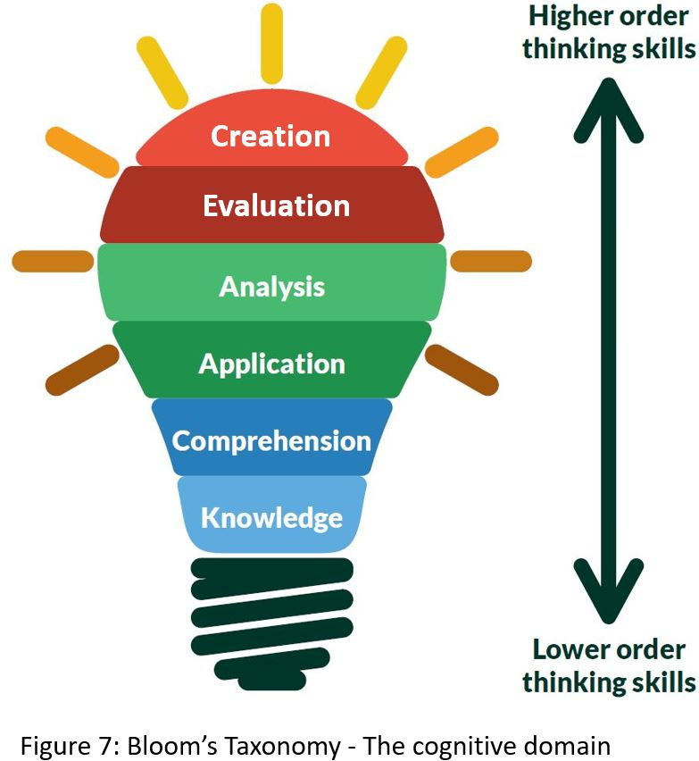
Smart Assessments - The way forwards
Assessment for learning
Information gathering (formative) – Using GAI
Should be followed up with discussions
Assessment of Learning
Creative assessments that expect individualism
Questions that need situational skills applications
Invigilated assessments
Assessment as learning
Creative assessments involving group tasks
Questions that need situational skills applications
Information gathered using GAI with verification scaffolding
Blooms Taxonomy – The Cognitive Domain
https://www.open.edu/openlearncreate/mod/page/view.php?id=148602

Slide 16
GAI assisted Assessment of learning - Example
Traditional essay question | Effective assessment question | Expected outcome
Write a 1000-word essay on the environmental effects of global warming and explain how this can be minimised. GAI can easily be used to answer this types of questions | This question can be transformed into three parts for group work. Each student will be asked to find answers using Chat-GPT. Write a 500-word essay on global warming. Write a 500-word essay the environmental effects of global warming. Write 500-word essay on how to minimise global warming Then they are expected to work together to produce a 1000-word critical summary of their findings (and submit with their individual Chat-GPT generated essays) | The assessment ensures that each student reads the essays produced by Chat-GPT, takes short notes, and explains their findings to their group. Then they will work together to produce a critical analysis of the information gathered from Chat-GPT. Although there is a chance to use the Chat-GPT to produce the final critical analysis, the task expects them to submit individual Chat-CPT generated essays. This ensures their own critical analysis

Slide 17
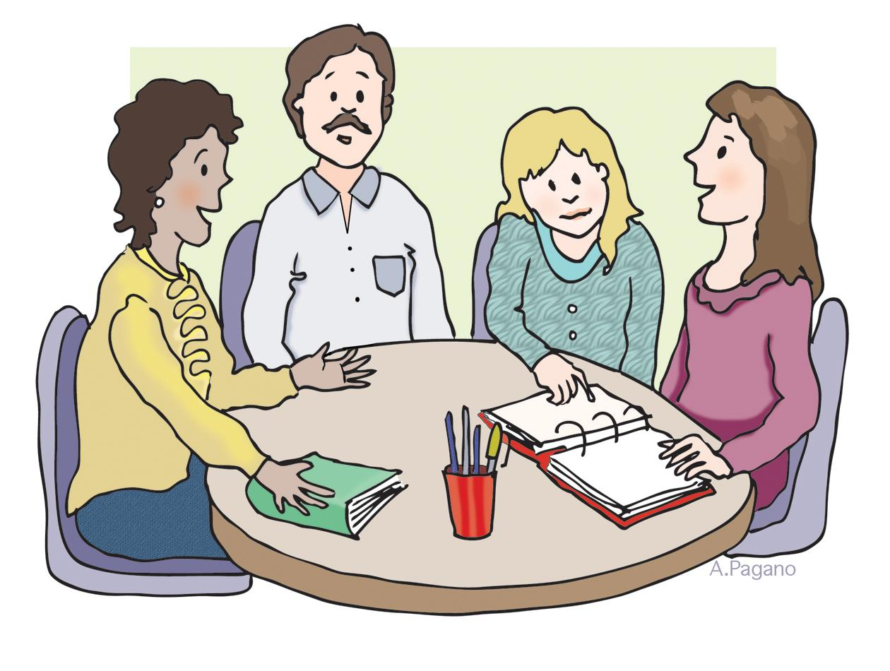
GAI-assisted assessment for learning - Example
Week 1
Week 2
Week 3
Student groups formed
Four in a group
Group titles given
Each student - one sub-title
Student group work
Clarification by the academic
Lecturer feedback
GAI usage assistance
Individual students to upload their initial essays
AI generated texts with student’s own summary.
Group discussions
Academic’s input
Fact checks for individual initial essays
Referencing
Week 4
Solo work
Individual student complete their own work
Based on week 3 discussions
Academic grading
Based on final work
Individualised grading

Slide 18
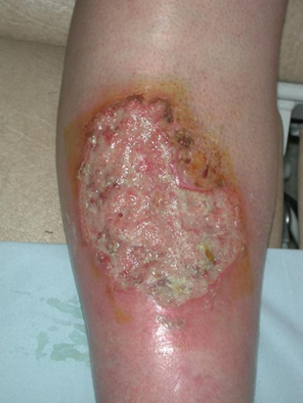
Smart assessment to minimise the use of GAI
A 60-year-old male was recently admitted to a local hospital. Clinical investigations revealed he had a left foot ulcer (see figure). He was extremely obese and complained of tiredness; nausea; giddiness; frequent urge to urinate; especially at night. He also complained of partial loss of vision, excessive trust and hunger.
What is the probable diagnosis for each this subject? Provide a detailed justification for your answer using the clinical symptoms and test results.
Discuss the different therapeutic approaches that can be applied to this patient to lead a normal life.
GAI can generate answers this question in a descriptive way. However, student may need to read the answers to understand the underlying cause for these symptoms.
GAI may possibly show the cause is diabetes, but students need to discuss the link between (a) diabetes and the symptoms and (b) how this may lead to atherosclerosis and (c) a possible therapeutic modality with justification.
GAI might offer therapeutic modalities, but students should be able to justify them. This approach aims to enhance the development of Human-Chat-GPT interface and interactions.

Slide 19
GAI-assisted assessment as learning - Example
Effective assessment questions | Expected outcome
Design a tool to diagnose dementia and provide a prognostic evaluation package using Chat-GPT. Following questions are given to help you with this task. What are causes of dementia? How can dementia be diagnosed? Discuss the treatment modalities for dementia? How can the prognosis of dementia treatment be evaluated? | Students are expected to use GAI to obtain the answers to (a) to (d). Then they need to discuss how to use GAI effectively to capture patient phonetic usage to develop speech patterns to be used in diagnostics/prognostic markers. In this way, students will understand the ways to productively use Chat-GPT generated text via human-open-AI interface.
*This question is based on the study by Felix Agbavor and Hualou Liang (2022) https://doi.org/10.1371/journal.pdig.0000168

Slide 20
Concluding remarks
An outright ban on using GAI or any other AI is not an effective way to deter academic misconduct.
‘Smart Assessments’ should be designed to have the potentials to protect against integrity challenges of generative AI.
Producing smart assessments may be challenging in some subject areas (such as history)

Slide 21
References
Bogost, I. (2022). ChatGPT is dumber than you think. https://www.theatlantic.com/technology/archive/2022/12/chatgpt-openai-artificial-intelligence-writing-ethics/672386/
Deng, J., & Lin, Y. (2022). The benefits and challenges of ChatGPT: An overview. Frontiers in Computing and Intelligent Systems, 2(2), 81–83. https://drpress.org/ojs/index.php/fcis/article/view/4465
Haque, M. U., Dharmadasa, I., Sworna, Z. T., Rajapakse, R. N., & Ahmad, H. (2022). “I think this is the most disruptive technology”: Exploring sentiments of ChatGPT early adopters using Twitter data. arXiv. - https://arxiv.org/abs/2212.05856
O’neil, C. (2017). Weapons of math destruction: How big data increases inequality and threatens democracy. Crown Publishing Group, New York - ISBN-10 - 553418815
Li, Z., Niu, C., Meng, F., Feng, Y., Li, Q., & Zhou, J. (2019). Incremental transformer with deliberation decoder for document grounded conversations. arXiv preprint arXiv. https://arxiv.org/pdf/1907.08854.pdf
Mann, D. L. (2023). Artificial Intelligence discusses the role of artificial intelligence in translational medicine. JACC: Basic to Translational Science, 8(2), 221–223. https://doi.org/10.1016/j.jacbts.2023.01.001
Rudolph, J., Tan, S., & Tan, S. (2023). ChatGPT: Bullshit spewer or the end of traditional assessments in higher education? Journal of Applied Learning & Teaching, 6(1). https://doi.org/10.37074/jalt.2023.6.1.9

