Slide 1
Application of ethics in different disciplines before and after ethical approval stage
Dr Shiva Sivasubramaniam
University of Derby, UK
3rd ENAI Academic Integrity Summer School 2023, 21st – 25th August 2023, Faculty of Electrical Engineering and Computer Science, University of Maribor, Slovenia

Slide 2
Ethics and Ethical Behaviour are for all disciplines
Not Just for Medical and Related Research

Slide 3
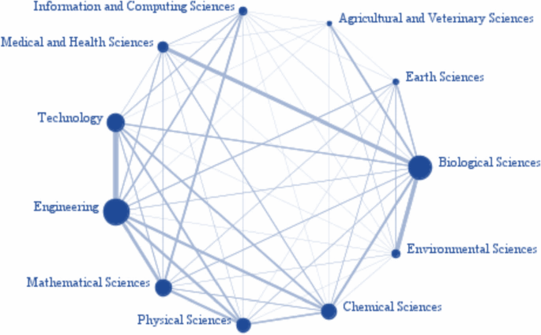
Interdisciplinarity Research: STEM
Information and Computing Sciences
Agricultural and Veterinary sciences
Medical and Health Sciences
Earth Sciences
Technology
Biological Sciences
Engineering
Environmental sciences
Mathematical Sciences
Chemical sciences
Physical sciences
Uddin, S., Imam, T. & Mozumdar, M. Research interdisciplinarity: STEM versus non-STEM. Scientometrics 126, 603–618 (2021). https://doi.org/10.1007/s11192-020-03750-9

Slide 4
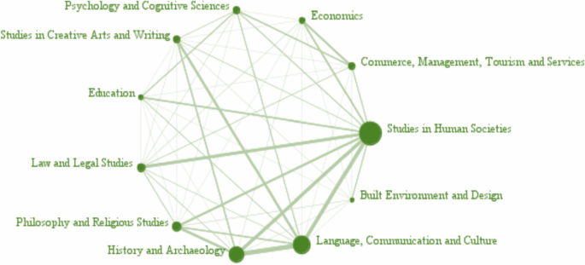
Interdisciplinarity Research: Non-STEM
Psychology and cognitive Sciences
Economics
Creative arts and writing
Commerce, Management, Tourism & Services
Education
Studies in Human Societies
Law and Legal studies
Built, Environment, and Design
Philosophy and Religious Studies
Language, communication and Culture
History and Archaeology
Uddin, S., Imam, T. & Mozumdar, M. Research interdisciplinarity: STEM versus non-STEM. Scientometrics 126, 603–618 (2021). https://doi.org/10.1007/s11192-020-03750-9

Slide 5
Complementarity between STEM and non-STEM
Mathematical Sciences
Chemical Sciences
Earth Sciences
Environmental Sciences
Biological Sciences
Agricultural & Veterinary Sciences
Information & Computing Sciences
Engineering
Technology
Medical & Health Sciences
Studies in Creative Arts & Writing
Education
Economics
Philosophy & Religious Studies
Commerce, Management, & Tourism
Psychology & Cognitive Sciences
Studies in Human Societies
Law & Legal Services
Agricultural & Veterinary Sciences
History & Archaeology
Built, environment, & Design
Language, communication & Culture
Uddin, S., Imam, T. & Mozumdar, M. Research interdisciplinarity: STEM versus non-STEM. Scientometrics 126, 603–618 (2021). https://doi.org/10.1007/s11192-020-03750-9

Slide 6
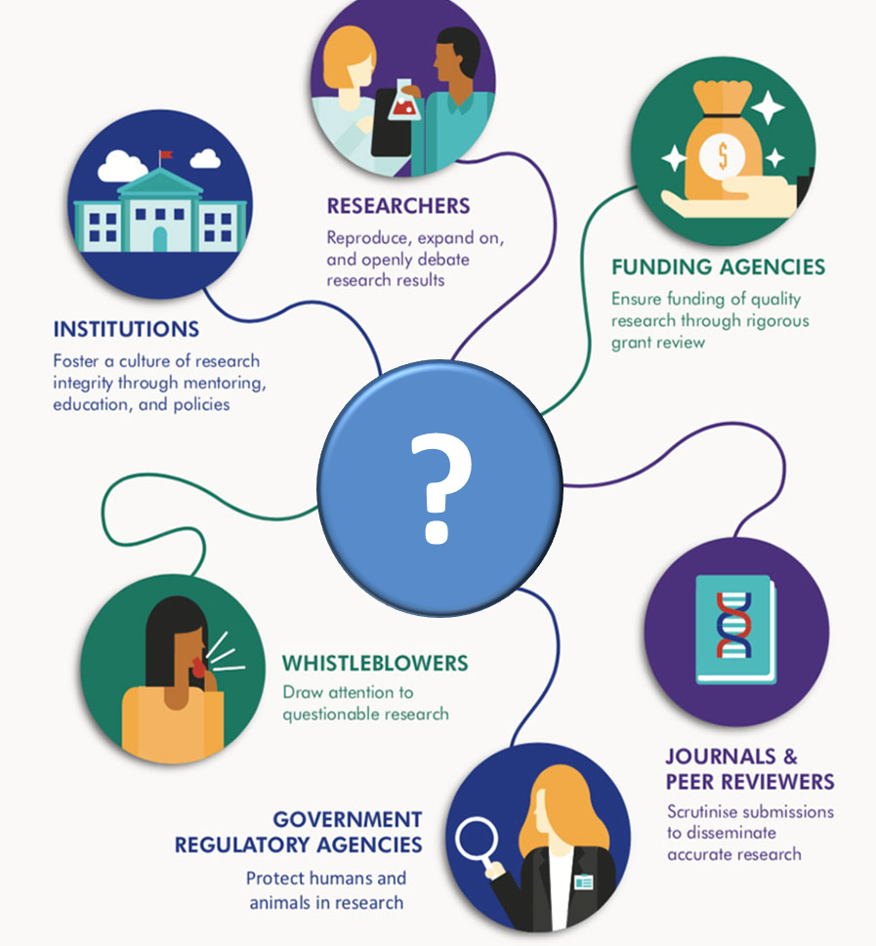
Who is responsible for research integrity?

Slide 7
Ethical Research
Compliance
Procedures
Policies provide guidance
Procedures should be based on policies to produce protocols
Compliance will automatically happen when behaviours are reinforced by ethical abidance
Policies

Slide 8
Role of the researcher: A summary
Rigour
Trust
Reliability
Responsibility
Honest Data Collection
Credibility
Following Ethical Procedures
Conduct
Honesty
Doing the Right Thing
Reproducible Results
Behaviour
Truthful
Honest Interpretations
Repeatability
Systematic
Transparency
Openness
Critical
Empirical Testing

Slide 9
Role of the researcher: A summary
Rigour
Trust
Reliability
Responsibility
Honest Data Collection
Credibility
Conduct
Honesty
Doing the Right Thing
Reproducible Results
Behaviour
Truthful
Honest Interpretations
Repeatability
Systematic
Transparency
Openness
Critical
Empirical Testing

Slide 10
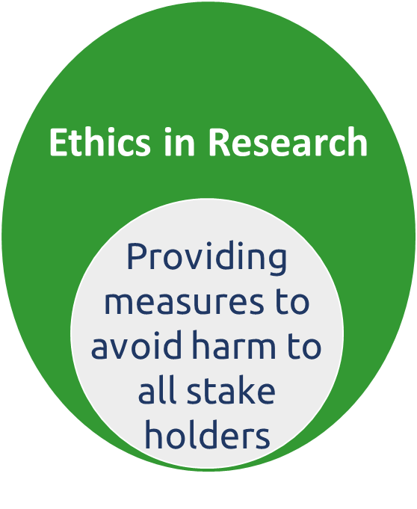
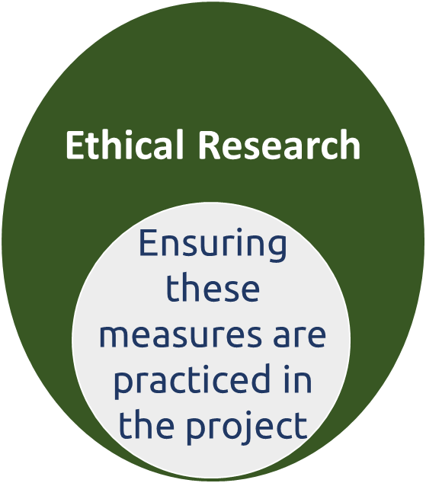
Ethics in Research Versus Ethical Research
Obtaining ethical approval for research (ethics in research)
Enlisting measures for keeping people safe is an ethical concept (ethics in research).
Ensuring ethical procedures are followed to provide protection (ethical research).
Reporting any such incidences with reflective action points (ethical research).
Modified from Dave Bell - https://tomorrowscities.org/how-do-we-ensure-our-impact-positive

Slide 11
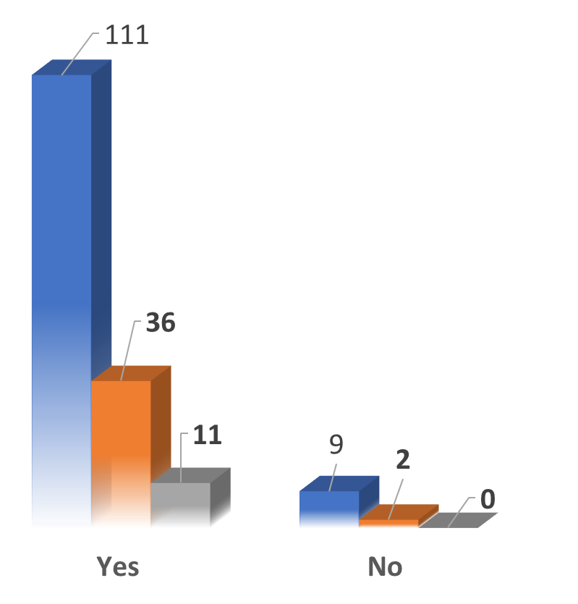
Small but Worrying Statistics
Students without understanding the ethical constraints of their individual projects
7% UG students
6% - PG students
Undergraduates (120 students)
Post-graduates (38 students)
Post-doctoral (11 researchers)
Sivasubramaniam (unpublished data)

Slide 12
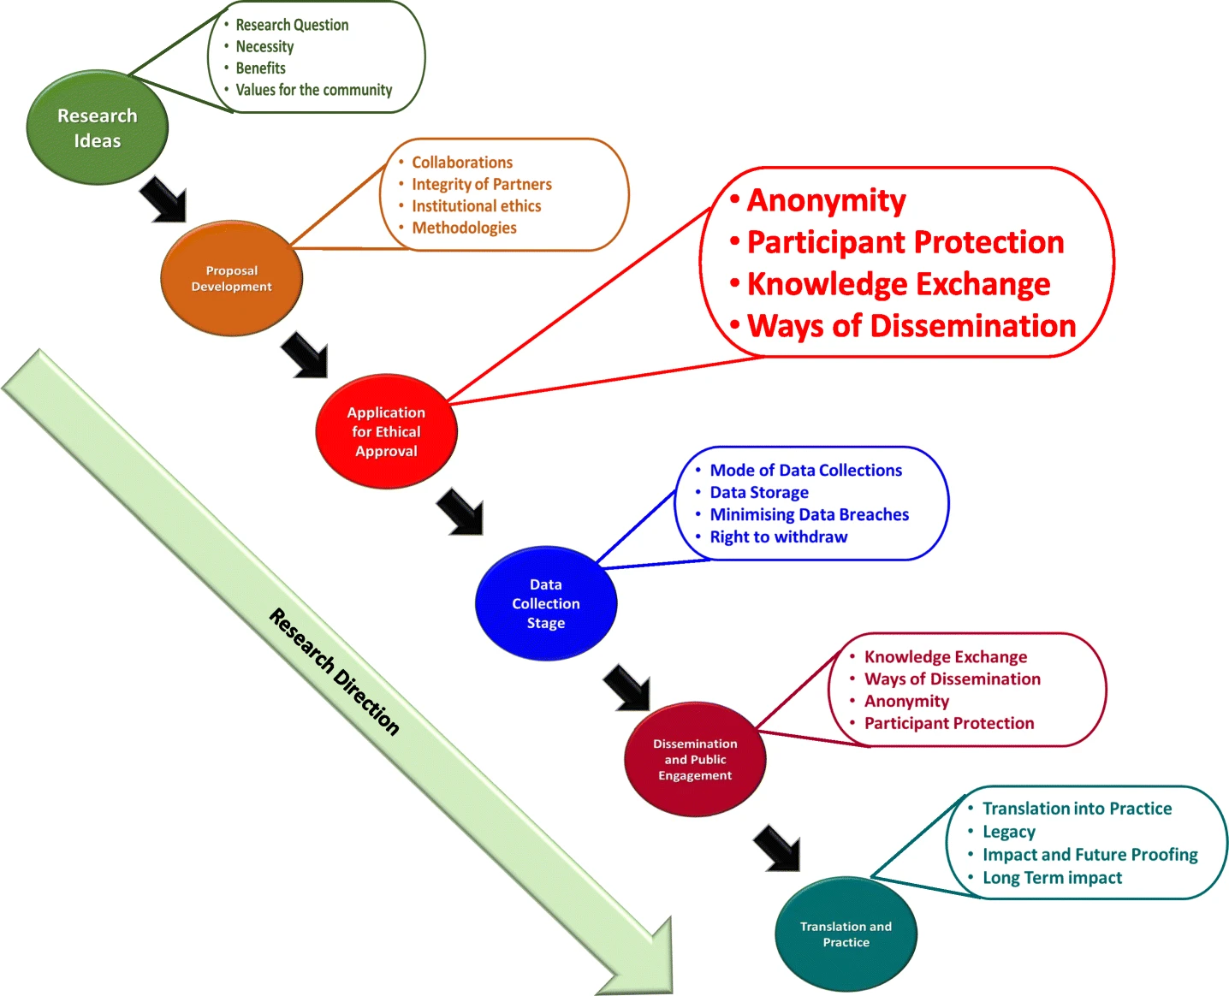
Anatomy of Research and Beyond
Conceptual Phase
Approval Phase
Practical stage
Analysis stage
Dissemination stage
Translational stage
Sivasubramaniam et al (2021). https://doi.org/10.1007/s40979-021-00078-6

Slide 13
Aims of TILT Sabbatical
Research Projects that Need Ethical Approval
Research that involves Human participants
Use of the ‘products’ of human participants
Work that potentially impacts on humans
Research that involves animals
A disclaimer is needed for ethical approval is deemed unnecessary.

Slide 14
Aims of TILT Sabbatical
Research Idea
Outside the scope
Exempt from ethics
Research involving Human
Research involving Animals
Continuing research
Performance reviews
Testing within normal education requirements
Literary or artistic criticism
Service evaluation - no change to the standard
Quality assurance/audit – anonymised
Projects that do not involve access to or collection of private or sensitive data
Legislative Approval
Development Phase
Complete Risk assessments /COSHH
Negligible Risk
Low Risk
Full review
Chairs action (or Partial Review)
Modified from Edith Cowen University (Australia) https://intranet.ecu.edu.au/research/research-ethics-and-integrity/applying-for-research-ethics-approval

Slide 15
Aims of TILT Sabbatical
Ethics in Research: Pre-approval Stage
Summary of background for the proposal
Nature of the data to be collected
Procedures and equipment/measuring tools
Who are the participants?
Risk assessments for all procedures (including COSHH)
How will the data collection occur?
How will data be stored? And for how long?

Slide 16
Aims of TILT Sabbatical
Risk assessment: “expecting the unexpectable”
Anonymity issues
The effects of environmental pollution on human behaviour
This study will first gather information on individuals’ own understanding about the topic using questionnaire
– The participants are expected fill the questionnaire is a specialised computer laboratory
This will be followed by an interactive group discussion based on information provided on screen
No room for small-group-based tasks
No self-study space
Immobile chairs – trips/falls

Slide 17
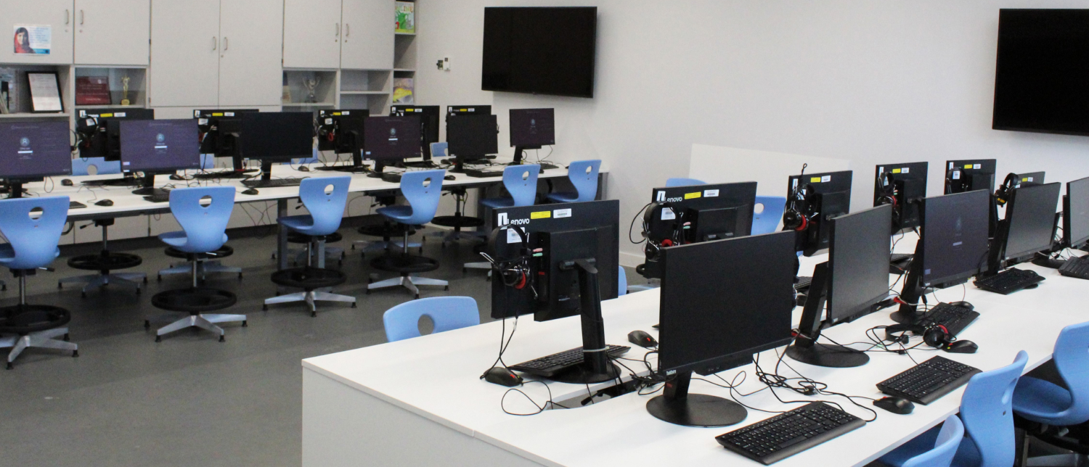
Aims of TILT Sabbatical
Risk assessment: “expecting the unexpectable”
No common stage for lecturer- student interactions
Anonymity issues
No room for small-group-based tasks
No self-study space
Immobile chairs – trips/falls
Exposed electrical wires – room for accidents

Slide 18
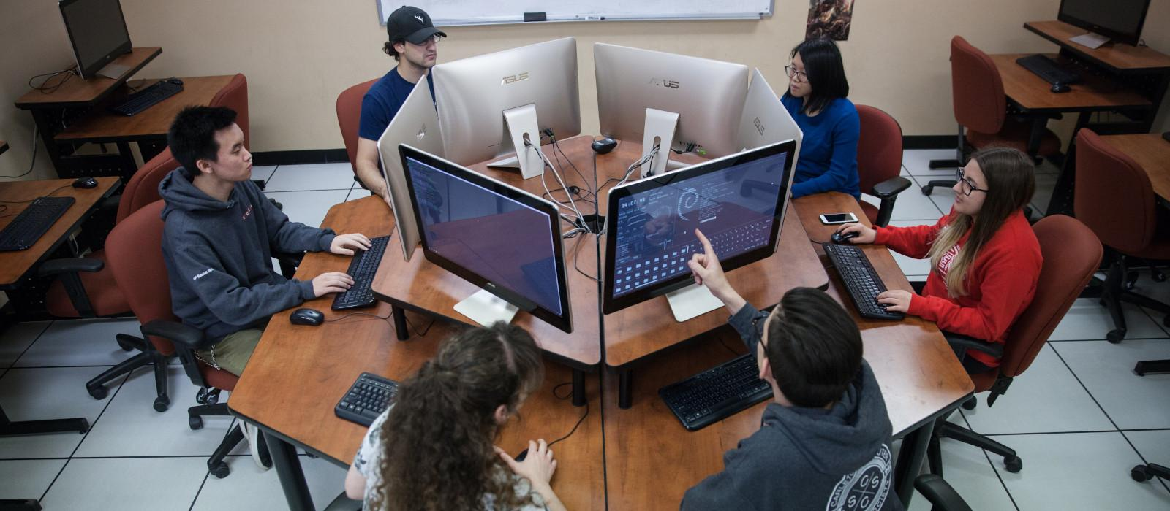
Aims of TILT Sabbatical
Risk Mitigation: Adaptability in relation to objectives
Room for lecturer- student interactions
Self-study space
Electric wires are away from users
Small-Group interaction
Anonymity issues
minimised
Mobile chairs

Slide 19
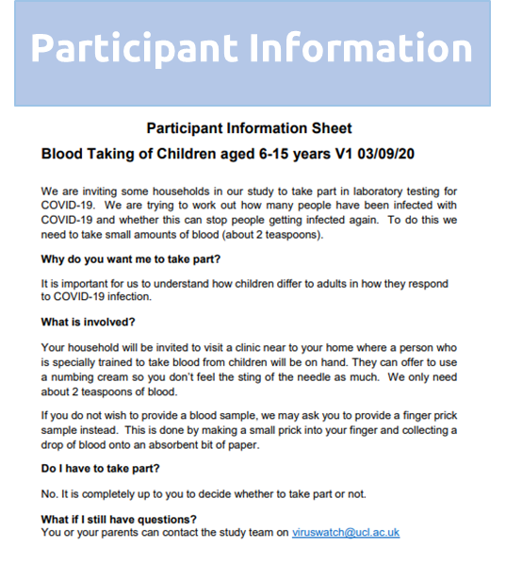
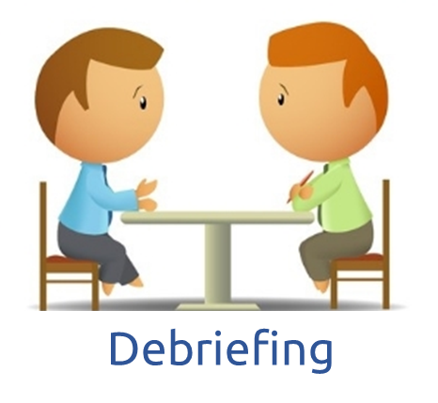
Aims of TILT Sabbatical
Additional Considerations & Documentations
General Data Protection Regulations

Slide 20
Valid informed consent
Using simple language
Be culturally relevant (e.g., language)
Be age specific (e.g., children)
Describe the method (e.g., online)
Collect a signed paper copy of an informed consent form
Video recording
Non-vulnerable adults can give consent for themselves.
Consent for vulnerable populations and children

Slide 21
A Scenario for Discussion
You have produced a consent form for a group photo of your final year students and lecturers.
The consent form requires them to opt out if they do not want their photo to be shared amongst others and in public.
One student opted out and does not want to be in the group photo.
Another student wants to opt out, but she wants to be in the group photo and demands that photo to be sent only to her.
Another student wants to be in the group photo but only to be shared amongst her peers.

Slide 22
Aims of TILT Sabbatical
Post-approval changes – Change in research
Changes to original proposal must be notified
Evidences of risk assessments for changes
If the changes are massive, research must be stopped and new approval should be gained
Completion of project must be notified
Any adverse events must be notified
Some applications will require safety protection clearance by the police

Slide 23
Situational Ethical Decision Making
Identify the problem
Situational decision making would depend on the legislations of the country
Evaluate the selected course of action
Determine the nature and dimensions
Implement
Consider the potential consequences
Generate the potential course(s) of action(s)
https://www.myamericannurse.com/situational-awareness-nursing-code-ethics/

Slide 24
Ethical Decision Making - Ghosting
You have attended five interviews.
You received your first offer and verbally commit to it.
You will not start to work for another two weeks.
Second offer comes in after a week with better pay offer.
Which offer will you take?
What additional actions you should take?
https://upjourney.com/real-life-examples-of-ethical-dilemmas

Slide 25
Medical Interventions Vs. Religious Beliefs
Mr X was a practicing Jehovah’s Witness and suffering from end stage kidney failure
Jehovah’s Witness do not believe in blood transfusions but, doctors believed he would die without a transfusion.
MacArthur insisted - No transfusion.
The patient had to be resuscitated twice, using CPR.
Further CPR without blood transfusion would be medically futile
https://www.myamericannurse.com/situational-awareness-nursing-code-ethics/

Slide 26
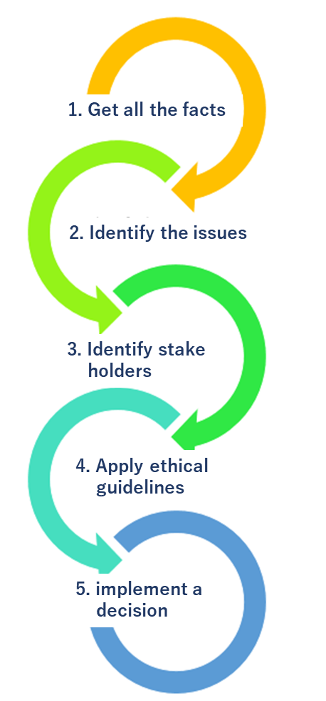
Aims of TILT Sabbatical
Situational Ethical Decision Making
Rational thinking
Proactive thinking
Lateral thinking
Considerate thinking
Consequential thinking
Evaluative thinking

Slide 27
Aims of TILT Sabbatical
Ethics of Using AI in research: Points to Ponder
Black-box models
Data co-operation
Algorithmic transparency
Bias and discrimination
Privacy violations
Algorithmic fairness
The morality of how humans design, construct, use and treat AI
How effectively AI be used to maximise benefits.
Individual autonomy and the effects of AI on social justice
Bruno Lepri, Nuria Oliver & Alex Pentland (2021) Ethical machines: The human-centric use of artificial intelligence https://doi.org/10.1016/j.isci.2021.102249

Slide 28
Aims of TILT Sabbatical
Summary: Takeaway Home Message
Ethics underpins everything we do, especially in research
Proactive thinking to identify ethical issues
Ethical approval process differs from institutions to institution
It is important to incorporate ethics culture in research

