Slide 1
FAITH Project Academic Integrity Policy Corpus
23 August 2023 University of Maribor, Slovenia
FAITH Project Learning/Teaching/Training Activity
3rd ENAI Academic Integrity Summer School
Salim Razı & Tolga Özşen

Slide 2
Outline
Academic Integrity
Academic Integrity Policies
HE Academic Integrity Policies
FAITH Project Results
Corpus Building
Policy Corpus

Slide 3
Academic Integrity
“Compliance with ethical and professional principles, standards, practices and consistent system of values, that serves as guidance for making decisions and taking actions in education, research and scholarship” (Tauginienė et al., 2018, pp. 8-9).
See ENAI glossary for more on related terminology:
https://www.academicintegrity.eu/wp/wp-content/uploads/2023/02/EN-Glossary_revised_final_24.02.23.pdf

Slide 4
Why do we need
academic integrity
at our institutions?

Slide 5
We need academic integrity because it…
… is fundamental to teaching, learning, and research (Bretag, 2016).
… boosts the quality of an institution’s educational provision.
… prepares individuals to contribute to society in an ethical manner (ENAI Academic Integrity Policies WG, n.d.).

Slide 6
How can we institute
a culture of academic integrity
at our institutions?

Slide 7
A culture of academic integrity and sustainable change are achieved by designing and implementing effective policies (Morris, 2016).

Slide 8
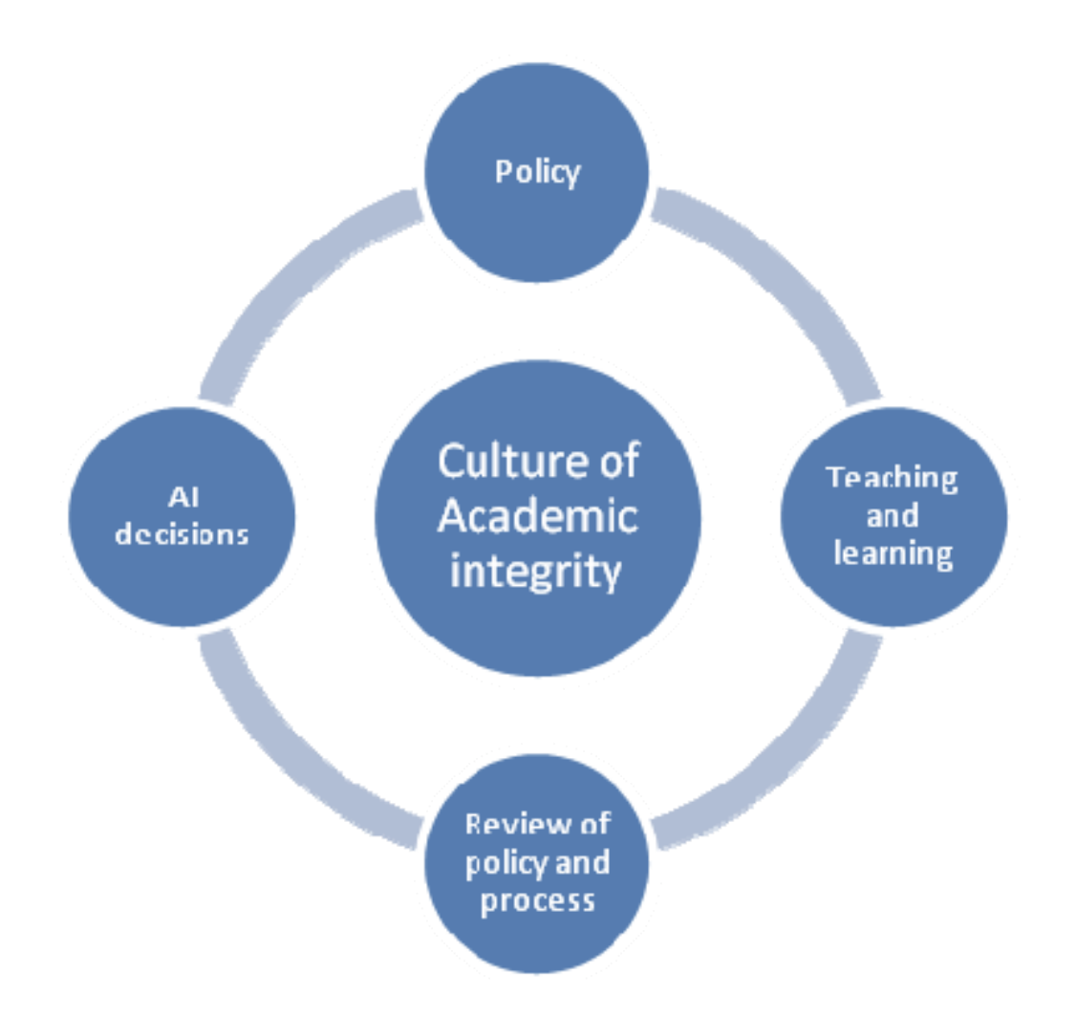
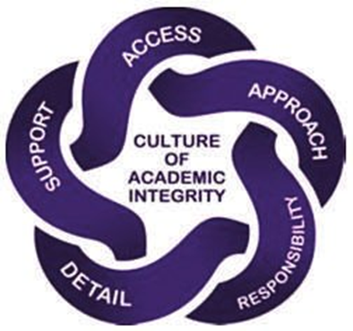
Core elements of exemplary AI policies
(Retrieved from Bretag et al., 2011, p. 7)
(Retrieved from Bretag et al., 2011, p. 5)

Slide 9
Academic Integrity Policies
Policy
Culture of academic integrity
A well-developed educative policy reveals the responsibilities of stakeholders (Razı et al., 2021).
Policies help institute a culture of academic integrity (Razı et al., 2022).
Rule Compliance Approach
“How do we stop students from cheating?”
(Bertram Gallant, 2017, p. 87)
Approaches to Integrity
(Paine, 1994)
Integrity
Approach
“How do we ensure students are learning?”
(Bertram Gallant, 2017, p. 87)

Slide 10
HE Academic Integrity Policies
Policies should be carefully developed and implemented with the collaboration of all stakeholders.
Serious problems with policies in many European HE institutions (e.g., Glendinning et al., 2022).
These policy deficiencies can be a threat to the realisation of AI and the quality of educational outcomes.
Fundamental dimensions of policies:
detecting AI breaches,
reacting to unacceptable academic conduct, and
promoting academic integrity values.
Policies should be carefully developed and implemented with the collaboration of all stakeholders.
Serious problems with policies in many European HE institutions (e.g., Glendinning et al., 2022).
These policy deficiencies can be a threat to the realisation of AI and the quality of educational outcomes.
Fundamental dimensions of policies:
detecting AI breaches,
reacting to unacceptable academic conduct, and
promoting academic integrity values.

Slide 11
Mobility of students and the role of institutions
Individuals should familiarise themselves with the principles of academic integrity during their student journey.
Expected to result in attachment to ethical values in lifelong learning.
HE brings together students from across the globe to study and mobility of students:
Enriches learning, facilitate the exchange of culture and ideas, and develop L2/FL skills.
Complicates avoiding plagiarism
Difficult for students writing in L2/FL.
Consider new educational expectations and institutional culture.
International students’ preconceptions about academic conduct:
Based on their previous educational experiences.
May not align with the host institution’s values.
HE institutions should ensure students maximise their opportunities and potential for success.
HE institutions should ensure that no student is disadvantaged through discrimination on any grounds.

Slide 12
HE Academic Integrity Policies
Promote responsible conduct of teaching, learning, and assessment, align the practices with community standards, foster the development of ethical standards, and educate staff and students to uphold academic integrity (Bretag & Mahmud, 2015).
Essential requirement of an institutional academic integrity culture (Scanlan, 2006).
Not “one size fits all” blueprints (East, 2015, p. 489).
Reflect contextual and cultural factors involved in the understanding and approaches of institutions toward academic integrity and therefore they might be slightly different from institution to institution, depending on the core values.
Although a shared understanding of academic integrity is essential in establishing a culture of academic integrity (Eaton et al., 2020), exploring different approaches and institution-specific best practices contributes to developing multi-pronged policies.

Slide 13
Why do we need
a policy corpus?

Slide 14
Importance of policy corpus
Policy analysis studies are essential in that they research informed approaches and best practices in different contexts.
Policy collection is time- and labour-intensive.
Researchers might need a database to draw a policy sample based on certain criteria and perform plain analyses.
Create a HE academic integrity policy corpus for scholars along with a web interface where users can download policies based on certain criteria.

Slide 15
What are
the main aims of
the FAITH project?

Slide 16
FAITH Project Results
Project Result 1 | Project Result 2 | Project Result 3
Policy for good practice: Establishing a benchmark for minimum standards for academic integrity policies in Europe and beyond based on good practice internationally | Proactive approach to prevent academic misconduct: Helping academics and undergraduate students to prevent, deter and detect academic misconduct through evidence-based guidance and training materials. | A support for victims of academic misconduct: an interactive portal and support network will be created to help victims of unethical practice

Slide 17
FAITH Project Result 1
Policy for good practice:
Establish a benchmark for minimum standards for academic integrity policies in Europe and beyond based on good practice internationally
PR1A
Building Policy Corpus
PR1B
Evidence-based Guideline
PR1C
Webinar for Policymakers

Slide 18
Corpus Building Framework
Developing a Representative HEAI Policy Corpus
Qualitative
Representativeness
Quantitative
Representativeness

Slide 19
Corpus Building Framework
Qualitative Representativeness
Clear Design Criteria
Domain Level
Countries
Languages
Format
Compilation Protocol
Finding Data
Downloading
Formatting
Storage

Slide 20
Corpus Building Framework
Clear Design
Criteria
Domain Level: University Policies
Countries: 1st Wave: partner countries and Europe, 2nd Wave: Beyond Europe
Languages: 1st Wave: partner languages and European languages, 2nd Wave: Beyond Europe
Format: Digital and Public

Slide 21
Corpus Building Framework
Compilation
Protocol
Finding Data: Search Terms, Synonym Replacements, Google Programmable Search Engine
Downloading: PDF format
Formatting: HTML to PDF via browser add-in
Storage: Google Drive via Google Forms

Slide 22
Corpus Building Framework
Quantitative
Representativeness
The larger the better approach

Slide 23
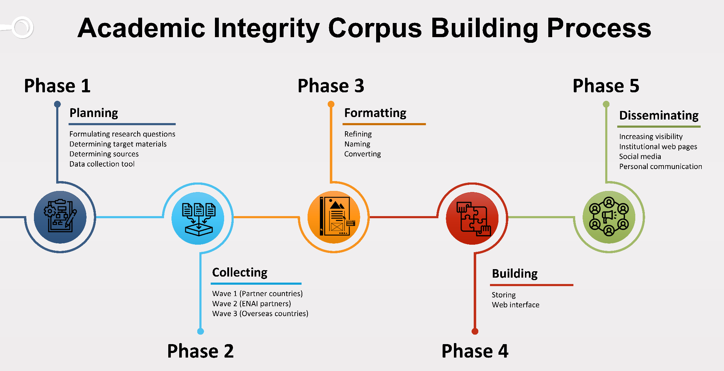
Research Workflow

Slide 24
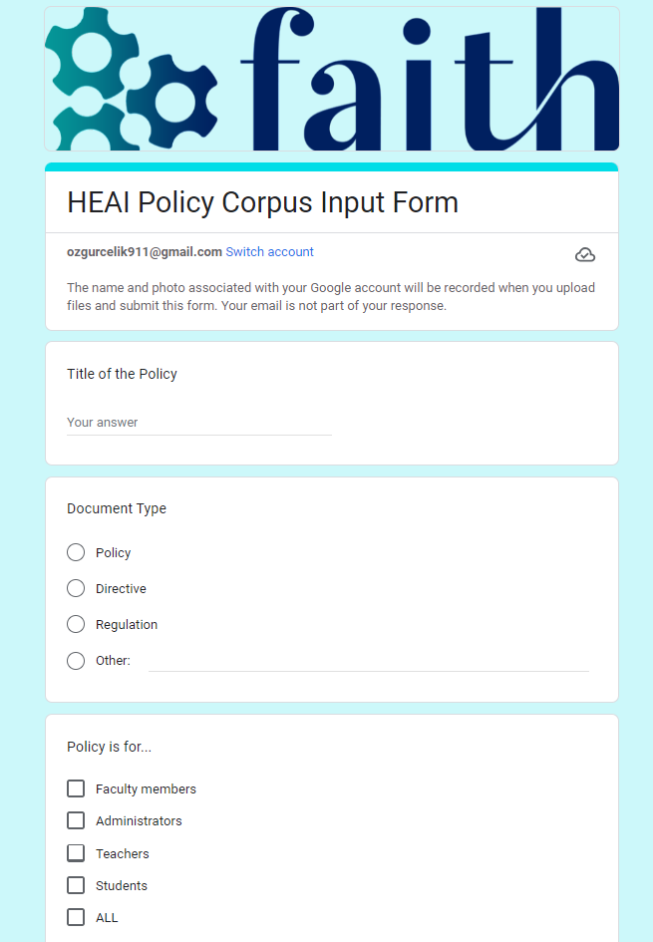
Policy Collection
344 policies
27 countries
15 languages

Slide 25
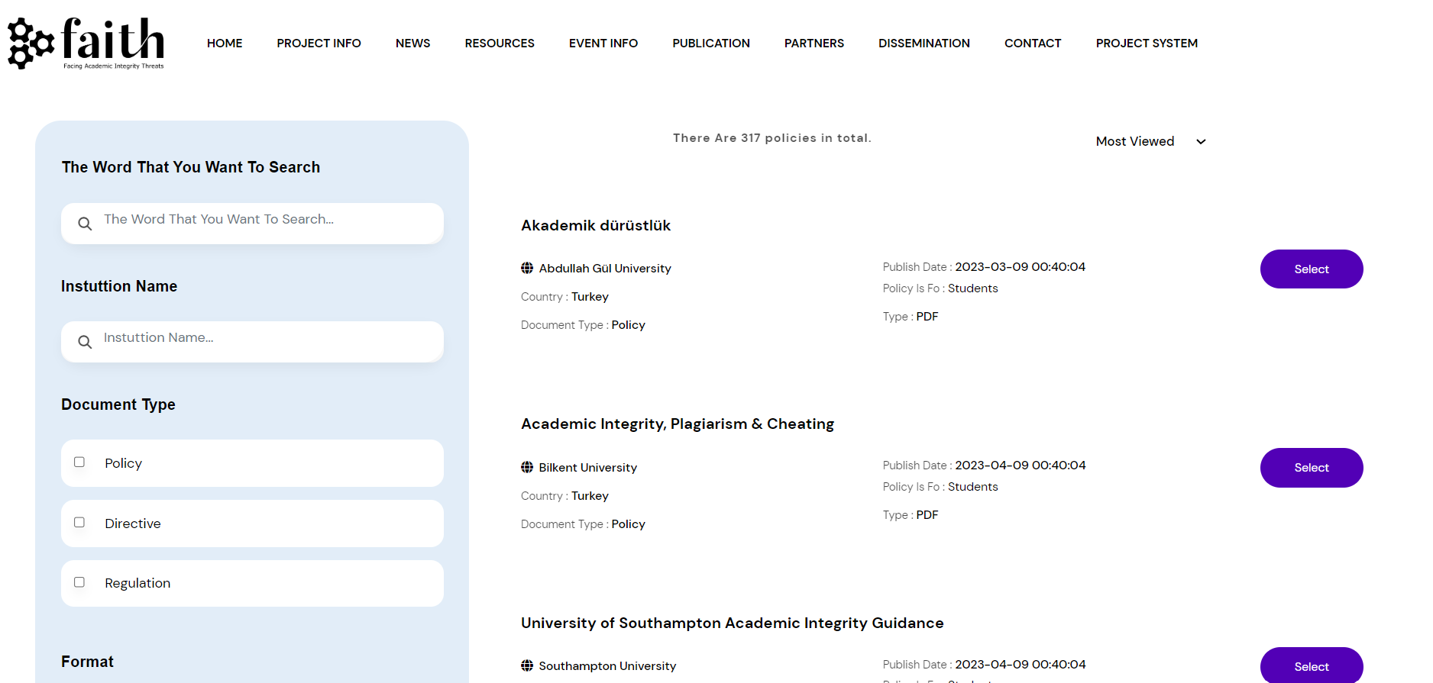
Website Development https://faithproject.info/

Slide 27
References
Bertram Gallant, T. (2017). Academic integrity as a teaching & learning issue: From theory to practice. Theory into Practice, 56(2), 88–94. https://doi.org/10.1080/00405841.2017.1308173
Bretag, T. (2016). Defining academic integrity–international perspectives: Introduction. In T. Bretag (Ed.), Handbook of academic integrity (pp. 3-5). Springer. https://doi.org/10.1007/978-981-287-098-8
Bretag, T., & Mahmud, S. (2015). A conceptual framework for implementing exemplary academic integrity policy in Australian higher education. In T. Bretag (Ed.), Handbook of academic integrity (pp. 1–14). Springer. https://doi.org/10.1007/978-981-287-079-7_24-1
Bretag, T., Mahmud, S., Wallace, M., Walker, R., James, C., Green, M., East, J., McGowan, U., & Partridge, L. (2011). Core elements of exemplary academic integrity policy in Australian higher education. International Journal for Educational Integrity, 7(2), 3-12.
Eaton, S. E., Stoesz, B. M., Thacker, E. J., & Miron, J. B. (2020). Methodological decisions in undertaking academic integrity policy analysis: Considerations for future research. Canadian Perspectives on Academic Integrity, 3(1), 83-91.
ENAI Academic Integrity Policies. (n.d.). ENAI academic integrity policies working group. https://www.academicintegrity.eu/wp/academic-integrity-policies/
Glendinning, I., Foltýnek, T., Henek Dlabolová, D., Dannhoferová, J., Králíková, V., Michalska, A., Orim, S. M., & Turčínek, P. (2022). Project on academic integrity in Armenia, Azerbaijan, Georgia, Kazakhstan and Turkey (Vol. 6). ETINED Council of Europe Platform on Ethics, Transparency and Integrity in Education. ISBN 978-92-871-9111-3
Morris, E. (2016). Academic integrity policy and practice: Introduction. In T. Bretag (Ed.), Handbook of academic integrity (pp. 409-411). Springer. https://doi.org/10.1007/978-981-287-098-8
Paine, L. S. (1994). Managing for organizational integrity. Harvard Business Review, 72(2), 106-117.
Razı, S., Glendinning, I., Sivasubramaniam, S. D., Eaton, S. E., Çelik, Ö., Khan, Z. R., Bjelobaba, S., Fishman, T., & Waddington, L. (2022, May 4). Changing trends in academic integrity policy development: Implications for post-COVID era [Paper presentation]. 8th European Conference on Academic Integrity and Plagiarism (ECAIP), Porto, Portugal. https://academicintegrity.eu/conference/wp-content/files/2022/Book_of_Abstracts_2022.pdf
Razı, S., Sivasubramaniam, S., Eaton, S. E., Bryukhovetska, O., Glendinning, I., Khan, Z. R., Bjelobaba, S., Çelik, Ö., & Zehir Topkaya, E. (2021, June 22). Systematic collaboration to promote academic integrity during emergency crisis [Paper presentation].
Scanlan, C. L. (2006). Strategies to promote a climate of academic integrity and minimize student cheating and plagiarism. Journal of Allied Health, 35(3), 179–185.
Tauginienė, L, Gaižauskaitė, I, Glendinning, I, Kravjar, J, Ojsteršek, M, Ribeiro, L, Odiņeca, T, Marino, F, Cosentino, M, Sivasubramaniam, S, Foltýnek, T. (2018). Glossary for academic integrity (Revised version). ENAI Report 3G [online]. https://www.academicintegrity.eu/wp/wp-content/uploads/2023/02/EN-Glossary_revised_final_24.02.23.pdf

Slide 28
Thank you for your participation!

