Slide 1
24 August 2023 University of Maribor, Slovenia
FAITH Project Learning/Teaching/Training Activity
3rd ENAI Academic Integrity Summer School
Developing
Academic Writing Skills
Salim Razı & Aysun Yavuz

Slide 2
Disclaimer
An earlier version of this presentation was presented at the following webinar:
Razı, S. (2023). Anonymous multi-mediated writing model in preventing plagiarism. Webinar at PUPP (Partnership on University Plagiarism Prevention) Project Webinar Series, 26 April. https://youtu.be/ojyxcKdXM44 https://pupp.uqo.ca/en/event/anonymous-multi-mediated-writing-model-in-preventing-plagiarism/

Slide 3
Outline
Definition of plagiarism
Risk of plagiarism in academic writing
Plagiarism cases in my courses
Development of anonymous multi-mediated writing model
Concluding remarks

Slide 4
What is plagiarism?

Slide 5
Definition of Plagiarism
Plagiarism occurs when someone:
Uses words, ideas, or work products
Attributable to another identifiable person or source
Without attributing the work to the source from which it was obtained
In a situation in which there is a legitimate expectation of original authorship
In order to obtain some benefit, credit, or gain which need not be monetary
(Fishman, 2009, p. 5)

Slide 6
Risk of Plagiarism in Academic Writing
Academic writing is complicated (see Matsuda, 2001).
Risk of plagiarism!
More common in expanding-circle.
Cross-cultural differences with regards to plagiarism (Baurain, 2011).
Cultural influences in writing (Kachru, 2009).
Consider national and institutional policies towards academic integrity.
Freshmen: inexperience in academic writing (e.g., Park, 2003; Razı, 2015b; Yeo & Chien, 2007) and L1 writing (Razı, 2015c).

Slide 7
“Academic Writing Skills” Course:
Plagiarism alert in 2010!

Slide 8
Plagiarism incidents in 2010-11 Academic Writing Skills Course
(Based on Razı, 2016)

Slide 9
What would you do
in this case?

Slide 10
Possible sanctions (Glendinning, 2016)
No action
Verbal warning
Formal written warning
Remedial education
Reduced mark, marking on academic merit
Zero mark (component, module)
Corrections / rework / new assessment – cap / no cap
Repeat module / year
Fail module / year / degree – with / without retake rights
Student’s misconduct made public
Suspension – temporary / short / long / permanent
Financial penalty, fine
Expulsion from the institution
Misconduct recorded on student’s file

Slide 11
Plagiarism incidents: 2010-11 vs 2011-12 Academic Writing Skills Course
(Based on Razı, 2016)

Slide 12
The implementation of
text matching software
resulted in a new problem.
Increase in no submissions!

Slide 13
Self-reported difficulties: Academic session 2012-13 (Razı, 2015a)

Slide 14
Lecturer-reported difficulties: Academic session 2012/13 (Razı, 2015a)

Slide 15
Students were unaware of their real problems in academic writing!

Slide 16
Anonymous
multi-mediated writing model (Razı, 2017, 2023)

Slide 17
Process Approach: Steps
Choosing the topic
Narrowing down the topic
Brainstorming
Obtaining relevant information
Preparing an outline
Blending sources to the outline
Writing the first draft
Writing the second draft
Revising for mechanical mistakes
Proofreading
Submitting the final version
Feedback

Slide 18
Peer Feedback: Theoretical Background
Several related theories:
Social constructionist theory of learning (Hanjani & Li, 2014).
Collaborative writing (Wigglesworth & Storch, 2012).
Sociocognitive approach (Atkinson, 2010; Nishino & Atkinson, 2015).
Activity theory (Engeström, 1987, 1999; Leont’ev, 1981).
Zone of Proximal Development (Vygotsky, 1978).
Scaffolding (Weissberg, 2006).
Noticing hypothesis (Schmidt, 1990).
Socicultural theory (Kayi-Aydar, 2013).
Social / Genre Approach (Tribble, 2015).
Process Approach (Wette, 2015).

Slide 19
Peer Feedback: Potential Problems
Problem 1:
Misleading each other due to their own deficiencies and lack of trust in peers’ feedback (see Aghaee & Hansson, 2013; Berggren, 2015; Nelson & Murphy, 1993; Paulus, 1999; Rinehart & Chen, 2012; Rollinson, 2005; Ruecker, 2010; Yang, Badger, & Yu, 2006; Zhao, 2014).
Problem 2:
Reluctant to criticize friends (Liou & Peng, 2009).

Slide 20
Anonymous Multi-Mediated Writing Model (Razı, 2017, p. 32)
Good peer
“The AMMW model enables anonymous asynchronous online feedback in a digital environment to encourage a balanced distribution of asymmetrical and symmetrical feedback” (Razı, 2023, p. 2).
Submit draft
Exchange anonymous digital peer feedback
Revise
Resubmit
Moderate peer
Poor peer

Slide 21
Transparent Academic Writing Rubric (Razı, 2015b)

Slide 22
Plagiarism incidents: 7 consecutive years

Slide 23
Emergency remote teaching implementation of the anonymous multi-mediated writing model

Slide 24
AMMW Model: Controlled Writing Process (Razı, 2023, p. 6)
Submission of three written assignments on teacher-assigned topics.
Introduction to academic writing.
Basic steps in process writing.
Day of Action against contract cheating.
Introduction to in-text citations.
Presenting in-text citations.
Familiarisation with academic integrity.
Avoiding plagiarism and contract cheating.
Interpreting text-matching software similarity reports.
Details with in-text citations.
Practising in-text citations.
Exchanging effective peer feedback.
Connecting ideas: Unity and coherence.
Online writing tools.

Slide 25
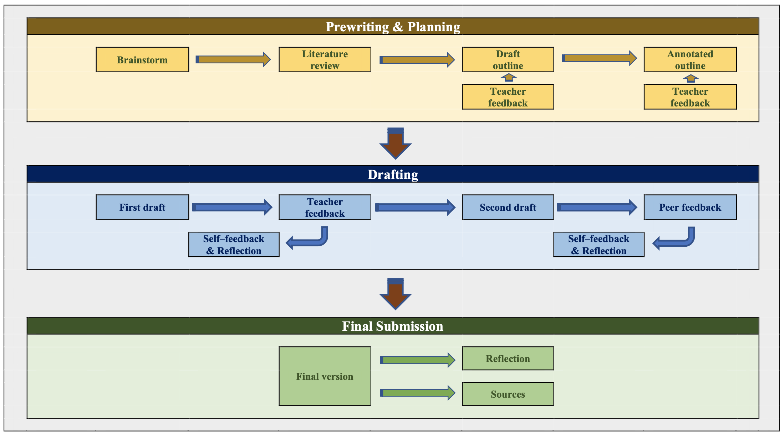
AMMW Model: Free Writing Process (Razı, 2023, p. 7)
Submission of an ELT–related review paper of their choice, approximately 2,000 words in length, excluding the abstract and references
Topic selection and finding relevant sources.
Reviewing literature.
Credibility of sources and avoiding predatory publishers.
Outlining.
Parts of an academic paper.
Headings in APA style.
Writing a list of references.
Practising writing references.
Drafting ideas.
Presenting tables and figures.
Introducing Transparent Academic Writing Rubric (TAWR).
Practising feedback exchange using TAWR.

Slide 26
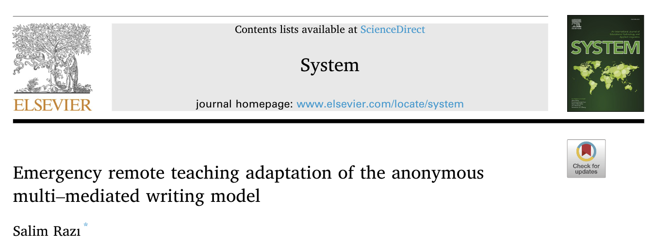
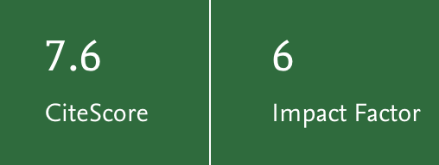
Suggested Reading
https://doi.org/10.1016/j.system.2023.102981

Slide 27
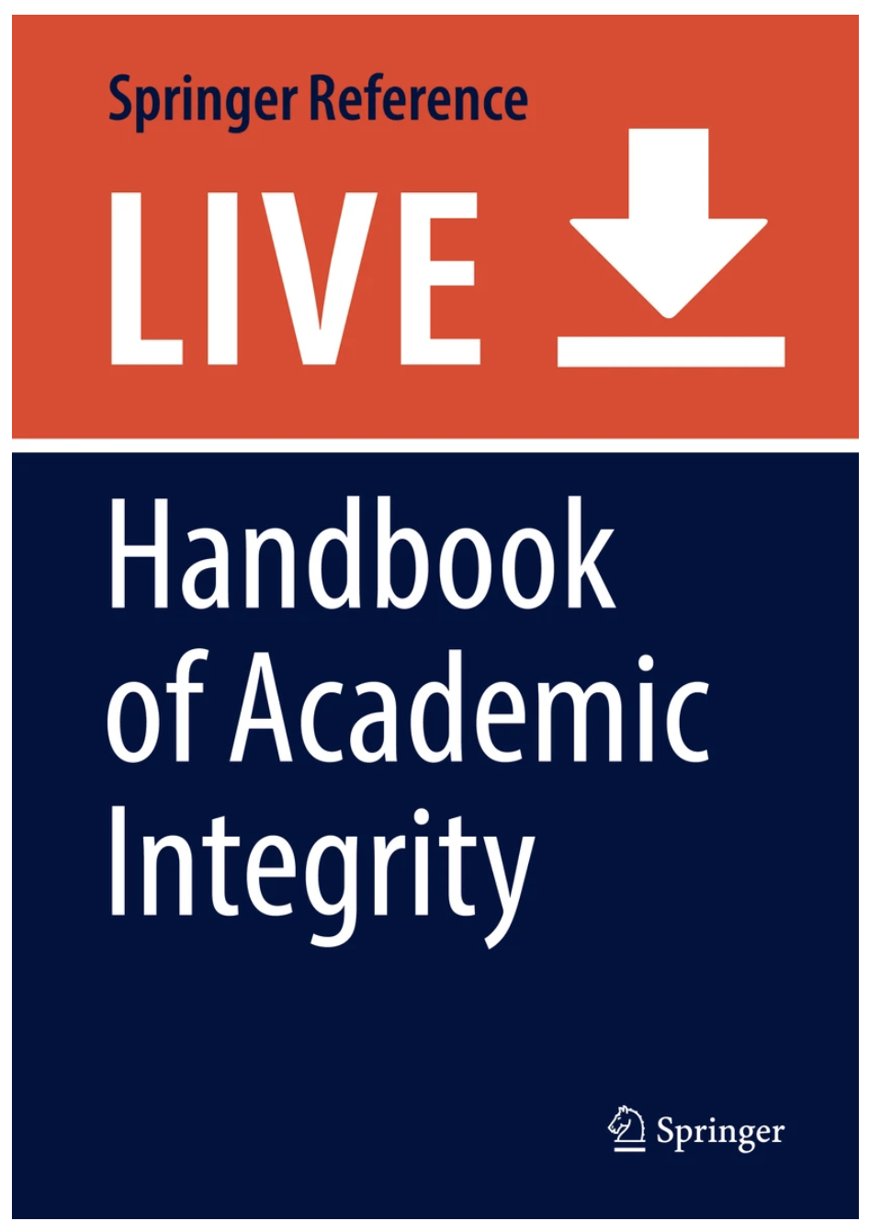
Suggested Reading
https://doi.org/10.1007/978-981-287-079-7_163-1

Slide 28
Concluding Remarks
Zero plagiarism is an utopia!
Anonymous multi-mediated writing model:
contributes to the institution of a culture of academic integrity,
provides ideas for standalone teaching and assessment practices to teachers to maximize learning
enables exchanging various type of feedback even in large classes,
implements rubric as a learning tool, and
develops academic writing skills from the very beginning until students become independent writers.

Slide 29
References
Aghaee, N., & Hansson, H. (2013). Peer portal: Quality enhancement in thesis writing using self-managed peer review on a mass scale. The International Review of Research in Open and Distance Learning, 14(1), 186-203.
Atkinson, D. (2010). Extended, embodied cognition and second language acquisition. Applied Linguistics, 31, 599–622.
Baurain, B. (2011). Cross-cultural moral explorations in plagiarism. In L. H. Phan & B. Baurain (Eds.), Voices, identities, negotiations, and conflicts: Writing academic English across cultures. Studies in writing (Vol. 22 – pp. 123-138). Bingley, UK: Emerald.
Berggren, J. (2015). Learning from giving feedback: A study of secondary-level students. ELT Journal, 69(1), 58-70.
Engeström, Y. (1987). Learning by expanding: An activity-theoretical approach to developmental research. Helsinki: Orienta-Konsultit.
Engeström, Y. (1999). Activity theory and individual and social transformation. In Y. Engeström, R. Miettinen, R.-L. Punamäki (Eds.), Perspectives on activity theory (pp. 19–38). Cambridge, UK: Cambridge University Press.
Fishman, T. (2009). “We know it when we see it” is not good enough: Toward a standard definition of plagiarism that transcends theft, fraud, and copyright. Paper presented at the 4th Asia Pacific Conference on Educational Integrity (4APCEI) 28–30 September 2009, Australia. Retrieved from http://www.bmartin.cc/pubs/09-4apcei/4apcei-Fishman.pdf
Glendinning, I. (2016). Disparities in penalties & practices across the EU for addressing violations to academic integrity. Paper presented at Inaugural Mediterranean Conference: Integrity as a way forward, 8-10 September 2016, Athens, Greece. Hanjani, A. M., & Li, L. (2014). Exploring L2 writers’ collaborative revision interactions and their writing performance. System, 44,101-114.
Hanjani, A. M., & Li, L. (2014). Exploring L2 writers’ collaborative revision interactions and their writing performance. System, 44, 101–114.
Kachru, Y. (2009). Speaking and writing in World Englishes. World Englishes today. In B. B. Kachru, Y. Kachru & C. L. Nelson (Eds.), The handbook of World Englishes (pp.240-270 ). Oxford: Wiley-Blackwell.
Kayi-Aydar, H. (2013). Scaffolding language learning in an academic ESL classroom. ELT Journal, 67(3), 324-335.
Leont’ev, A. N. (1981). The problem of activity in psychology. In J. V. Wertsch (Ed.), The concept of activity in Soviet psychology (pp. 37–71). New York, NY: M.E. Sharpe.
Liou, H. C., & Peng, Z. Y. (2009). Training effects on computer-mediated peer review. System, 37, 514-525.
Matsuda, P. K. (2001). Voice in Japanese written discourse: Implications for second language writing. Journal of Second Language Writing, 10, 35–53.
Nelson, G., & Murphy, J. (1993). Peer response groups: Do L2 writers use peer comments in revising their drafts? TESOL Quarterly, 27(1), 135-142.
Nishino, T., & Atkinson, D. (2015). Second language writing as sociocognitive alignment. Journal of Second Language Writing, 27, 37-54.
Park, C. (2003). In other (people’s) words: Plagiarism by university students – Literature and lessons. Assessment & Evaluation in Higher Education, 28, 471–488.
Paulus, T. M. (1999). The effect of peer and teacher feedback on student writing. Journal of Second Language Writing, 8, 265-289.
Razı, S. (2015a). Cross-checked problems in undergraduate academic writing. K. Dikilitaş, R. Smith, & W. Trotman (Eds.), Teacher-researchers in action (pp. 147-161). Kent: IATEFL.
Razı, S. (2015b). Development of a rubric to assess academic writing incorporating plagiarism detectors. SAGE Open, 5(2), 1-13. DOI: 10.1177/2158244015590162
Razı, S. (2015c). Plagiarism in academic writing in English medium universities. Paper presented at the 21st Conference of the International Association for World Englishes, 8-10 October, Istanbul, Turkey.
Razı, S. (2016). Undergraduates’ perceptions of anonymous and open digital peer feedback in academic writing. Paper presented at the 4th International Conference on Foreign Language Learning and Teaching, 24-25 June 2016, Bangkok, Thailand.
Razı, S. (2017). Anonymous multi-mediated writing model: Peer feedback exchange in EAP. In D. Köksal (Ed.), Researching ELT: Classroom methodology and beyond (pp. 29-42). Frankfurt: Peter Lang.
Razı, S. (2023). Emergency remote teaching adaptation of the anonymous multi-mediated writing model. System, 113, 102981. https://doi.org/10.1016/j.system.2023.102981
Rinehart, D., & Chen, S. J. (2012). The benefits of a cycle of corrective feedback on L2 writing. Saarbrücken, Germany: Lambert Academic Publishing.
Rollinson, P. (2005). Using peer feedback in the ESL writing class. ELT Journal, 59, 23-31.
Ruecker, T. (2010). The potential of dual-language cross-cultural peer review. ELT Journal, 65, 398-407.
Schmidt, R. (1990). The role of consciousness in second language learning. Applied Linguistics, 11, 129-158.
Tribble, C. (2015). Writing academic English further along the road. What is happening now in EAP writing instruction? ELT Journal, 69(4), 442-462.
Vygotsky, L. S. (1978). Mind in society: The development of higher psychological processes. Cambridge, MA: Harvard University Press.
Weissberg, R. (2006). Scaffolded feedback: theoretical conversations with advanced L2 writers. In K. Hyland & F. Hyland (Eds). Feedback in second language writing: Contexts and issues (pp. 246-265). Cambridge: Cambridge University Press.
Wette, R. (2015). Teacher-led collaborative modelling in academic L2 writing courses. ELT Journal, 69(1), 71-80.
Wigglesworth, G., & Storch, N. (2012). What role for collaboration in writing and writing feedback. Journal of Second Language Writing, 21, 364-374.
Yang, M., Badger, R. & Yu, Z. (2006). A comparative study of peer and teacher feedback in a Chinese EFL writing class. Journal of Second Language Writing, 8(3), 265-289.
Yeo, S., & Chien, R. (2007). Evaluation of a process and proforma for making consistent decisions about the seriousness of plagiarism incidents. Quality in Higher Education, 13, 187–204.
Zhao, H. (2014). Investigating teacher-supported peer assessment for EFL writing. ELT Journal, 68, 155-168.

Slide 30
24 August 2023 University of Maribor, Slovenia
FAITH Project Learning/Teaching/Training Activity
3rd ENAI Academic Integrity Summer School
Developing
Academic Writing Skills
Salim Razı & Aysun Yavuz

