Slide 1
Ethical considerations of AI in Education: ENAI Recommendations
Tomáš Foltýnek
(with contribution from Sonja Bjelobaba)
3rd ENAI Academic Integrity Summer School 2023, 21st – 25th August 2023, Faculty of Electrical Engineering and Computer Science, University of Maribor, Slovenia

Slide 2
Rationale
AI tools being released into the public domain
Make our lives easier
Bring both opportunitites and challenges to education
Thomas Lancaster’s webinar in September 2022
Artificial Intelligence and Academic Integrity
Improvements in generative AI tools
Release of ChatGPT
Concerns among the educators
Midjourney /imagine artificial intelligence writing student essay in blue and yellow

Slide 3
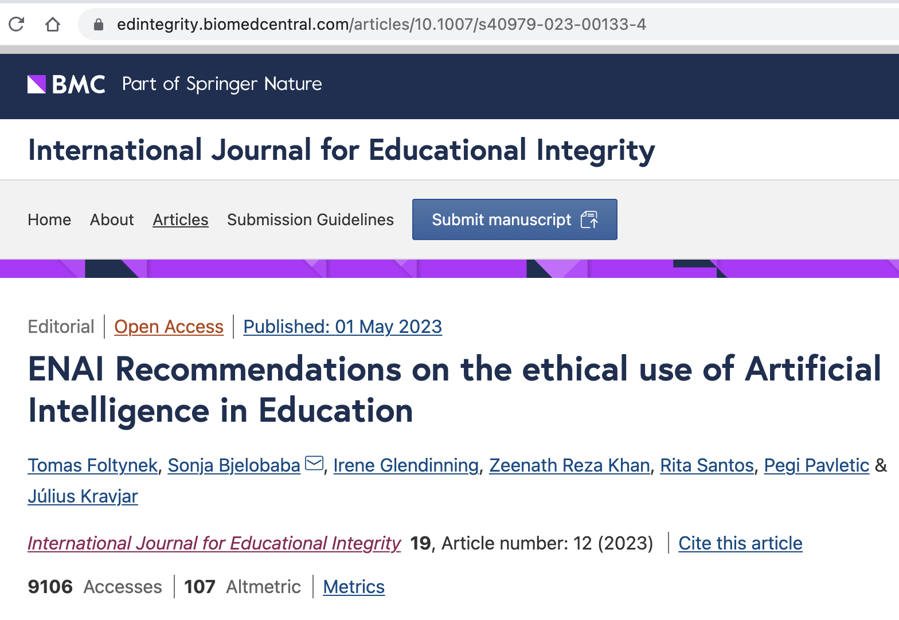
ENAI Recommendations
January 2023: List of ideas
February 2023: Feedback from ENAI working groups
March 2023: Wording, clean document
April 2023: Publication
July 2023: Feedback & Improvements
International Journal for Educational Integrity

Slide 4
Definitions
Academic integrity can be defined as “compliance with ethical and professional principles, standards, practices, and a consistent system of values that serves as guidance for making decisions and taking actions in education, research and scholarship” (ENAI Glossary)
Artificial Intelligence refers to systems that appear to have “intelligent behaviour by analysing their environment and taking actions – with some degree of autonomy – to achieve specific goals” (EU definition)
Midjourney /imagine artificial intelligence
Notes:
Here we point out that it is already for second time that AI is depicted as human. Let’s explore other options…

Slide 5
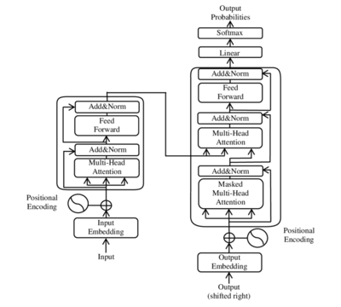
Definitions
Academic integrity can be defined as “compliance with ethical and professional principles, standards, practices, and a consistent system of values that serves as guidance for making decisions and taking actions in education, research and scholarship” (ENAI Glossary)
Artificial Intelligence refers to systems that appear to have “intelligent behaviour by analysing their environment and taking actions – with some degree of autonomy – to achieve specific goals” (EU definition)
Image source: https://en.wikipedia.org/wiki/Transformer_%28machine_learning_model%29

Slide 6
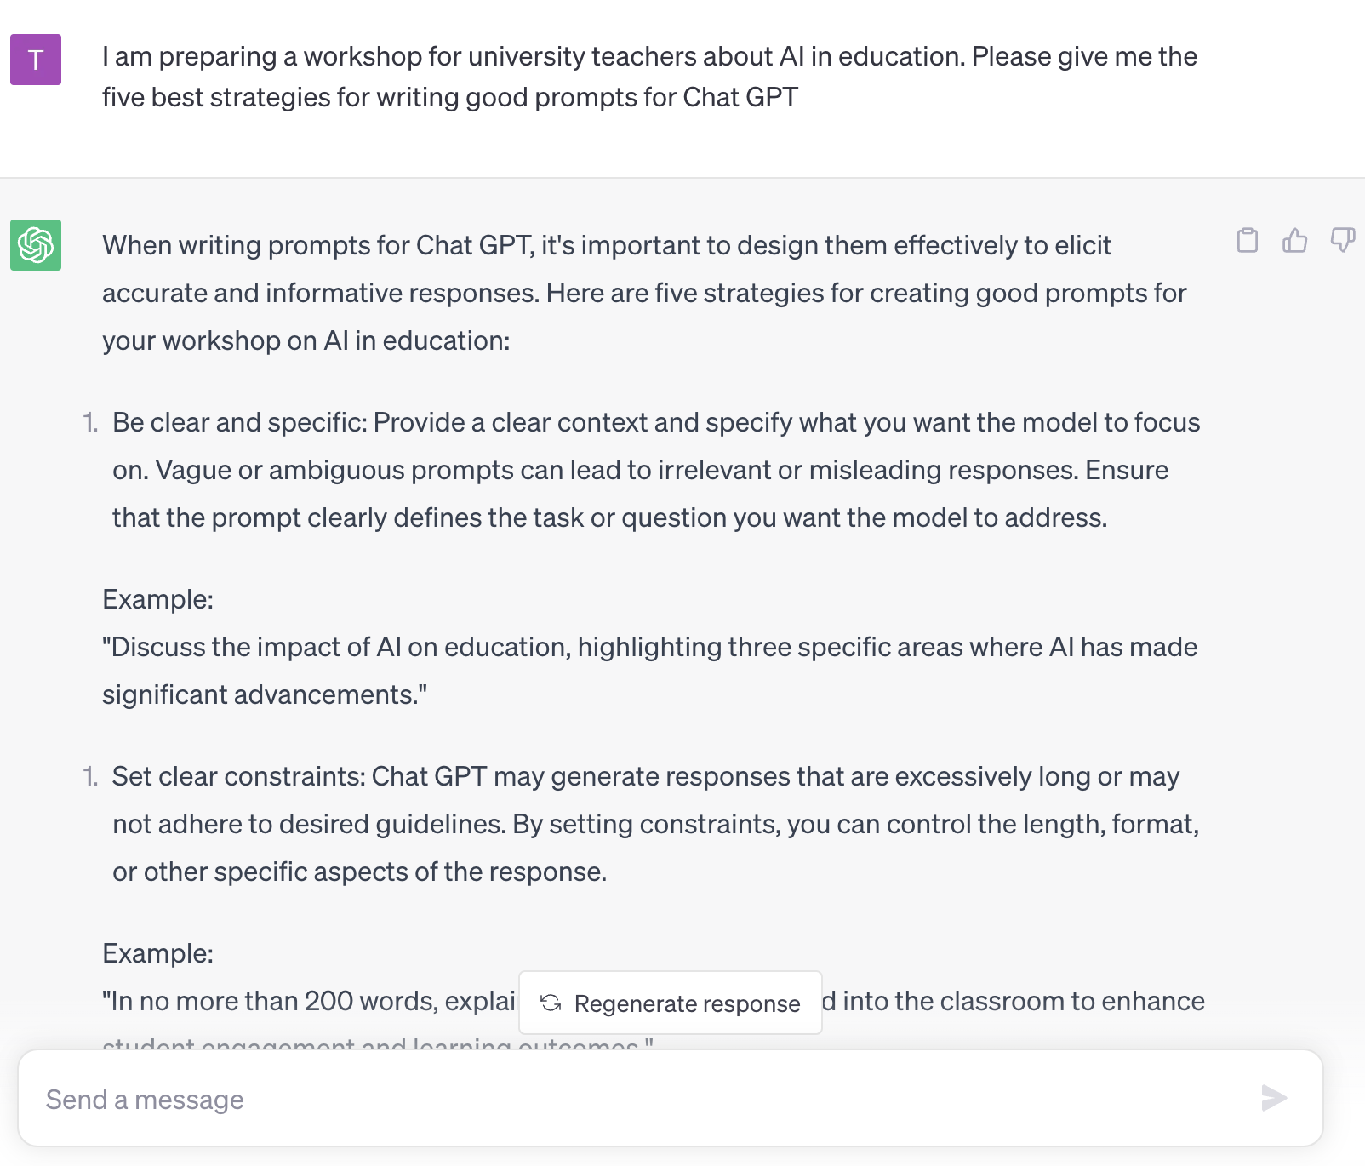
Definitions
Academic integrity can be defined as “compliance with ethical and professional principles, standards, practices, and a consistent system of values that serves as guidance for making decisions and taking actions in education, research and scholarship” (ENAI Glossary)
Artificial Intelligence refers to systems that appear to have “intelligent behaviour by analysing their environment and taking actions – with some degree of autonomy – to achieve specific goals” (EU definition)
Image source: https://en.wikipedia.org/wiki/Transformer_%28machine_learning_model%29

Slide 7
Definitions
Academic integrity can be defined as “compliance with ethical and professional principles, standards, practices, and a consistent system of values that serves as guidance for making decisions and taking actions in education, research and scholarship” (ENAI Glossary)
Artificial Intelligence refers to systems that appear to have “intelligent behaviour by analysing their environment and taking actions – with some degree of autonomy – to achieve specific goals” (EU definition)
Midjourney /imagine large language model with transformer architecture using artificial neural network

Slide 8
Which depiction of Artificial Intelligence is the most appropriate?

Slide 9
Background and Context
AI-based tools can be used to transform, produce or generate any kind of content, such as text, images, art, music, or programming code.
It is increasingly challenging to reliably distinguish AI-generated content from human-produced content
The wide accessibility of AI may exacerbate existing types of academic integrity threats, such as essay and paper mills, fabrication and falsification of data, etc.

Slide 10
Threats to academic integrity
Hosseini, M., Rasmussen, L. M., & Resnik, D. B. (Jan 2023). Using AI to write scholarly publications. Accountability in Research. https://doi.org/10.1080/08989621.2023.2168535
Incorrect or irrelevant answers
Thorough check of correctness
Accountability of authors
Publication integrity
Disclose the use of AI/NLP systems and their impact to the content
Do not use AI to fabricate or falsify data

Slide 11
Concerns related to AI (Hosseini, Rasmussen & Resnik, 2023)
Incorrect or irrelevant answers:
any section of a manuscript written by an NLP system should be checked by a domain expert for accuracy, bias, relevance, and reasoning
If a section of a manuscript written by an NLP system contains errors or biases, coauthors need to be held accountable for its accuracy, cogency, and integrity
Research/Publication integrity:
researchers should not use NLP systems to fabricate empirical data or falsify existing data

Slide 12
Concerns related to AI (Hosseini, Rasmussen & Resnik, 2023)
Publication integrity
researchers should disclose their use of such systems and indicate which parts of the text were written or co-written by an NLP system
When NLP assistance has impacted the content of a publication (even in the absence of direct use of NLP-generated text), this should be disclosed
Contribution from someone who does not qualify for authorship → Acknowledgement
To what extent is SOMEONE similar to SOMETHING?

Slide 13
Acceptable use of AI tools
Authorised and declared usage of AI tools is usually acceptable
Academic misconduct: “any action or attempted action that undermines academic integrity and may result in an unfair academic advantage or disadvantage for any member of the academic community or wider society” (ENAI Glossary)
May not explicitly include unauthorised and/or undeclared use of AI

Slide 14
Unauthorised Content Generation
Production of academic work, in whole or part, for academic credit, progression or award, whether or not a payment or other favour is involved, using unapproved or undeclared human or technological assistance.
Midjourney /imagine artificial intelligence writing student essay in blue and yellow, white background
Notes:
I believe the human is OK here, because there is “human or technological assistance”

Slide 15
AI = Multiplier of Ability
Both in good and bad ways
Students and Educators should be guided on benefits and limitations of AI → learn how to use AI ethically
AI penetrates all areas of human activity
University graduates should be prepared for using AI
Relevant AI tools should be embedded in the curricula

Slide 16
What Should Be Acknowledged?
All persons, sources, and tools that influence the ideas or generate the content should be properly acknowledged.
Consequently, when an AI tool is used, it should be acknowledged.
Form of acknowledgement may differ
If possible, prompt should be provided
Appropriate use of services, sources, and tools that only influence the form is generally acceptable
e.g. proofreaders, proofreading tools, spelling checkers, thesaurus

Slide 17
Responsibility
The outputs of AI tools can include biased, inaccurate, or incorrect content that users should be aware of
Neither the AI tool, nor the provider of the AI tool take responsibility for the generated content
Human (user) is always responsible!
An AI tool cannot be listed as a co-author in a publication
See COPE guidelines

Slide 18
Students & Teachers
Students should be included and educated on the following:
The purpose of all activities related to learning and assessment and why they should develop (e.g. write) their individual/group work assignments.
How to develop their ethical writing and content production skills.
Teachers should receive training on ethical use of AI
including development of relevant learning outcomes, learning activities, and assessment strategies.
Midjourney /imagine future of university education with artificial intelligence

Slide 19
National & Institutional Level
National guidance should provide overarching advice on what institutions should include in their policies.
Institutional policies:
Should define default rules on allowed use of AI
There should be space for specific rules at course level
The policy and the rules should be clearly communicated to all stakeholders
Should guide the users on how to correctly and transparently acknowledge the use of AI tools in an assignment, dissertation, thesis, paper, article, book chapter, computer programme, graphic, artwork and other types of artefact

Slide 20
Summary Statement
There is no doubt that AI brings significant change to education
As with any other technology, it extends and enhances human abilities and may be used both in a positive and a negative way
ENAI urges national policymakers, institutions, and all individual members of the academic community to seek ways on the ethical use of AI and share best practices in order to benefit from the opportunities that AI brings to education and science

Slide 21
Sharing Good Practice
How does your university address generative AI?
Dedicated working group?
Guidelines & workshops for teachers?
Guidelines & workshops for students?
Documents from Masaryk University, Czechia
General statement on AI in education
Recommendation for students

