Slide 1
Raising Awareness for Victims of Academic & Research Misconduct – Validation of the Erasmus+ FAITH Survey
Rita Santos – ENAI Executive Director, Project Manager &
Researcher

Slide 2
Who are the victims of academic malpractice?
“My teaching materials are being used elsewhere without my consent!”
“My PhD advisor stole my research data!”
“One of my co- authors manipulated data and now I’m
being accused!”
“I’ve reported a bad action and now I’m being persecuted!”
“My paper was
plagiarised!”
“I’m not a co-author of a
paper I did most of the work!”

Slide 3
Do victims of unethical actions feel supported?
Few research on reporting academic/research misconduct and the impacts on both the victims and the respondents (see Gunsalus, 1998; Bouter & Hendrix, 2017);
Filling charges of scientific misconduct can be a risky and dangerous endeavor –
whistleblowers often pay a high price!
Reporting suspected scientific misconduct is a shared and serious responsibility of all scientific community!
Lack of institutional support mechanisms and formal procedures!
The two sides of the coin: misconduct or misunderstanding?

Slide 4
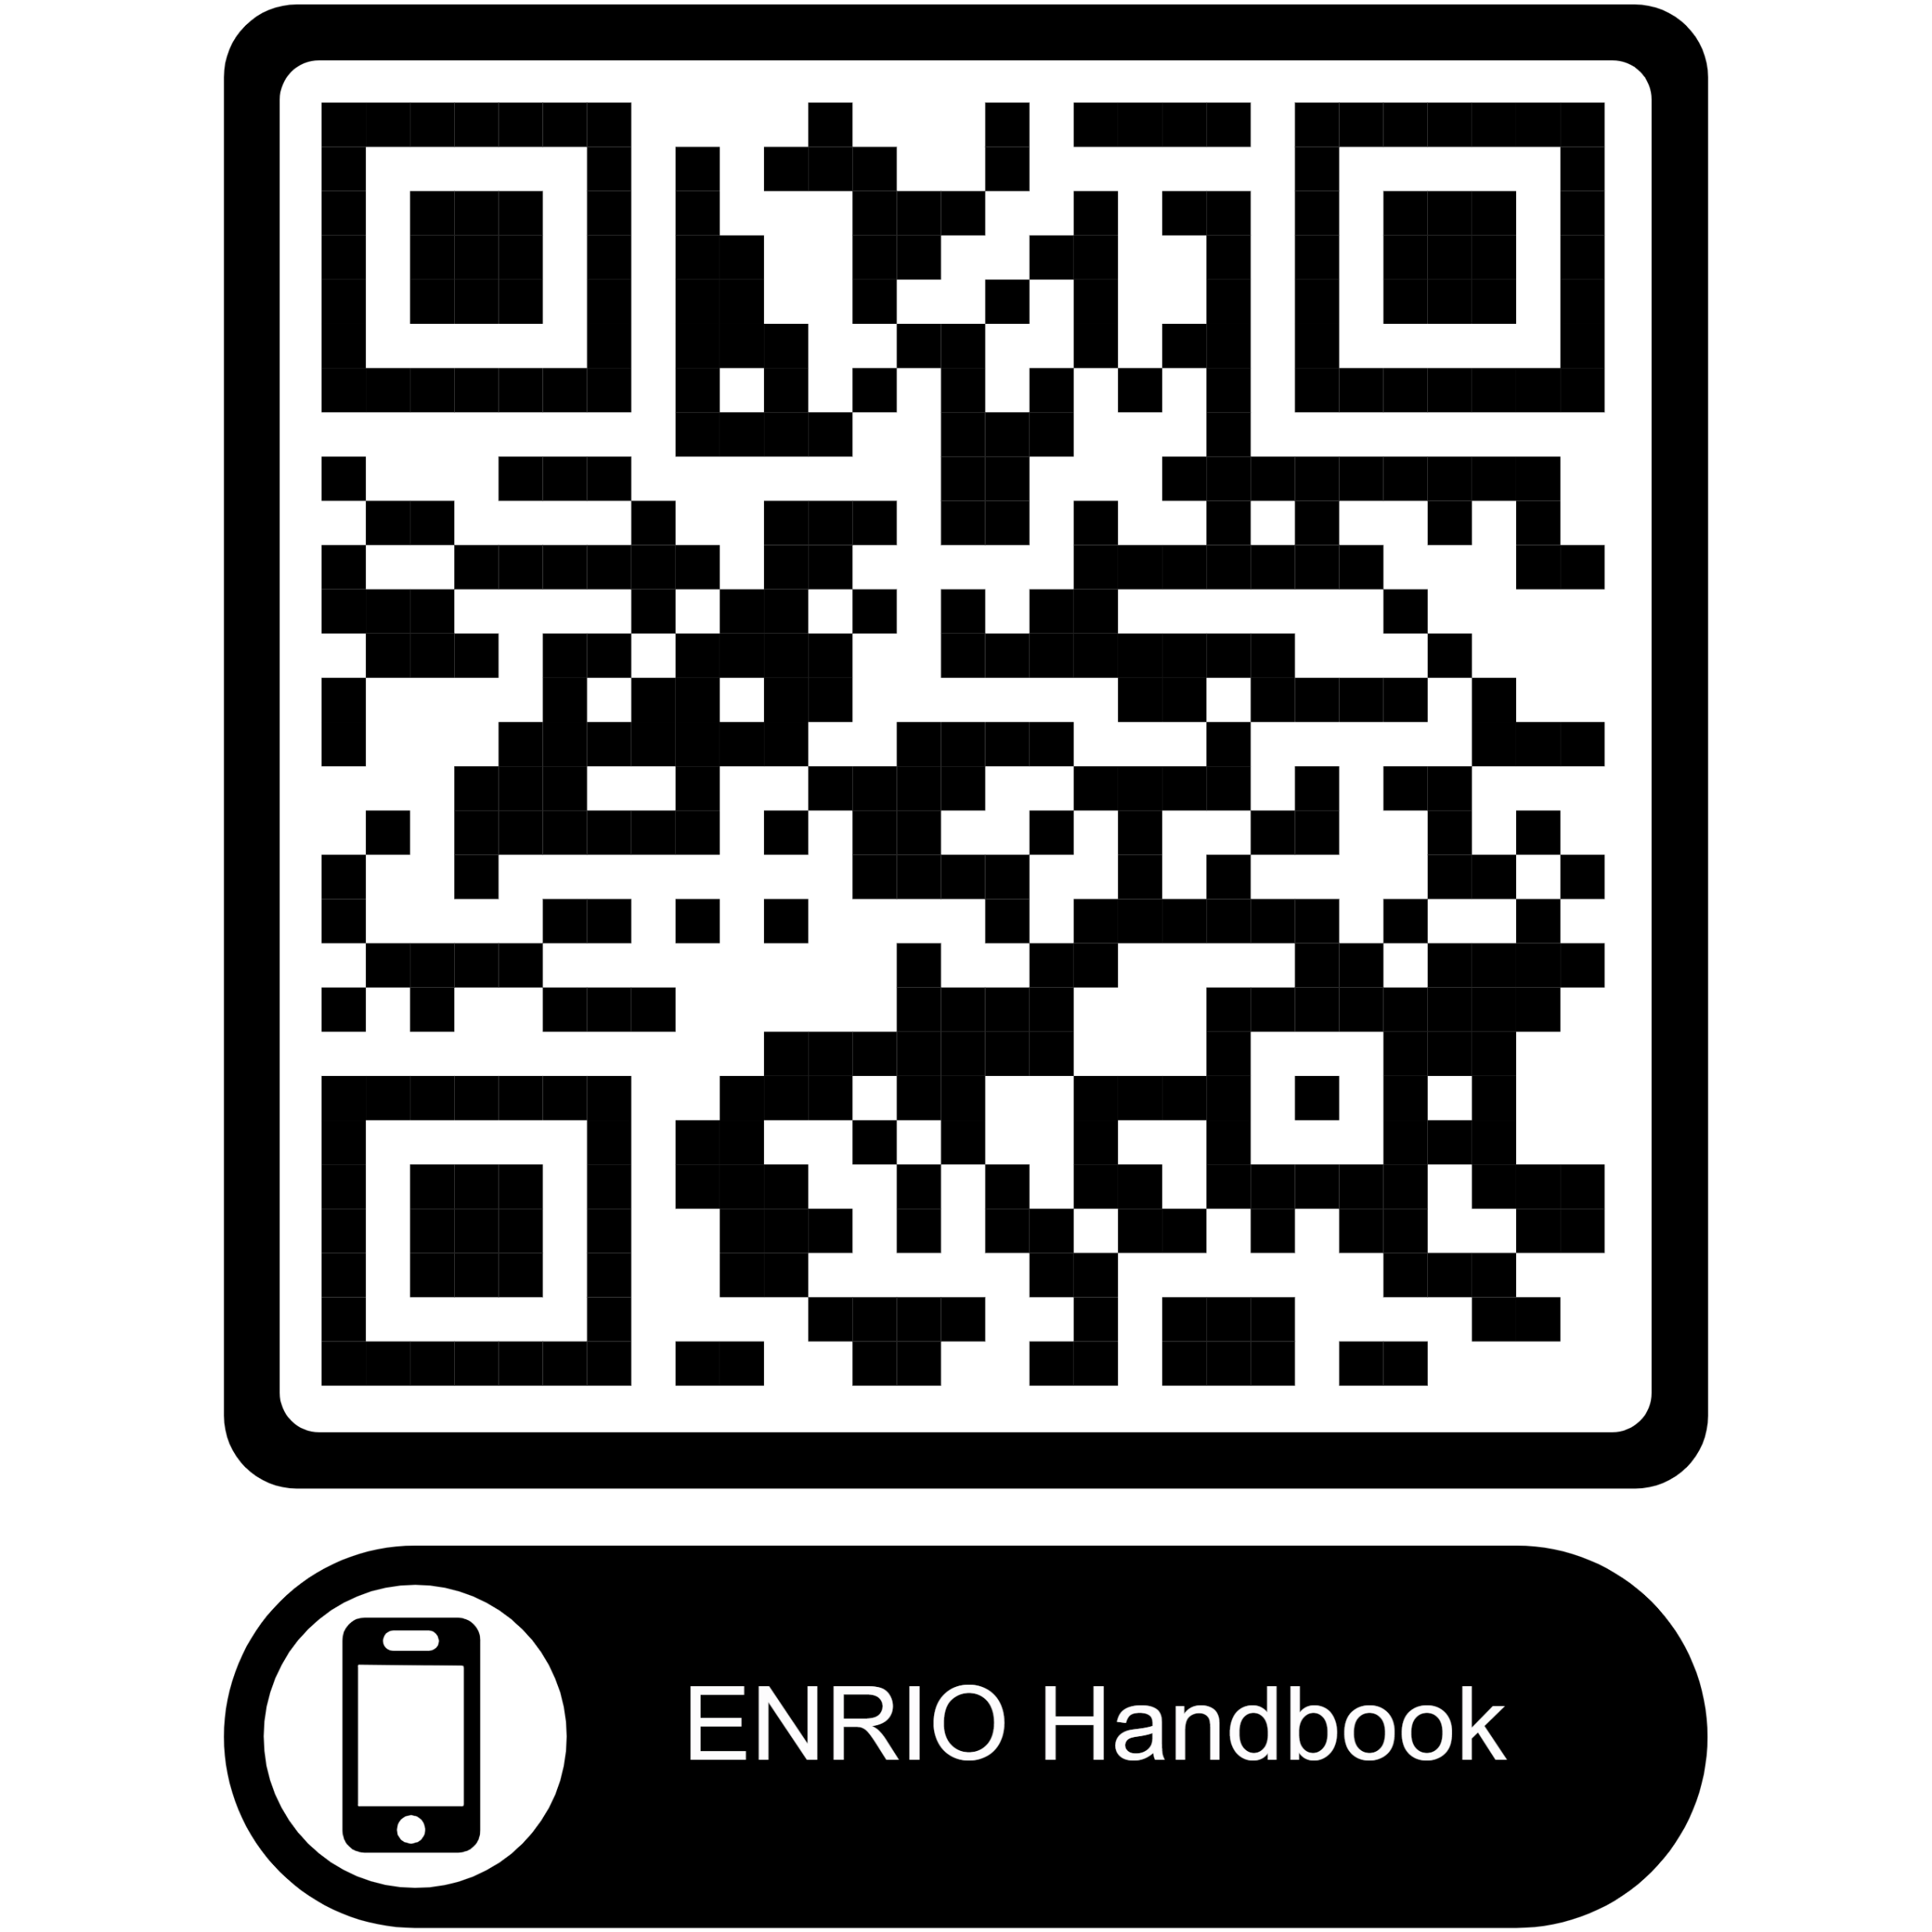
Do victims of unethical actions feel supported?
The handbook showcase best practices regarding the protection of whistleblowers in research
The handbook is useful to those monitoring research projects or individual researchers and those handling allegations of wrongdoing in research

Slide 5
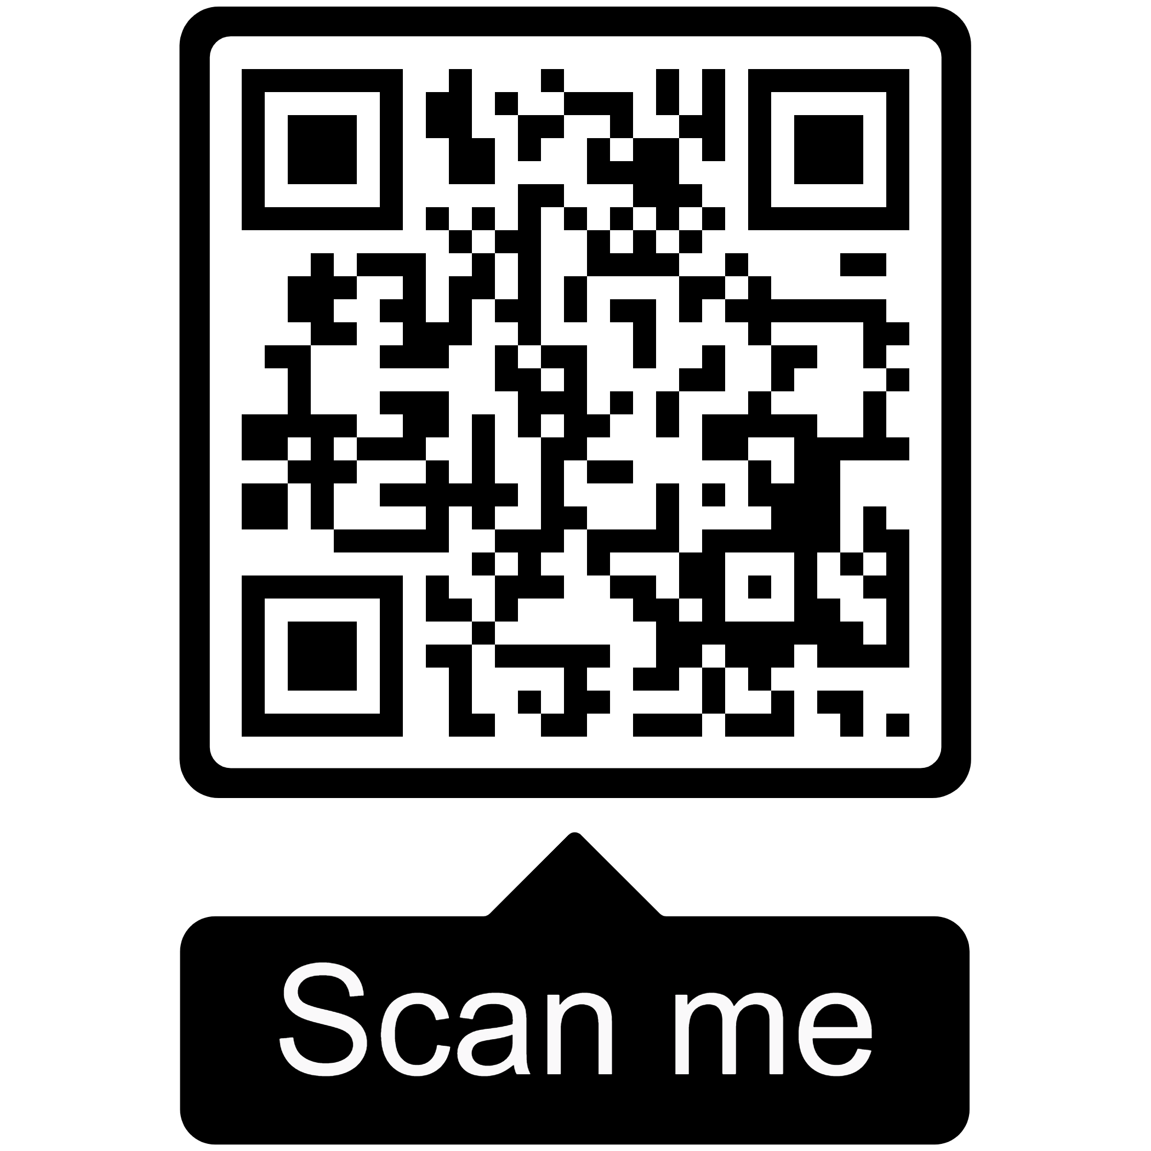
Erasmus+ FAITH project
FAITH – Facing Academic Integrity Threats
Cooperation partnerships in higher education (2021-1- TR01-KA220-HED-000027559)
Timeline: 28th Feb 2022 – 27th Feb 2025 (36 months)
Budget: 274,709.00 EUR
Project partners:

Slide 6
Erasmus+ FAITH project
PR1 - Establish a benchmark for minimum standards for academic integrity policies in Europe and beyond based on good practice internationally
PR2 - Help academics and undergraduate students to prevent, deter and detect academic misconduct through evidence-based guidance and training materials
PR3 – Support for Victims of Academic Misconduct – an interactive portal and support network to support victims of academic and research malpractice
Academic Integrity Corpus
Guidelines for the development of Academic Integrity Policies
Training for policymakers
Training tools for students
Training tools for teachers and other educational stakeholders
Raise awareness for victims of academic and research misconduct
Online support network to provide guidance to anyone affected by the unethical actions of others

Slide 7
PR3 methodological framework
PR3A
PR3B
Understanding the different needs of potential victims – Literature Review & Online Survey study
PR3C
Victim Support Network
Educational and Mentoring Support

Slide 8
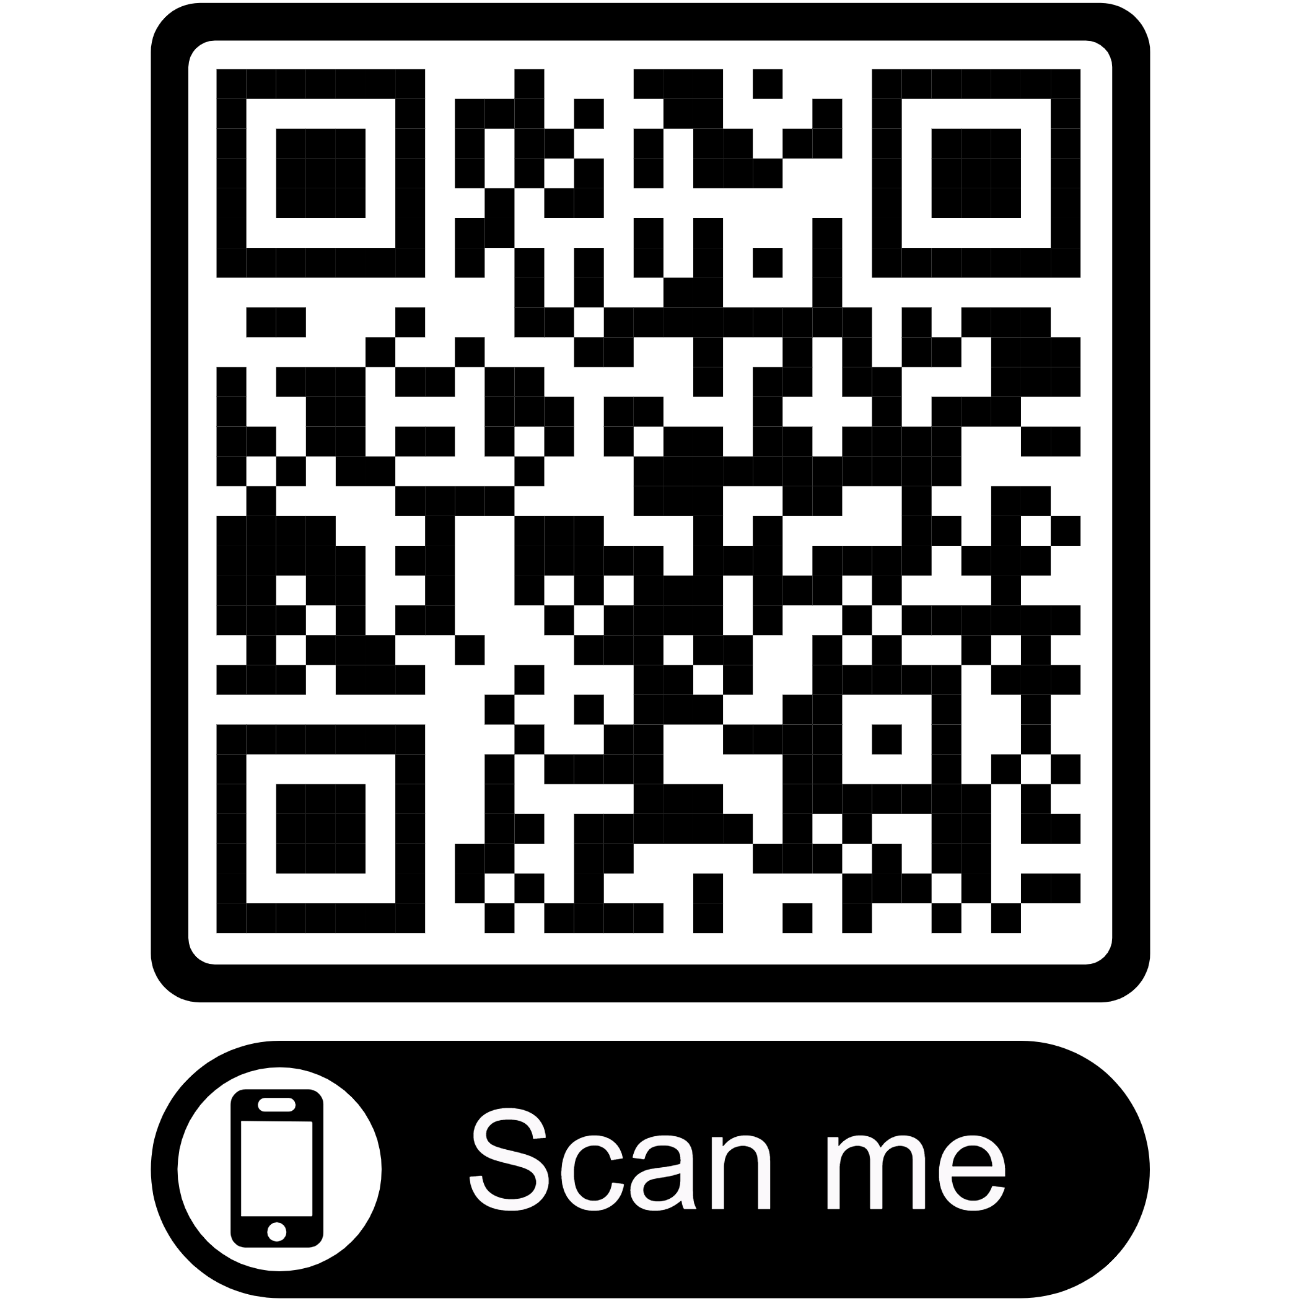
Victim Support Portal

Slide 9
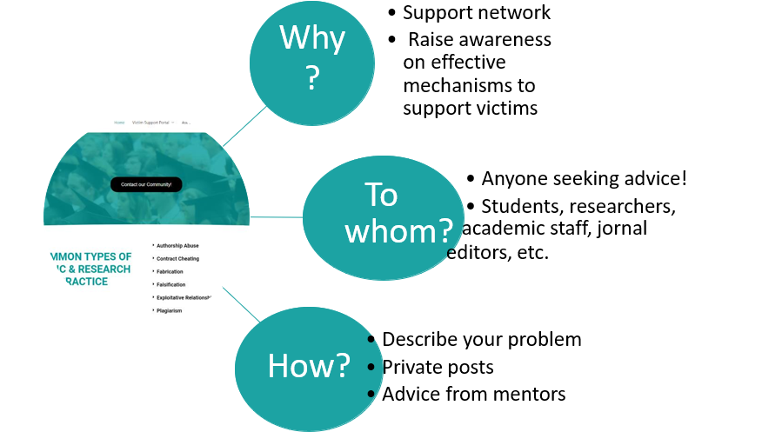
Victim Support Portal

Slide 10
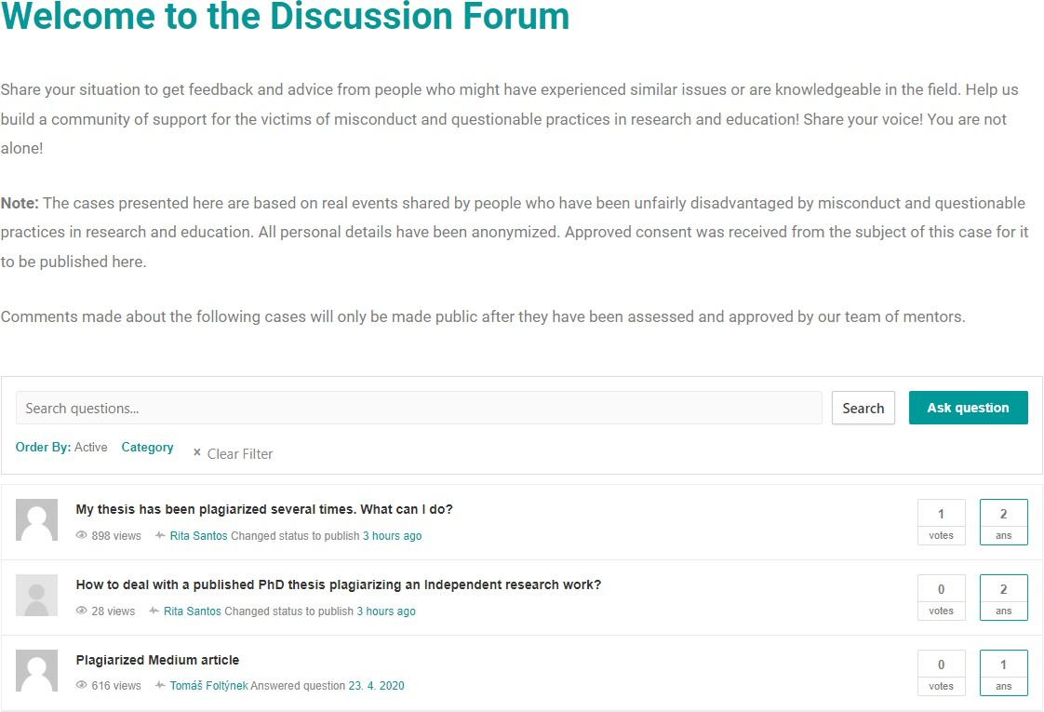
Raising Awareness on Victims of Academic Misconduct
✔ Cases made public after receiving informed consent from the victim
✔ Raise awareness and support
people facing similar problems
✔ Interact with others!
✔ Comments made public only after assessment of content

Slide 11
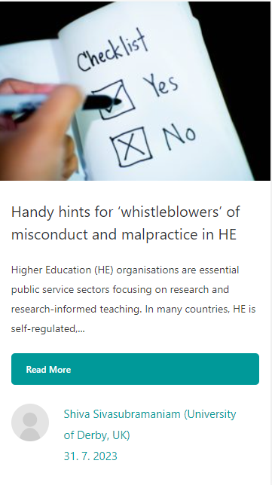
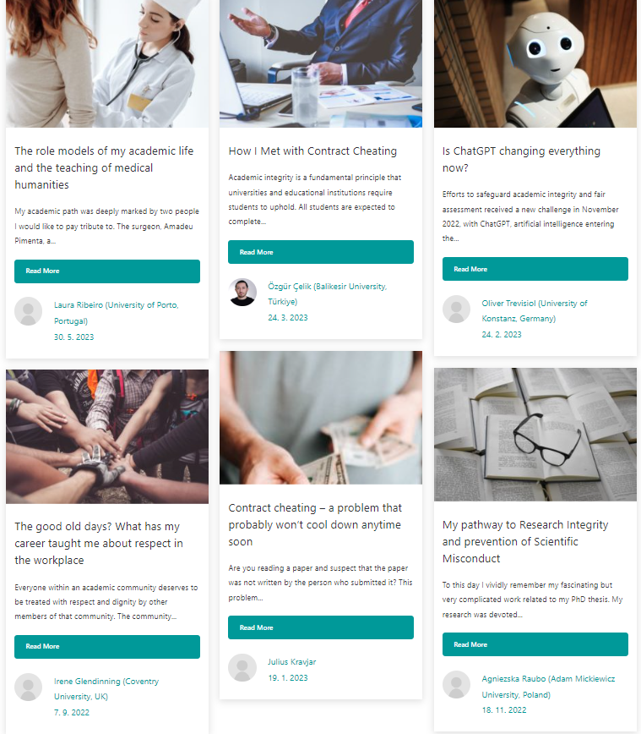
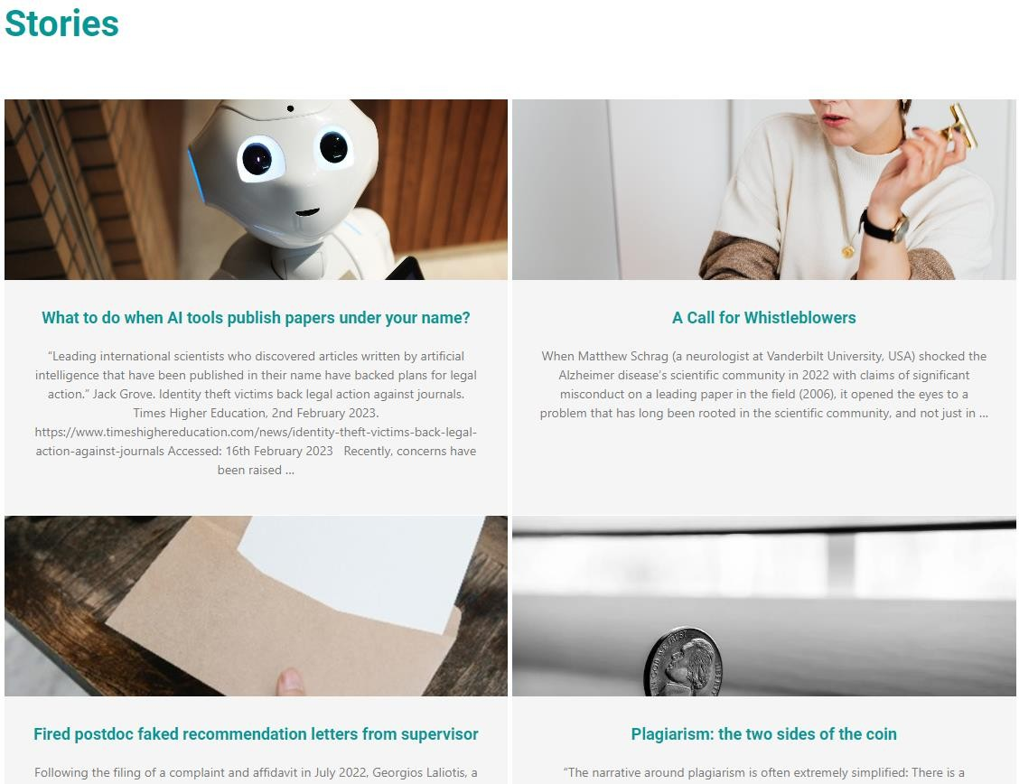
Raising Awareness on Victims of Academic Misconduct

Slide 12
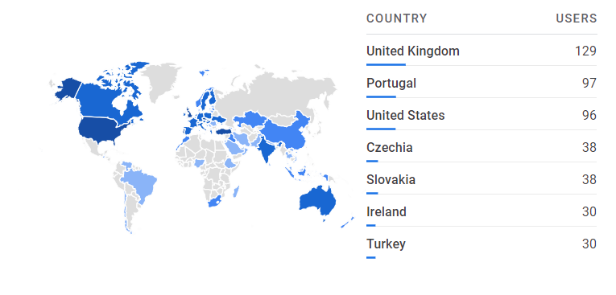
Victim Support Portal - Impact
7951 page views
757 users from 70 countries
10 cases supported
3 cases turned public
Resources (blog, stories, webinar, conference presentations, bibliography & guidelines)
Continuous dissemination & promotion

Slide 13
Understanding different needs of potential victims – FAITH Online Survey
Online Survey
- Undergraduate
- Master & PhD
- Researchers
- Academic staff
Aims
Assess target group’s knowledge, attitudes, experiences & support needs on academic integrity, academic misconduct & questionable practices
Ethical Approval
- ENAI Ethical Approval
- Canakkale Onsekiz Mart University (Türkiye) Ethical Approval – Coordinator

Slide 14
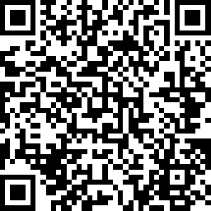
Validation of the Erasmus+ FAITH Survey
You can access the Erasmus+ FAITH survey here
https://www.surveymonkey.com/r/PHC5YJ7
Your participation is voluntary and anonymous! You’re free to withdraw any time! We will only use your responses to make necessary adjustments to each survey!

Slide 15
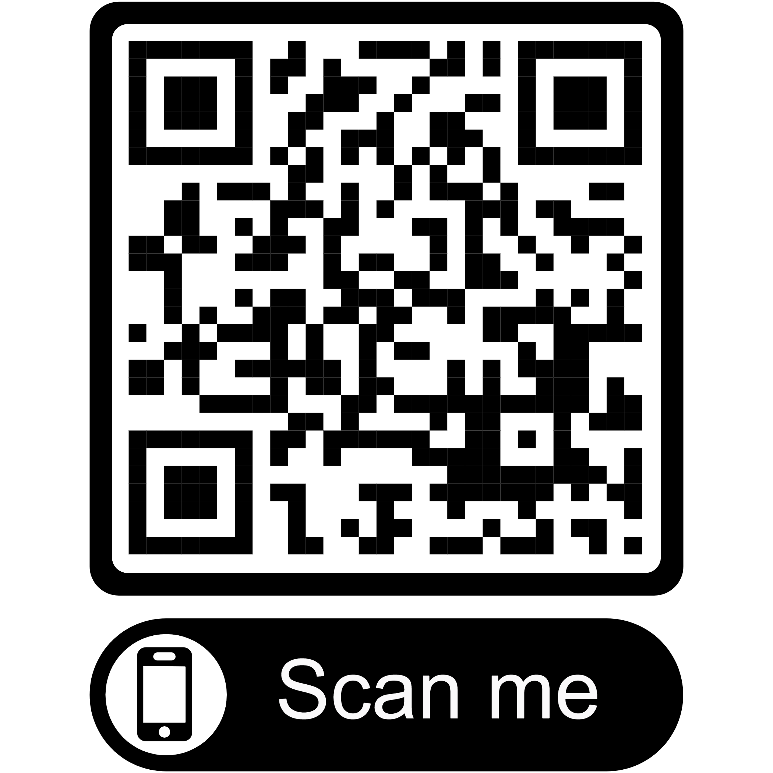
Feedback & Q/A
Were the questions made clear to you?
Were the questions relevant to your own context?
Did you find overlap between questions?
Was the survey too long?
Would you like to make any suggestions to improve the survey?
https://forms.gle/c6MKbmP6kAw666i66
Short Feedback survey

Slide 16
Thank you!
Contact us anytime!
European Network for Academic Integrity – info@academicintegrity.eu
Rita Santos – Executive Director, Senior Researcher & Project Manager – rita.santos@academicintegrity.eu victims@academicintegrity.eu
Facebook
Twitter
LinkedIn
YouTube

