Slide 1
Guidance on ethical publishing and dissemination
Dr Irene Glendinning
Academic Integrity Lead
Coventry University Group
3rd ENAI Academic Integrity Summer School 2023, 21st – 25th August 2023, Faculty of Electrical Engineering and Computer Science, University of Maribor, Slovenia

Slide 2
Contents
Overview of academic publishing and dissemination
Peer review process
Assessing the quality of an academic journal or paper
EPAD resources
Your turn to check some examples
Fair authorship rules

Slide 3
Aims and objectives of EPAD
Ethical Publishing and Dissemination Working Group
Identify, define and characterise questionable editorial, publishing and dissemination practices
Promote institutional academic integrity, using existing checklists to identify disreputable publishers and conferences
Disseminate good practice – with reference to COPE (Committee on Publication Ethics)
Highlight the threats from disreputable publishers and conferences
Provide support to students and scholars for developing knowledge and skills in distinguishing reputable from disreputable publications / journals / events
Conduct research about this phenomenon, for example – explore where / how / to what extent academic progression and promotion depends on the predatory industry
Network/collaborate with institutions, working groups, other people interested in this topic (EPAD, n.d.)
Run workshops and summer schools for PhD candidates, ECRs, supervisors.
IG
Notes:
irene

Slide 4
Intended learning outcomes
Raise awareness about academic publishing options and threats
Provide practical examples of what to avoid
Provide guidance about differences between scholarly and poor-quality journals, publishers and conferences

Slide 5
Why this topic is important
Publishing and dissemination is central to academic life
Signposting guidelines and codes of conduct can help embed good practice in research centres and universities
Academic publishing is complicated and misunderstood even by some experienced researchers
Highlighting threats and scams can help to reduce dependency on disreputable and “predatory” publishing

Slide 6
Overview of academic publishing
Commercial publishing companies: eg Elsevier, Springer Nature, Pearson, Wiley
Specialist subject-based academic journals, professional bodies
Funding models and sources: Green open access, Gold Open, Hybrid, Platinum, embargo (Gasparyan et al., 2017)
Article Processing Charge, who pays?
Why is open access important?
Journal Impact Factor (JIF = Web of Science indexation criteria) (Bell, 2018)
Preprint servers
Retractions

Slide 7
Responsibilities of publishers: Registering, Curating, Evaluating, Disseminating, Archiving (Wouters et al. 2019)
Volunteers: Editors, editorial board, peer reviewers, authors
Funding of science, research and publications
Consumers: libraries, researchers, academics, students

Slide 8
Peer review process
Paper submitted
Publisher or editorial pre-check
Reviewers invited
Reviewer accepts
Reviews completed and submitted
Editor checks reviews & sends response to author
Author reworks in response to feedback
Desk Reject
Paper accepted
Reviewer refuses
Paper Rejected

Slide 9
How reputable academic publishers manage the peer review process
Peer review
Single-blind peer review
Double-blind peer review
Open peer review

Slide 10
Other types of peer review
Review type | Features
Transparent / open peer review | Reviewers play a vital role in academic publishing Acknowledges the important role of reviewers Enriches published articles and improves reading experience
Collaborative review | Two or more reviewers work together, discuss their opinions and submit a unified report. Reviewers collaborate with authors to improve the paper until it reaches a publishable standard
Pre-prints Post-publication review | Draft published after editorial checks Appraisal and revision of a paper continues – or occurs – after publication.
Triple-blind peer-review | Reviewers & handling editors do not know identity of authors. Evaluation of articles should based on scientific merit.

Slide 11
Why do we have peer review?
Please share your thoughts and ideas

Slide 12
Why do we have peer review?
To check that proposals fit the scope and subject of the publication
To ensure the quality of papers within a journal or chapters of a book
To check whether the contribution is relevant and complete
To suggest how authors can improve their writing and communication
To clarify any concerns
To check for accuracy of information
To ensure that only good science gets published
For evaluating applications for funding and grants

Slide 13
Corruption of peer review
Unprofessional conduct by reviewers, editors or authors
Publishers & editors falsely claiming to conduct peer review
Fake reviews
Peer review rings
Hijacking and cloning of reputable journals
Reviewer publishing the draft as their own work
Unfairly negative reviews – eg rivalry between research teams
Reviewers not declaring conflicts of interest

Slide 14
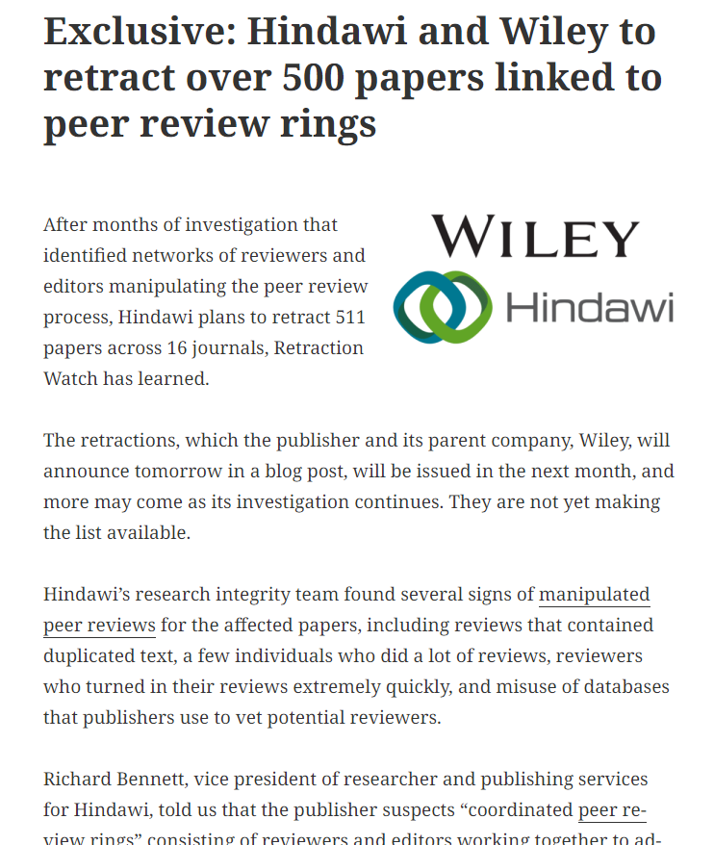
Kincaid, E. (2022). Exclusive: Hindawi and Wiley to retract over 500 paper linked to peer review rings. Retraction Watch, 28th September, 2022. https://retractionwatch.com/2022/09/28/exclusive-hindawi-and-wiley-to-retract-over-500-papers-linked-to-peer-review-rings/

Slide 15
Why is peer review challenging?
Peer review relies on voluntary efforts of very busy academics
Trust-based system: not everyone involved is trustworthy (Abalkina, 2021)
Publish or perish mentality and misguided incentives drive some people to evade or fake the necessary checks and balances (Mills & Inouye, 2020).
There is money to be made from academic publishing and dissemination (Grove, 2021)

Slide 16
More on peer review fraud
Editors ask authors to name existing experts in the field as reviewers, author supplies the name and fake email address that they control.
Authors recommend fictitious reviewers and supply an email address that they control.
A “paper mill” submits a paper, naming an author using a fake email address or simply creates a fake reviewer account and recommend it as a reviewer.
Paper mills sell authorship and co-authorship for accepted fake papers to anyone willing to pay their fee.
(Adapted from Adam Day. SAGE Publishing, 1 Oliver’s Yard, London, EC1Y 1SP, https://arxiv.org/pdf/2202.03310.pdf)

Slide 17
Disreputable publishers and journals
Often called predatory or potentially predatory (PPJs)
White lists and black lists (e.g. Cabells, Beall’s List)
Poor quality, only interested in making money
Weak or absent editorial and publishing services
Ineffective or no peer review
Non-specialist, publish anything submitted
Avoid publishing in any journal that is of dubious quality

Slide 18
EPAD resources
Checklist on identifying disreputable publishers and journals
Guidance notes for Authors
Guidance notes for Peer Reviewers
https://drive.google.com/drive/folders/1JqfpihgKYjq4mz-j73gxyly0iOz--dgY?usp=sharing

Slide 19
A few clues for helping to identify PPJs
The papers of the journal are of poor research quality
The journal website does not present an editorial board (or has fake board members)
Incorrect or strange address of the editorial office
The journal title claims a national affiliation that does not match its location
The publishing schedule is not clearly stated (or impossibly short & frequent)
The journal mimics another journal title or the website of a reputable journal
Claim of high impact factor despite the fact that the journal is relatively new
The journal includes articles outside its stated scope
Unsolicited invitation to submit an article for publication
Emails from the journal editor and web site are written in poor language
Vague journal title (international – research – scientific - global)
Editors have gmail accounts or similar

Slide 20
Fake conferences, for example:
From: humanities@eurasiaconferences.org
To: Irene Glendinning
Mon 21/08/2023 06:09
Subject: Paris Awaits: WCAHSSE-Paris-2023 Early Bird Discount
Dear Irene Glendinning,
Greetings from Eurasia conferences!
With great pleasure, we invite you to join our prestigious event “3rd World Conference on Arts, Humanities, Social Sciences, and Education” which is all set to take place during Oct 16-17, 2023 and will have both online and on-site versions in Paris, France. We are delighted to have you as a potential speaker for our conference. As a distinguished expert in your field, your valuable insights will undoubtedly enrich our event and contribute to meaningful discussions among academics, researchers, and professionals from around the world.
For more details please visit: https://eurasiaconferences.com/events/paris/2023/arts-humanities-social-sciences-and-education/ Kindly submit your abstract as a positive acknowledgment and get an additional 25% discount on the registration fee
We believe that your presence will be a great addition to the WCAHSSE-Paris-2023 stage. If you have any questions or need clarification, please feel free to contact me anytime
Anticipating a positive reply from your end Best Regards, Maggie Grace Program Manager | WCAHSSE-Paris-2023 Eurasia Conferences Kemp House, 152-160 City Road, London, EC1V 2NX.

Slide 21
Distinguishing reputable from disreputable
Look at the following examples and discuss any clues about whether this publisher / journal is reputable or disreputable.
What in the example gives you confidence that this publisher / journal / conference is reputable?
What evidence can you find that the publisher / journal / conference call is poor quality or predatory?

Slide 22
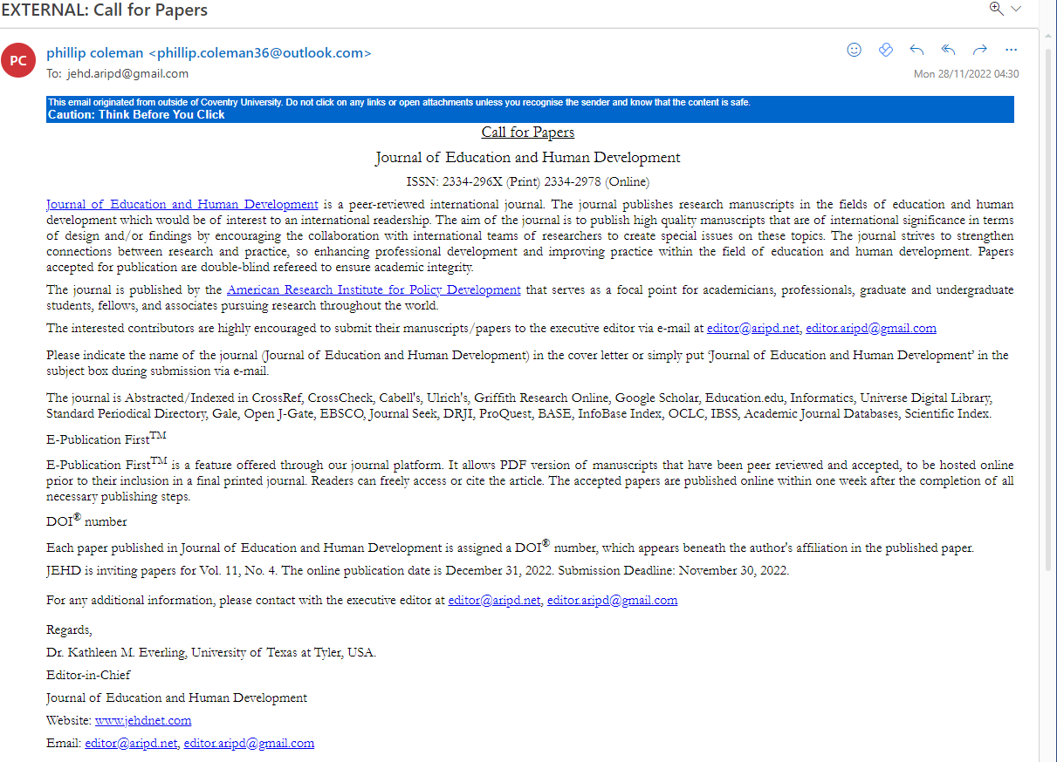
Example 1

Slide 23
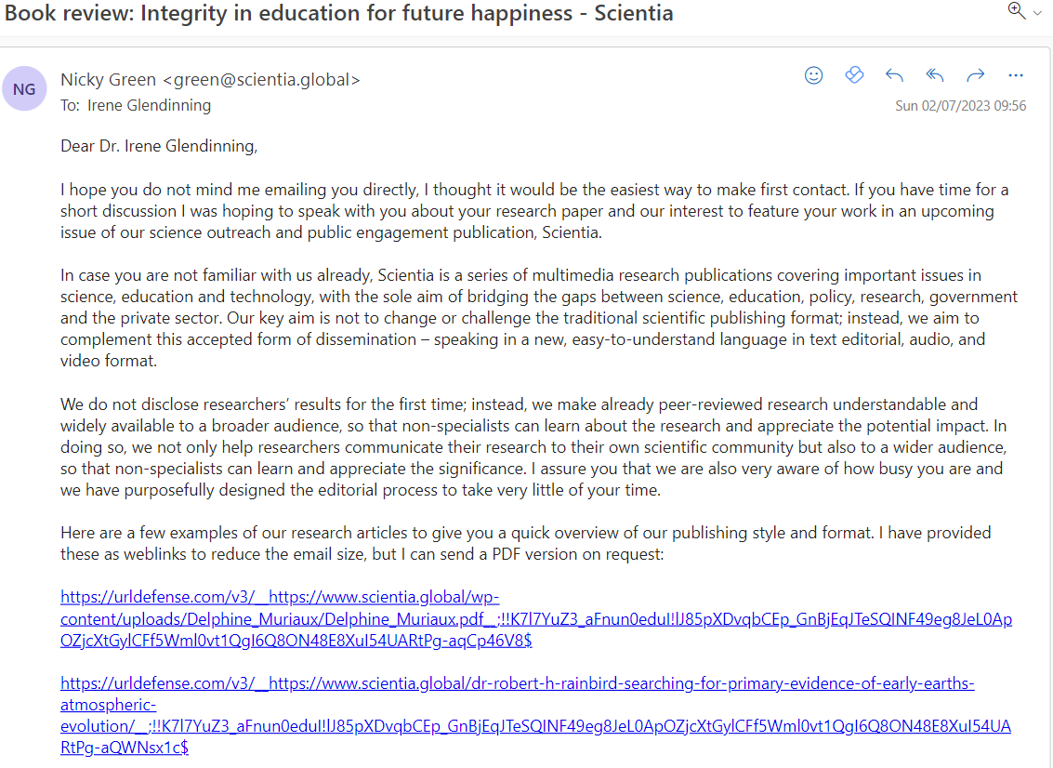
Example 2

Slide 24
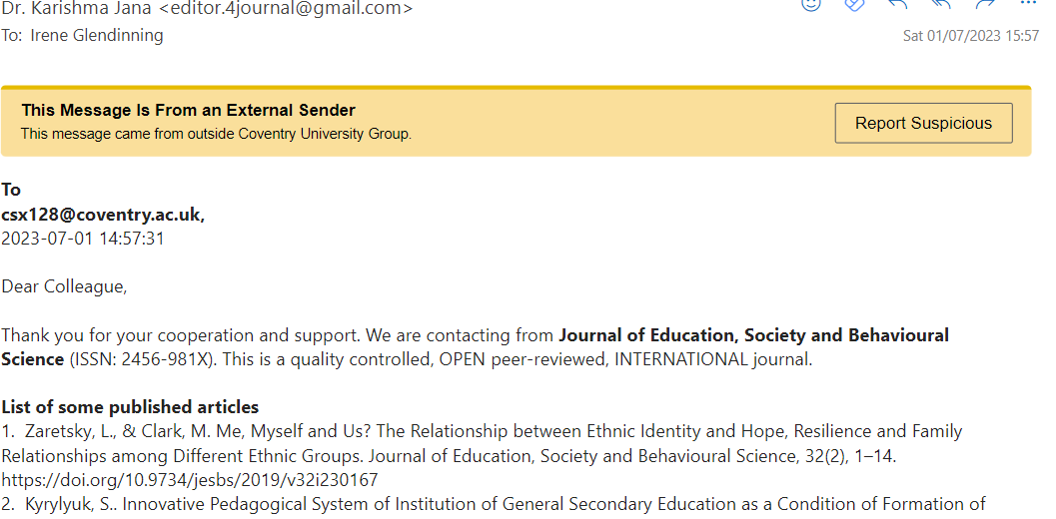
Example 3
More on next slide

Slide 25
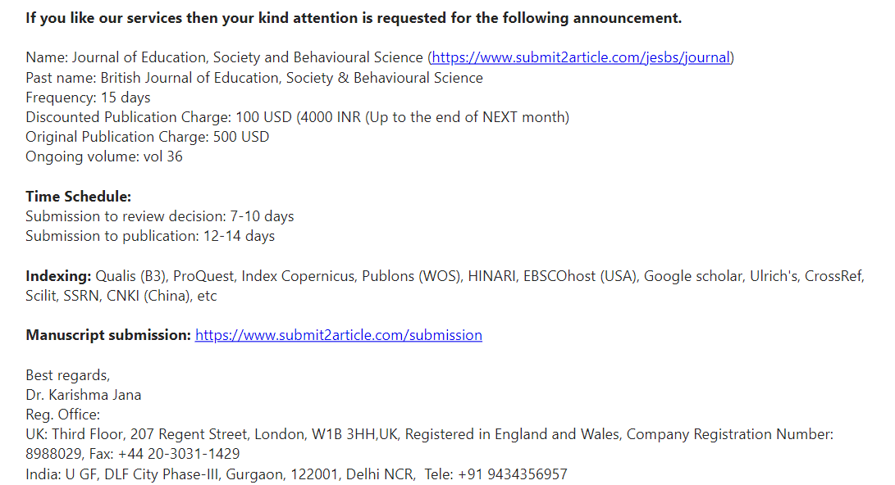
Example 3
Second extract

Slide 26
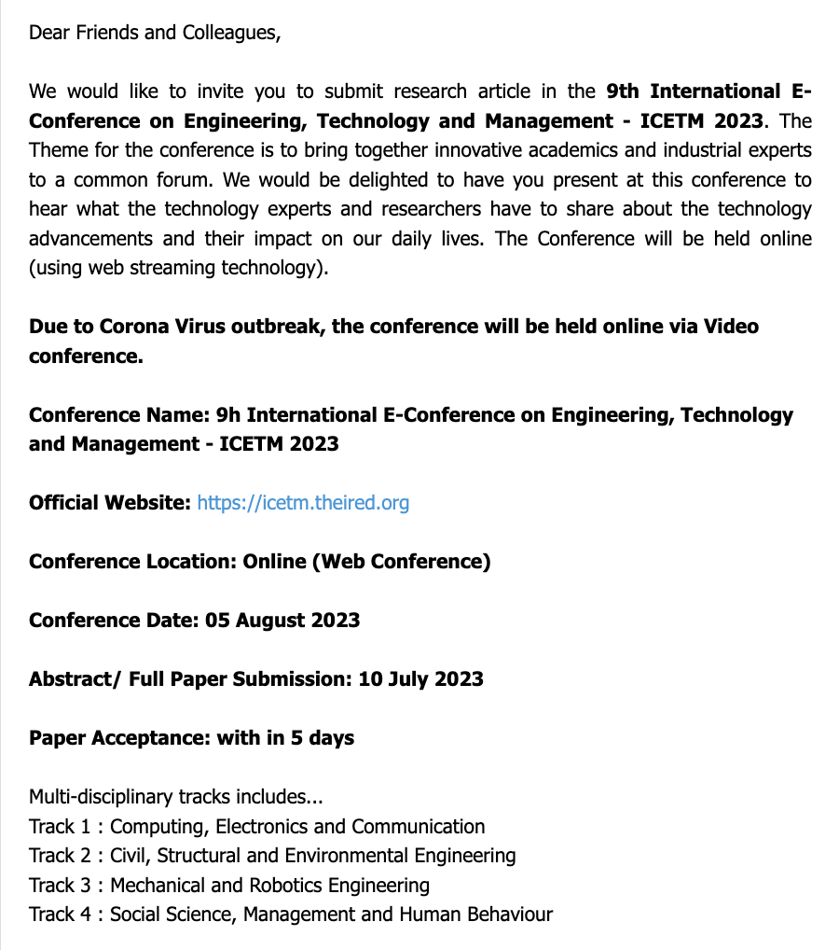
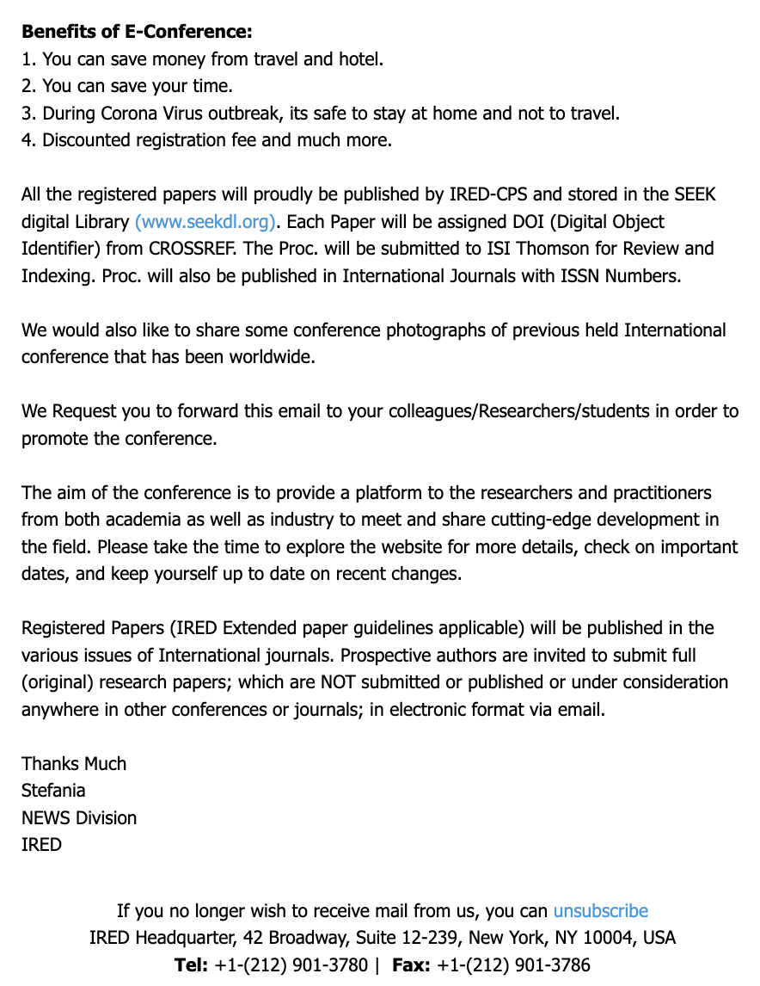
Example 4

Slide 27
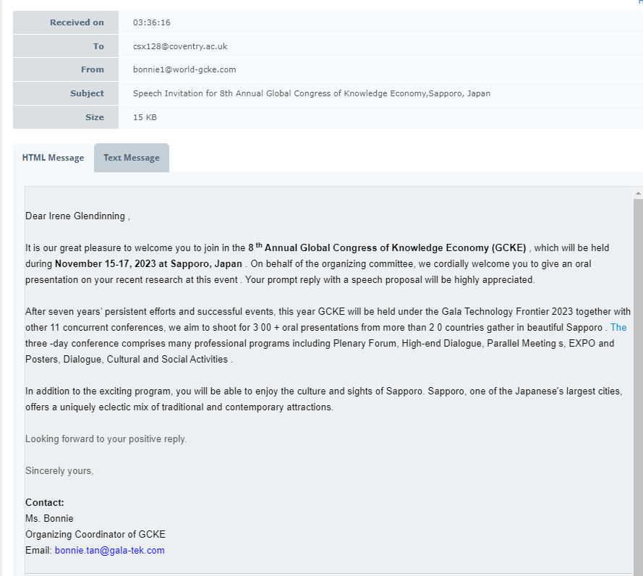
Example 5
Notes:
Irene - for discussion - what looks wrong about this email invitation?

Slide 28
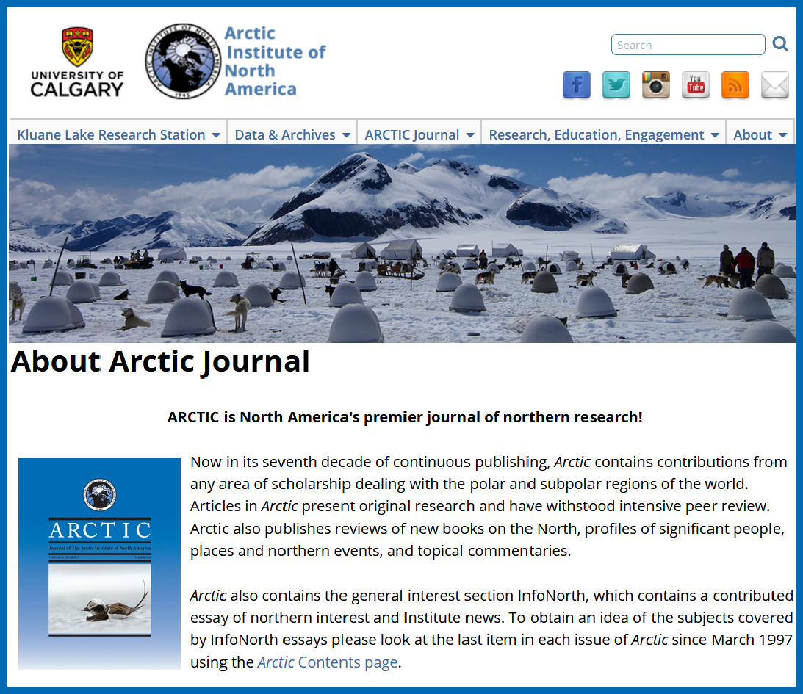
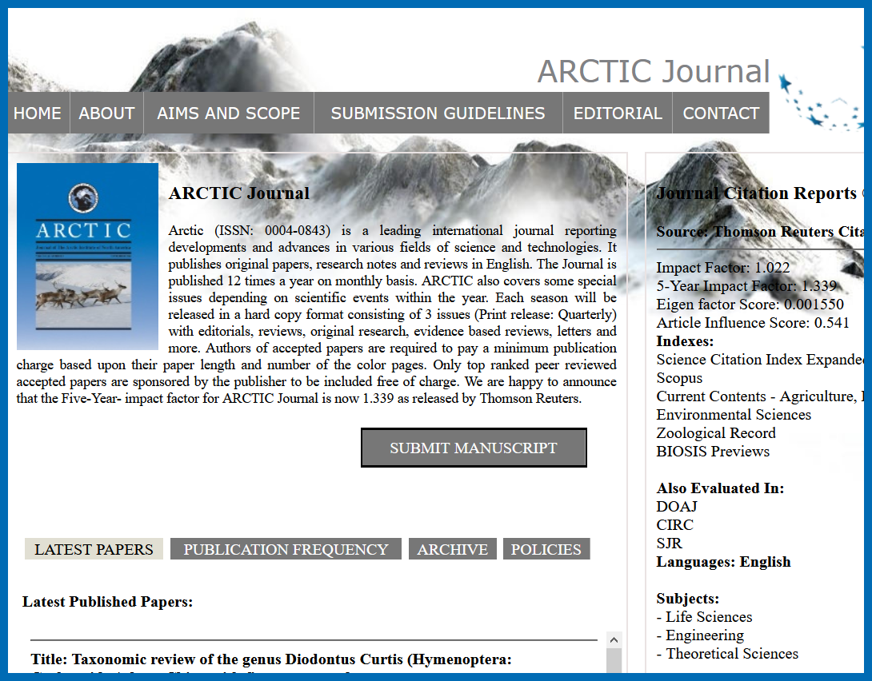
Hijacked and cloned Journals
Legitimate journal webpage
Cloned journal webpage
https://arctic.ucalgary.ca/about-arctic-journal
https://www.arcticjournal.org/
SDS

Slide 29
Checking journal quality is vital because:
Some poor quality journals are included in real indexes, eg in Scopus, Directory of Open Access Journals (DOAJ) (see Bohannon, 2013)
Publisher web sites and content of emails may be inaccurate, misleading or fraudulent (Burdick, 2017, Gillis, 2018)
Despite claims, peer review may not be carried out or may lack rigour
PPJs use false, fake or invented indexes

Slide 30
Retraction Watch Hijacked Journals Checker: https://docs.google.com/spreadsheets/d/1ak985WGOgGbJRJbZFanoktAN_UFeExpE/edit#gid=5255084

Slide 31
Drivers of corruption in academic publishing
Journal publications required for PhD (eg Turkey)
Cash bonuses for publications (eg China, Thailand)
Publication record > appointment, promotion, tenure
Lack of agreement about how to define reputable / disreputable journals and publishers
Anyone can set up a journal – good money to be made

Slide 32
Related scams and threats
Paper mills
Plagiarism by translation
Salami slicing
Gift, guest, paid for authorship
Supervisory bullying eg demanding first authorship
Neglectful or incompetent peer reviewers

Slide 33
Fair authorship rules
Authors should discuss authorship when planning research, agree authorship in writing, and revisit the agreement through stages of the research.
Handle disagreements as they happen.
Negotiate disputes and misconduct dispassionately, using facts and guidelines.
Acknowledgements may be acceptable to a journal when contributions do not constitute authorship.
Authors should describe what each author contributed to the research project.
The order of authors should be decided jointly between the authors and make it clear the editor the reasons behind the author order.
All authors should be listed.
People should not be added as authors if they have not contributed significantly to the project.
Read the journal's instructions for authors as they can differ between journals.
(COPE: https://publicationethics.org/resources/guidelines-new/how-handle-authorship-disputesa-guide-new-researchers)

Slide 34
How can we make academic publishing and dissemination more ethical?
Raise awareness through sessions like this and academic publications
Encourage providers to include relevant topics in ECR and PhD training
Highlight mistakes, eg misguided incentives driving publish or perish mentality
Share and discuss good and less good practices on publishing

Slide 35
Thanks for listening and contributing
Thanks to other members of EPAD use of resources
EPAD welcomes new members
Join us for our annual conferences: 2024 in Gatineau-Ottawa
Contact ireneg@coventry.ac.uk

Slide 36
Useful resources to share
ThinkCheckSubmit.org. (n.d.). Choose the right journal for your research. Retrieved from http://thinkchecksubmit.org/
COPE (n/d). Publication Guidelines. Committee on Publication Ethics. https://publicationethics.org/guidance/Guidelines
Eaton, S. E. (2018). Avoiding Predatory Journals and Questionable Conferences: A Resource Guide. Calgary, Canada: University of Calgary. https://prism.ucalgary.ca/bitstream/handle/1880/106227/Eaton%20-%20Avoiding%20Predatory%20Journals%20and%20Questionable%20Conferences%20-%20A%20Resource%20Guide.pdf?sequence=1&isAllowed=y

Slide 37
References and bibliography
Abalkina, A. (2021). Unethical Practices in Research and Publishing: Evidence from Russia. The Scholarly Kitchen, 4th February 2021. Retrieved on April 20th 2022 from https://scholarlykitchen.sspnet.org/2021/02/04/guest-post-unethical-practices-in-research-and-publishing-evidence-from-russia/?informz=1
Beall’s list: https://beallslist.net/
COPE. Ethical guidelines for peer reviewers. DOI: https://doi.org/10.24318/cope.2019.1.9
COPE.(2003). How to handle authorship disputes. DOI: https://doi.org/10.24318/cope.2018.1.1
Grove, J. (2021). Hijacked Journals 'siphon millions of dollars' from research. Times Higher Education, 30th August 2021. Retrieved on April 20th 2021 from https://www.timeshighereducation.com/news/hijacked-journals-siphon-millions-dollars-research
Littman, M.L., (2021). Collusion Rings Threaten the Integrity of Computer Science Research. Communications of the ACM June 2021, Vol 64 No 6, pages 43-4. https://cacm.acm.org/magazines/2021/6/252840-collusion-rings-threaten-the-integrity-of-computer-science-research/fulltext
Mavrogenis, A.F., Quaile, A., Scarlat, M.M. (2020). The good, the bad and the rude peer-review. International Orthopaedics (2020) 44:423-415. Springer. https://doi.org/10.1007/s00264-020-04504-1
Mills, D., & Inouye, K. (2020). Problematizing ‘predatory publishing’: A systematic review of factors shaping publishing motives, decisions, and experiences. Learned Publishing. Published online 23rd August. https://doi.org/10.1002/leap.1325
Nature Editorial (2022). Nature is trialling transparent peer review - the early results are encouraging. https://www.nature.com/articles/d41586-022-00493-w
Open Access Academy. Types of open access. Available at: http://www.oaacademy.org/types-of-open-access.html
Oransky, I. (2021). Journal retracts 122 papers at once. Retraction Watch December 15th 2021. https://retractionwatch.com/2021/12/15/journal-retracts-122-papers-at-once/
Packer, M. (2018). Overdue: Civilised Post-publication Peer Review, Med Page today, 20th June 2018. https://www.medpagetoday.com/blogs/revolutionandrevelation/73587
Retraction Watch Hijacked Journals Checker (n.d.). https://docs.google.com/spreadsheets/d/1ak985WGOgGbJRJbZFanoktAN_UFeExpE/edit#gid=5255084
ThinkCheckSubmit.org. (n.d.). Choose the right journal for your research. Retrieved from http://thinkchecksubmit.org/
Wouters, P., Sugimoto, C.S., Larivière, V., McVeigh, M.E., Pulverer, B. de Rijcke, S., Waltman, L. (2019). Rethinking impact factors: better ways to judge a journal, Springer Nature Publishing AG. https://www.nature.com/articles/d41586-019-01643-3?WT.ec_i

