Slide 1
Policies for Academic and Research Integrity
Dr Irene Glendinning
Academic Integrity Lead, Office of Teaching and Learning
Coventry University, UK
3rd ENAI Academic Integrity Summer School 2023, 21st – 25th August 2023, Faculty of Electrical Engineering and Computer Science, University of Maribor, Slovenia

Slide 2
Agenda
Strategy, definition and scope of academic and research integrity
Education for academic integrity
Academic conduct procedures
Ethics and research integrity
Outcomes / sanctions / penalties
Involving students
Quality, standards and Integrity,
Q&A

Slide 3
Academic Integrity
for use with students
Academic Integrity is about: behaving with honesty and showing respect for others; taking responsibility for your own learning and development; adopting an ethical and professional approach towards work, study and your private life.
Your assessments have been designed:
To be an integral part of your learning and development
For applying learning, knowledge and skills
To evaluate your learning and understanding
To provide constructive feedback on how you can improve
For praising, encouraging and rewarding excellence
To evidence your achievements
To contribute to your qualification grade

Slide 4
SCOPE OF ACADEMIC INTEGRITY POLICIES (Glendinning, 2022, p. 208.)

Slide 5
Academic Integrity Strategy
Academic Integrity underpins quality and standards
Consistent approach
Supported by clear guidance and training for all
Education-led
Steering group monitoring
Use of statistics to understand and improve
Working with students
Pro-activity – research and development

Slide 6
Education for Academic Integrity
Pre-arrival guidance on academic integrity
Induction quiz, video, diagnostic writing
Initial education about academic integrity and ethical conduct – don’t forget late arrivals
Training on academic writing, ethical and study skills throughout study, all semesters, all years, building knowledge and skills
Library skills, finding and understanding academic sources
Academic writing, referencing, paraphrasing, critical thinking
Tutorial specific to student’s needs
Action plan, monitoring and support
Corrective guidance and support following academic misconduct

Slide 7
Research Integrity
Research Degree Quality Assurance and approval process
Ethical approval process
Research conduct procedures
Regular training, development, updates for staff and students
Research skills, research methods, ethical conduct
Supervisor training, Principal Investigator training
Ethical approval
Training for ethics leads and reviewers
Codes of conduct
Annual progress and review meetings for PGRs

Slide 8
Educational themes relating to academic & research integrity
Study & assessment literacy
Writing & referencing skills
Essential skills for HE study
Developed throughout the student journey
Academic & research integrity
Thinking & analytical skills
Research skills
Preparing for future work and study
Plus career capabilities

Slide 9
Knowledge & skills relating to academic integrity
Study skills, expectations
Evaluating & using sources
Language skills
Interpreting similarity reports
Collecting information, note-taking
Academic writing
Paraphrasing
Digital literacy
Referencing & citation
Avoiding academic misconduct allegations
Critical thinking, rhetoric
Editing, reviewing, summarising
Exam protocol
Reporting academic dishonesty
Academic integrity
Managing and protecting data
Ethical conduct and approval
Research skills
Data collection methods & protocols
Creativity, analytical skills
Employability and professional skills
Time and project management
Effective team-working
Giving and responding to feedback
Literacy on transformative and generative AI tools

Slide 10
Academic Conduct Coventry University Group
Academic Conduct Panel (ACP) chair leads local team: Panel = Chair 1+ ACO, 1 other
Local registry team coordinates, records, advises on regulations
Senior Academic Conduct Officers (ACOs) triage allegations – is there a case to answer?
ACOs manage routine cases, ACPs hear complex and very serious cases
Group-wide consistency of approach achieved by
ACO Guidance Notes + Scale of Outcomes Table
Benchmarking of ACO decisions by an ACP
Regular training for ACOs
Regular training for all other staff
Monitoring by steering Group (AISG), reporting to QuiLT (Quality in learning and teaching)
Academic Integrity Unit, overall coordination and support, pro-activity
All follow General Regulations Appendix 1

Slide 11
Academic conduct procedures
Registry / Lead ACO: Triage
ACO: Initial decision
ACO meeting
AC viva
AC Panel
Appeal, mitigation
Consider evidence,
Present evidence, student responds
Academic process
Extra assessment
Student asked about process, content, sources, support etc
ACP meets
Registrar advises
ACOa presents the case
Student responds
Are there valid grounds
Is there a case to answer?
NCTA
PAP
Minor +
Contract cheating
Collusion
Decision on severity
History considered
Decision on outcomes using table and guidance notes
Yes: Pass to ACP
Student responds
Yes: Assign ACO to case
No: pass back to tutor
More evidence needed or mark on merit
Panel of 3 plus registrar
ACO presents case
Students responds, panel asks questions
Decision taken
Mark on merit
Schedule ACO meeting
Schedule AC Viva
Schedule ACP
Decision: Learning outcomes met?
Yes: NCTA
No: schedule ACO or ACP meeting
No: refuse request
Guidance for student on next steps & educational element

Slide 12
2023-24: Definition of academic misconduct
1.6.1 Academic misconduct includes ethical misconduct and is defined as:
any attempt to gain an unfair advantage in an assessment (including examinations/tests). This includes (but is not confined to):
List 1: types of academic misconduct
b) failure to observe the University’s Principles and Standards of Conduct on the Governance of Applied Research, including:
List 2: types of research misconduct
c) assisting another student to do any of the above.

Slide 13
List 1: Definition of academic misconduct, page 1 of 3
1.6.1 Academic misconduct includes ethical misconduct and is defined as:
any attempt to gain an unfair advantage in an assessment (including examinations/tests). This includes (but is not confined to):
i) copying from other students;
ii) collusion - unauthorised sharing of solutions and working with others when individual work is required;
iii) impersonation - arranging for someone else to complete a test or examination on one’s behalf;
iv) plagiarism - presenting the work of others without acknowledging the sources and submitting it as if it is one’s own work;
v) submitting work that has been wholly or partially written by a third party, (contract cheating – requesting work to be completed on one’s behalf by a colleague, friend, family member, essay mill, ghost-writer etc.);
vi) self-plagiarism, - the unacknowledged or un-referenced re-presentation of one’s own work (the submission of work presented previously or simultaneously for summative assessment at this or any other institution), unless explicitly allowed;
vii) unauthorised access to unseen examination papers or model answers;
viii) attempted or proven bribery;
ix) falsification or fabrication of data or results in projects, surveys or other assessed work;
continued…

Slide 14
List 1: Definition of academic misconduct, page 2 of 3
1.6.1 Academic misconduct includes ethical misconduct and is defined as:
any attempt to gain an unfair advantage in an assessment (including examinations/tests). This includes (but is not confined to):
x) the act of uploading assessment tasks, course materials, solutions or other coursework to a website, social media or other such portal;
xi) making a request, via a website, social media or other such portal, to ask for help with completing assessment tasks, or to request the provision of a finished or partially finished assignment;
xii) Unauthorised or unacknowledged use of technological aids and artificial intelligence, including translation software, paraphrasing tools, text generation software (essay bots), and tools to generate programming code, graphics or artwork;
xiii) where an assignment is required to be written in a specified language, writing all or most of it in another language and then using translation software or assistance from a third party to convert into the specified language;
xiv) deception - converting text to graphical objects, screenshots, hidden or special fonts and characters in one’s work in an attempt to disguise plagiarism, reduce the text similarity percentage or change the word count;
xv) misrepresentation – including invented or irrelevant references, or copying an entire reference list from another source into one’s own work;
Continued…

Slide 15
List 1: Definition of academic misconduct, page 3 of 3
1.6.1 Academic misconduct includes ethical misconduct and is defined as:
any attempt to gain an unfair advantage in an assessment (including examinations/tests). This includes (but is not confined to):
xvi) switching off a web cam or microphone during a remote on-line examination/test, or leaving the view of the camera;
xvii) attempting to communicate with anyone other than the invigilator during an examination/test, including anyone else being in the room where a remote examination/test is taking place;
xviii) having access to unauthorised materials in an examination room/assessment space. This includes any calculator or dictionary not permitted under General Regulations appendices 8 and 9, pencil cases, manuals for calculators, spare paper or any notes written on anything, including parts of the body;
xix) having access to a mobile telephone, electronic equipment including watch, technology-enabled spectacles and other devices in an examination room/assessment space, whether switched off or not;
xx) refusal to provide evidence when asked about whether or not one has access to unauthorised equipment or material

Slide 16
List 2: Definition of ethical and research misconduct Failure to observe the University’s Principles and Standards of Conduct on the Governance of Applied Research, including:
i) failure to follow accepted procedures/codes of practice, or to exercise due care in carrying out responsibilities for avoiding unreasonable risk or harm to: humans; animals; cells, blood, tissues; the environment; the reputation of the University;
ii) failure to obtain ethical approval for an assessment submission;
iii) late submission of ethical approval applications, including cases where data has already been collected (which may involve deception);
iv) breach of ethical approval conditions, including deviations from an approved research design;
v) failure to renew or reapply for ethical approval when changes have occurred that have ethical implications;
vi) failure to safeguard data, as well as the inappropriate handling of privileged or private information on individuals collected during research;
vii) failure to follow the Computer Use, Data Management and Data Protection policies specific to storing and destroying data securely;
viii) fabrication, falsification and misrepresentation of information contained within an ethics application (including misrepresentation of possible conflicts of interest and risk).

Slide 17
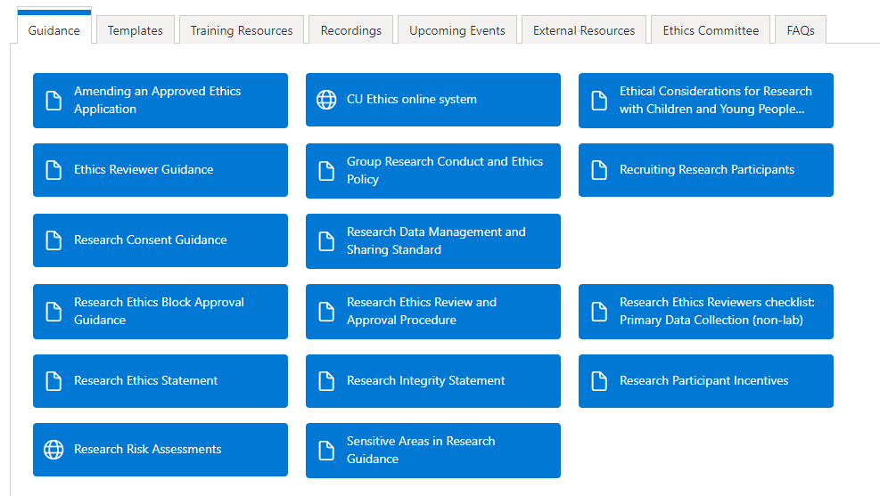
Coventry University Ethical Approval
All research carried out by staff and students at Coventry University requires ethical approval.

Slide 19
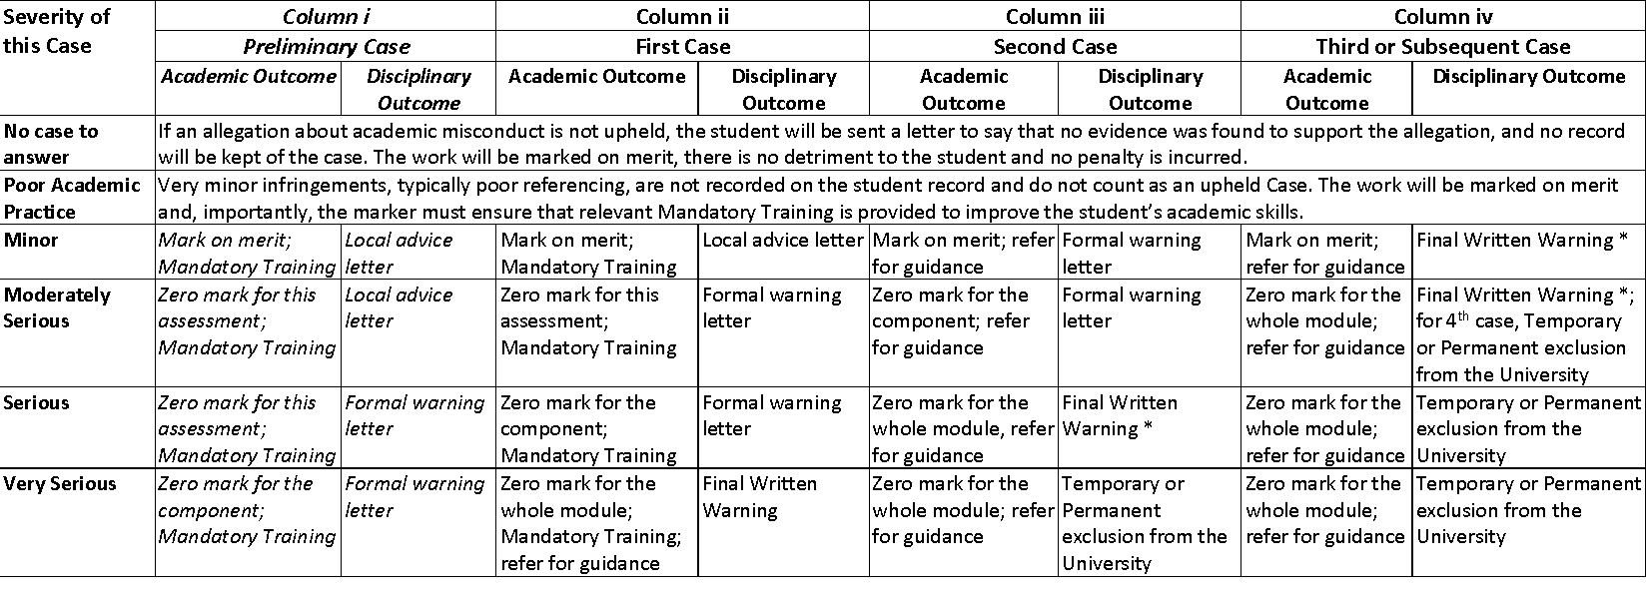
COVENTRY UNIVERSITY: SCALE OF OUTCOMES FOR ACADEMIC INTEGRITY BREACHES WITH EXPLANATORY NOTES FOR STUDENTS
AIU December 2021

Slide 20
Recording upheld cases
Note added to student’s record
Reflected in student references
Impacts on professional registration
More serious outcomes applied for repeat cases
Problem areas identified and addressed
Trends monitored over time – targeted measures applied
(Adapted from Glendinning & Orim, 2023. p.36)

Slide 21
Consequences of students not completing their own work
Student assessments need to be designed:
To be an integral part of student learning and development
For applying learning, knowledge and skills
To evaluate the student’s learning and understanding
To provide constructive feedback on how the student can improve
For praising, encouraging and rewarding excellence
To evidence the student’s achievements
To contribute to the student’s qualification grade
To evaluate the process followed and critical thinking skills, not just knowledge
If students do not complete their own work:
They have not fully benefited from learning and development opportunities
They have not learnt how to apply their learning, knowledge and skills
The evaluation of their learning and understanding is unreliable
Any feedback will miss the target for helping to improve their weaknesses
Any praise and reward for excellence is not deserved and unfair to other students
The student’s achievements are not known as the work is not by them
The student’s qualification grade will not accurately reflect their attainment

Slide 22
Why sanctions are needed (adapted from Glendinning & Orim, 2023, p.35)
Justice
Deterring student malpractice
Identifying & providing missing skills and knowledge
Maintaining fairness and proportionality
Correcting inappropriate conduct
Ensuring student grades reflect genuine learning and achievement
Upholding standards and quality
Punishment

Slide 23
Outcomes: the educational element
Workshops designed to meet student needs
Scheduled on-line workshop or one-to-one meeting
Quiz to test knowledge of academic integrity
Videos by Diane Irving, Stella-Maris Orim, Mary Davis
https://web.microsoftstream.com/channel/6a600163-95f8-47b8-bff0-2e52db2c68e5
(academic Integrity, Referencing, Using Turnitin, Academic conduct offences)
https://www.youtube.com/user/izegbua/videos
(7 videos on Avoiding plagiarism – Turnitin editing and resubmitting etc)
Video for students on Turnitin by Mary Davis, Oxford Brookes

Slide 24
Proof-reading guidance
Limit / check who can proof-read
Proof-readers need to follow the guidance
Students required to keep draft of their work before the proof-reading
Please ask if you’d like a copy

Slide 25
Turnitin
All text-based submissions go through Turnitin
Features on Turnitin, similarity score, red flags
Turnitin Authorship: ~25 License-holders
Supports detection, evidencing of contract cheating
Authorship report
Analyses portfolio of submitted work for one student
Linguistics, metadata, physical properties
Student submissions: docx if possible not pdf
Checklists for contract cheating and misuse of AI tools
Turnitin’s AI – Detector: Currently with limited access, under testing

Slide 26
Working with students on integrity
Students as partners and colleagues
Students as agents for change
Students contributing to policies and guidance
Listening to students’ views and perspectives

Slide 27
Messages to students
The University provides a lot of high quality support services to help you to succeed, please make use of them rather than relying on poor quality and potentially illegal external services
You are here to learn, please make good use of your time with us, it will shape your future life
Plagiarising, colluding with others, resorting to contract cheating (getting someone else to do your assessments for you) and other forms of cheating are very dangerous, for all these reasons:
We now have powerful tools that help us to detect and evidence all forms of academic misconduct – the tools and techniques we use are getting better all the time
Those who know a student has cheated may decide to blackmail them or report it to us right now or at any time in the future
The University has the power to zeroise any modules and rescind degrees, if cheating is discovered either before or at any time after graduation, it is not worth the risk
If you do not complete your own assessments you will have gaps in your learning, knowledge and skills that are likely to be identified by an employer in future, leading to your dismissal
Students found to have breached academic integrity during their studies, may become ineligible to register for professional practise when they graduate
Students facing allegations of academic misconduct may have delays to their progression and perhaps also their graduation
Essay mills do not care about the welfare or education of their student clients and they are known to sell off any personal details they have to the highest bidder

Slide 28
Take home messages
Academic integrity underpins quality and standards
Everyone within HE is responsible for academic integrity
On-going communication and training is essential
Focus on education first
Students as partners
Regular reviews
Academic Quality
Academic Standards
Academic integrity
Notes:
To be honest before I started researching in this area I never really knew there was so much dishonesty, malpractice, fraud and corruption out there, especially in education.
It is easy to think of it as someone else’s problem, but that would be a big mistake.
What do we mean by corruption? A simple definition is Any deliberate act to gain unfair advantage.
What is seen as corruption to one person can be seen as normal behaviour to someone else.

Slide 29
References
Glendinning, I. (2022). Aligning academic quality and standards with academic integrity. In S. E. Eaton, G. Curtis, B. M. Stoesz, K. Rundle, J. Clare, & J. Seeland (Eds.), Contract cheating in higher education: Global perspectives on theory, practice, and policy. Palgrave Macmillan, pp. 199-218. DOI: 10.1007/978-3-031-12680-2
Glendinning, I., Orim, S.M. (2023). Comparison of Institutional Strategies for Academic Integrity in Europe and Eurasia. Bjelobaba, S., Foltýnek, T., Glendinning, I., Králíková, V., Dlabolová, D. (Eds) (2023). Academic Integrity: Broadening Practices, Technologies, and the Role of Students. Springer series: Ethics and Education in Educational Contexts, Volume 4, January 2023, pp 29-46. DOI: 10.1007/978-3-031-16976-2_3 https://doi.org/10.1007/978-3-031-16976-2

