Slide 1
Interpreting Text-Matching SW Similarity Reports
Dita Henek Dlabolová & Tomáš Foltýnek
3rd ENAI Academic Integrity Summer School 2023, 21st – 25th August 2023, Faculty of Electrical Engineering and Computer Science, University of Maribor, Slovenia

Slide 2
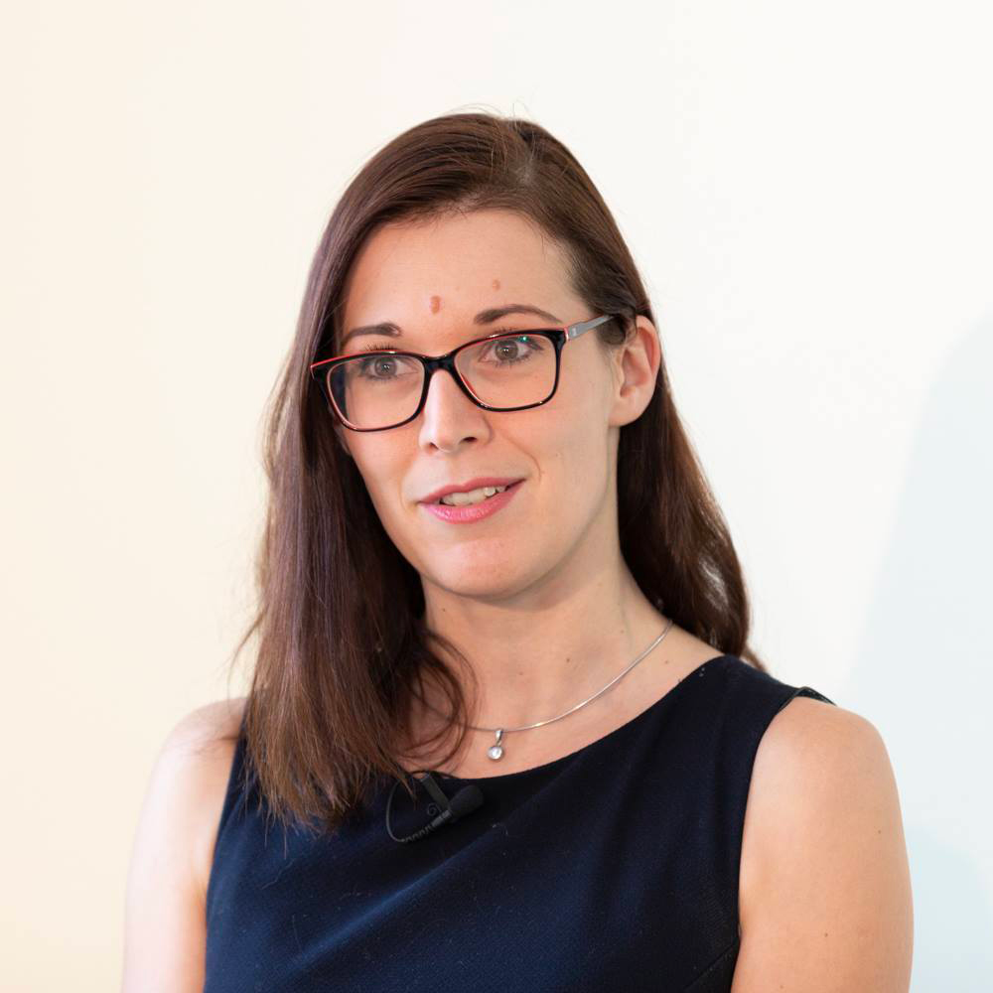
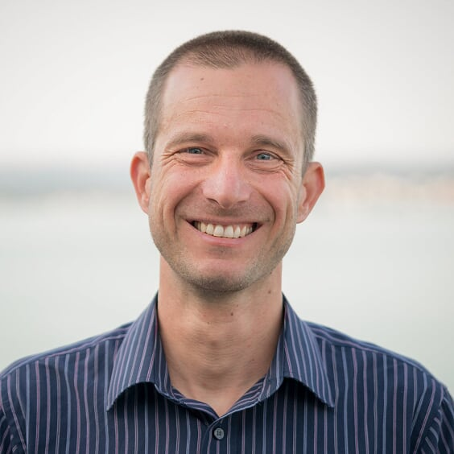
About the Authors
Ing. Dita Henek Dlabolová, Ph.D.
ENAI Executive Director
Mgr. Tomáš Foltýnek, Ph.D.
Assistant Professor, FI MU
President of the ENAI Board

Slide 3
Outline
Definition of plagiarism
Institutional processes dealing with plagiarism
Testing of Support Tools for Plagiarism Detection
Interpreting the reports: Judgement of cases
Prevention of plagiarism
Discussion
Photo: Fatemeh F.

Slide 4
Definition of Plagiarism
What do you understand by plagiarism?
Write down your definition to the Mentimeter
Go to www.menti.com
Enter code: 9812 4737

Slide 5
Definition
What do you understand by plagiarism?
the use of ideas, content, or structures
without appropriately acknowledging the source
to benefit in a setting where originality is expected
Published in: Foltýnek, T., Meuschke, N., & Gipp, B. (2019). Academic Plagiarism Detection: A Systematic Literature Review. ACM Comput. Surv., 52(6), 112:1--112:42. https://doi.org/10.1145/3345317
Based on:
Meuschke, N., & Gipp, B. (2013). State-of-the-art in detecting academic plagiarism. International Journal for Educational Integrity, 9(1): 50-57
Fishman, T. (2009). ‘We Know It When We See It’ Is Not Good Enough: Toward a Standard Definition of Plagiarism That Transcends Theft, Fraud, and Copyright. In Proceedings 4th Asia Pacific Conference on Educational Integrity (4APCEI), 5, 2009.

Slide 6
Plagiarism includes…
Using the work of someone else and presenting it as your own
Presenting translation or paraphrase of another work as original
Using your own previously published work without proper acknowledgement
Failing to correctly cite and reference another source
Not giving due credit for the contribution of someone else to your work

Slide 7
What is NOT plagiarism
You don’t have to provide the source of
General knowledge
General knowledge of your field
Someone else’s contribution not influencing content
Proofreading
Typographic corrections
Formatting

Slide 8
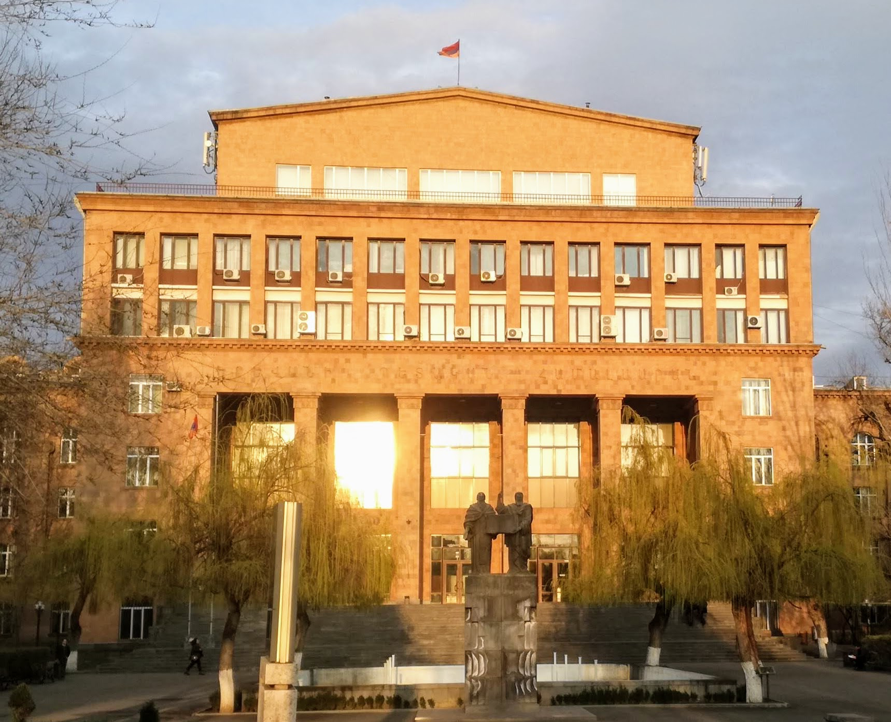
Practice at Your University?
What text-matching system your institution use?
What happens if a teacher finds plagiarism in a student’s assignment?
Answer in Mentimeter

Slide 9
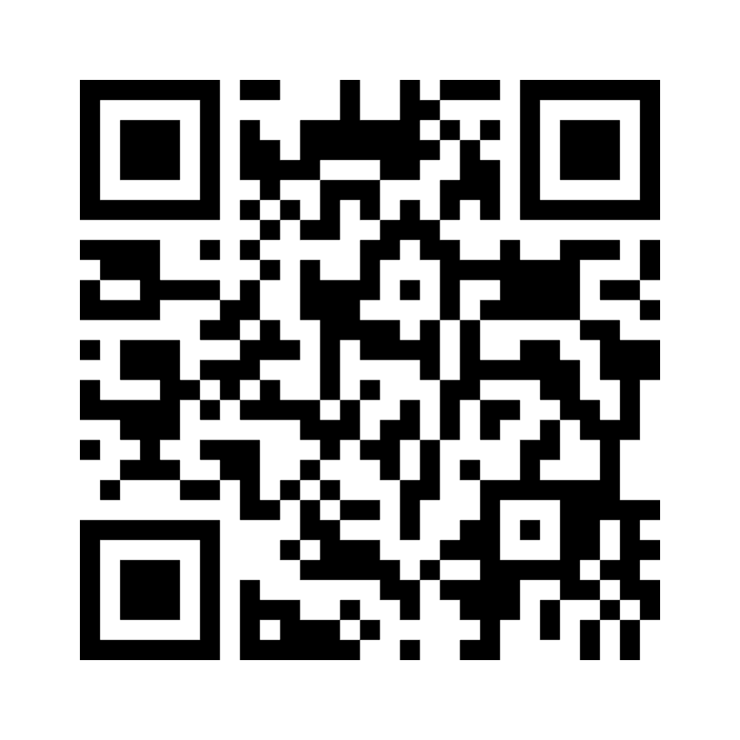
Practice at your University
Go to
www.menti.com
Enter code
7791 3005

Slide 10
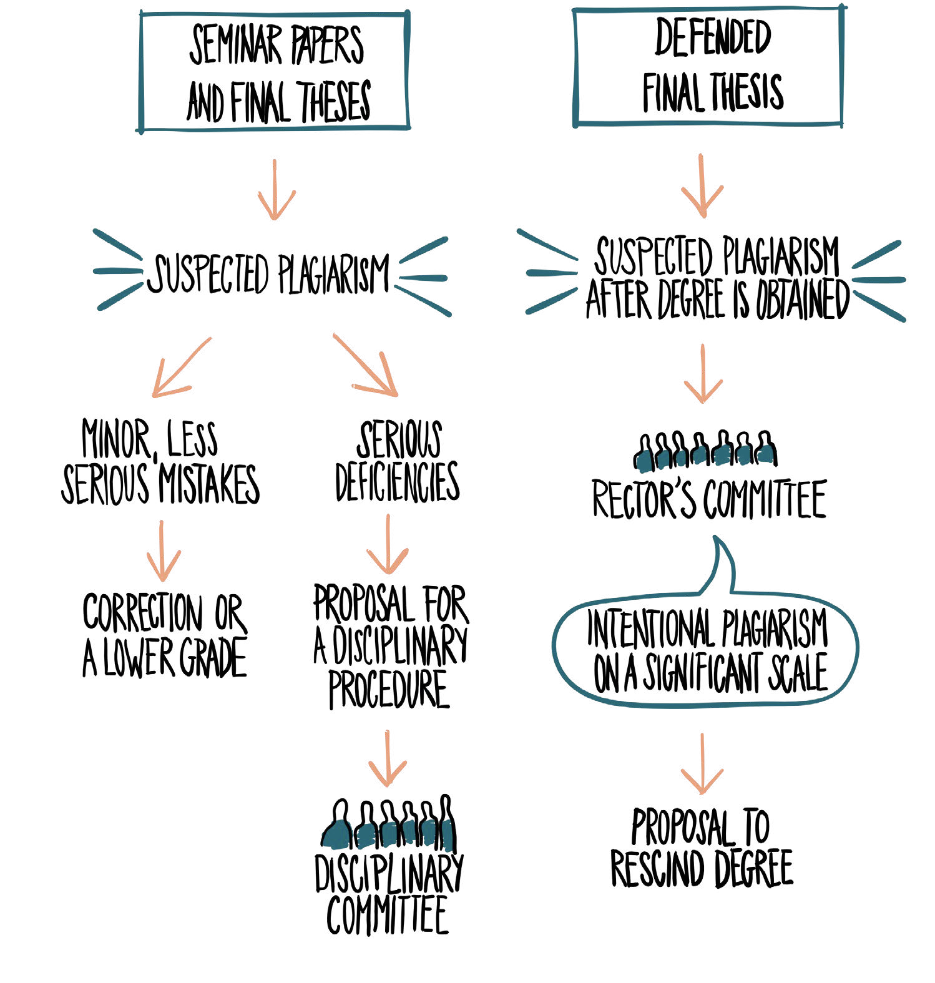

Slide 11
Summary of the process
Consider: Intent, extent
Possible outcomes:
Explanation, warning, lower grade, resubmit, fail the course/module
Official warning, suspension, (conditional) expulsion
Should be clearly defined in a policy

Slide 12
Testing of Support Tools for Plagiarism Detection

Slide 13
Testing of Support Tools for Plagiarism Detection
The largest text-matching tools test ever
Documents in 8 languages
15 systems tested
Foltýnek, T. et al. Testing of support tools for plagiarism detection. International Journal of Educational Technology in Higher Education 17, 46 (2020). https://doi.org/10.1186/s41239-020-00192-4
Acknowledgement: Debora Weber Wulff contributed to the slides in this part

Slide 14
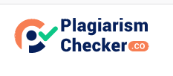
Vendors

Slide 15
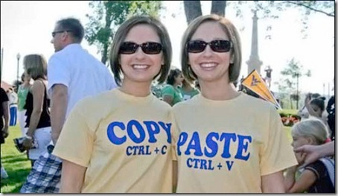
Testing Documents
Eight European languages: EN, DE, ES, TR, IT, CZ, SK, LV
File formats: PDF, DOCX, TXT
Various plagiarism types
Copy-paste
Synonym replacement
Paraphrase
Translation
Various types of sources:
Wikipedia
Open access journal papers
Student theses publicly available from a university webpage
Single-source / Multi-source
Used by permission,Charles Robinson, 2008, http://charles.robinsontwins.org/photos/2008/twinsdays/content/IMGP1792_large.html

Slide 16
Coverage Evaluation
Percentages presented by the systems do not convey much information
Some systems presented different values for the same document
Evaluation based on the amount of detected plagiarism
5: All
4: Major portion
3: More than half
2: Half or less
1: Minor portion
0: None
Two people independently examined each report
Interpretation of criteria discussed within whole team
% ?

Slide 17
Coverage Evaluation: Wikipedia
Scale: 0 (lowest) to 5 (highest)

Slide 18
Coverage Evaluation: Type of Source
Scale: 0 (lowest) to 5 (highest)

Slide 19
Coverage Evaluation: Plagiarism Method
Scale: 0 (lowest) to 5 (highest)

Slide 20
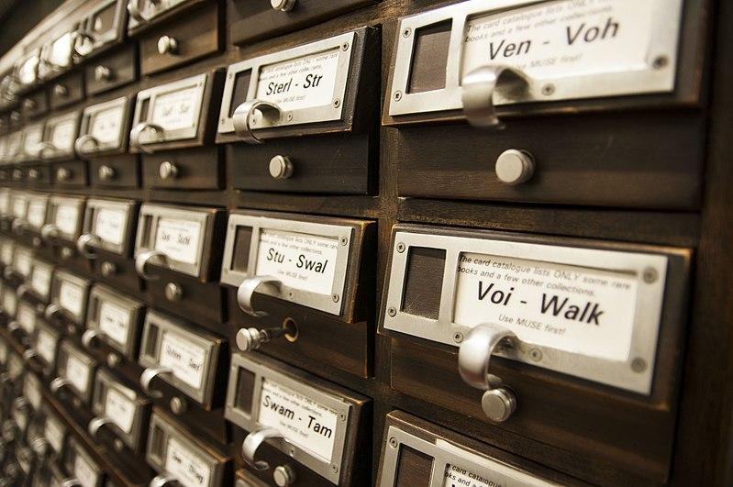
Coverage Evaluation: General Notes
Almost all systems are able to identify Wikipedia
Some of the systems only in some languages
None of the systems perform semantic analysis
Cannot reliably identify paraphrase or translation plagiarism
Except Academia, but its database is very limited
The systems vary in indexing
Open Access journal papers
Other internet sources
Elena Tatiana Chis, CC BY-SA 4.0, via Wikimedia Commons

Slide 21
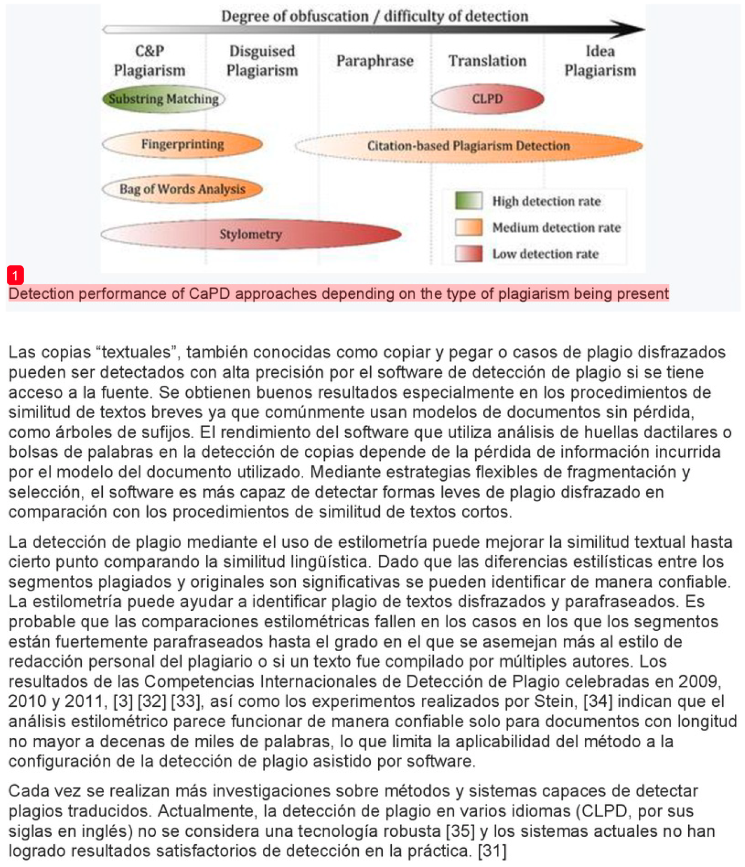
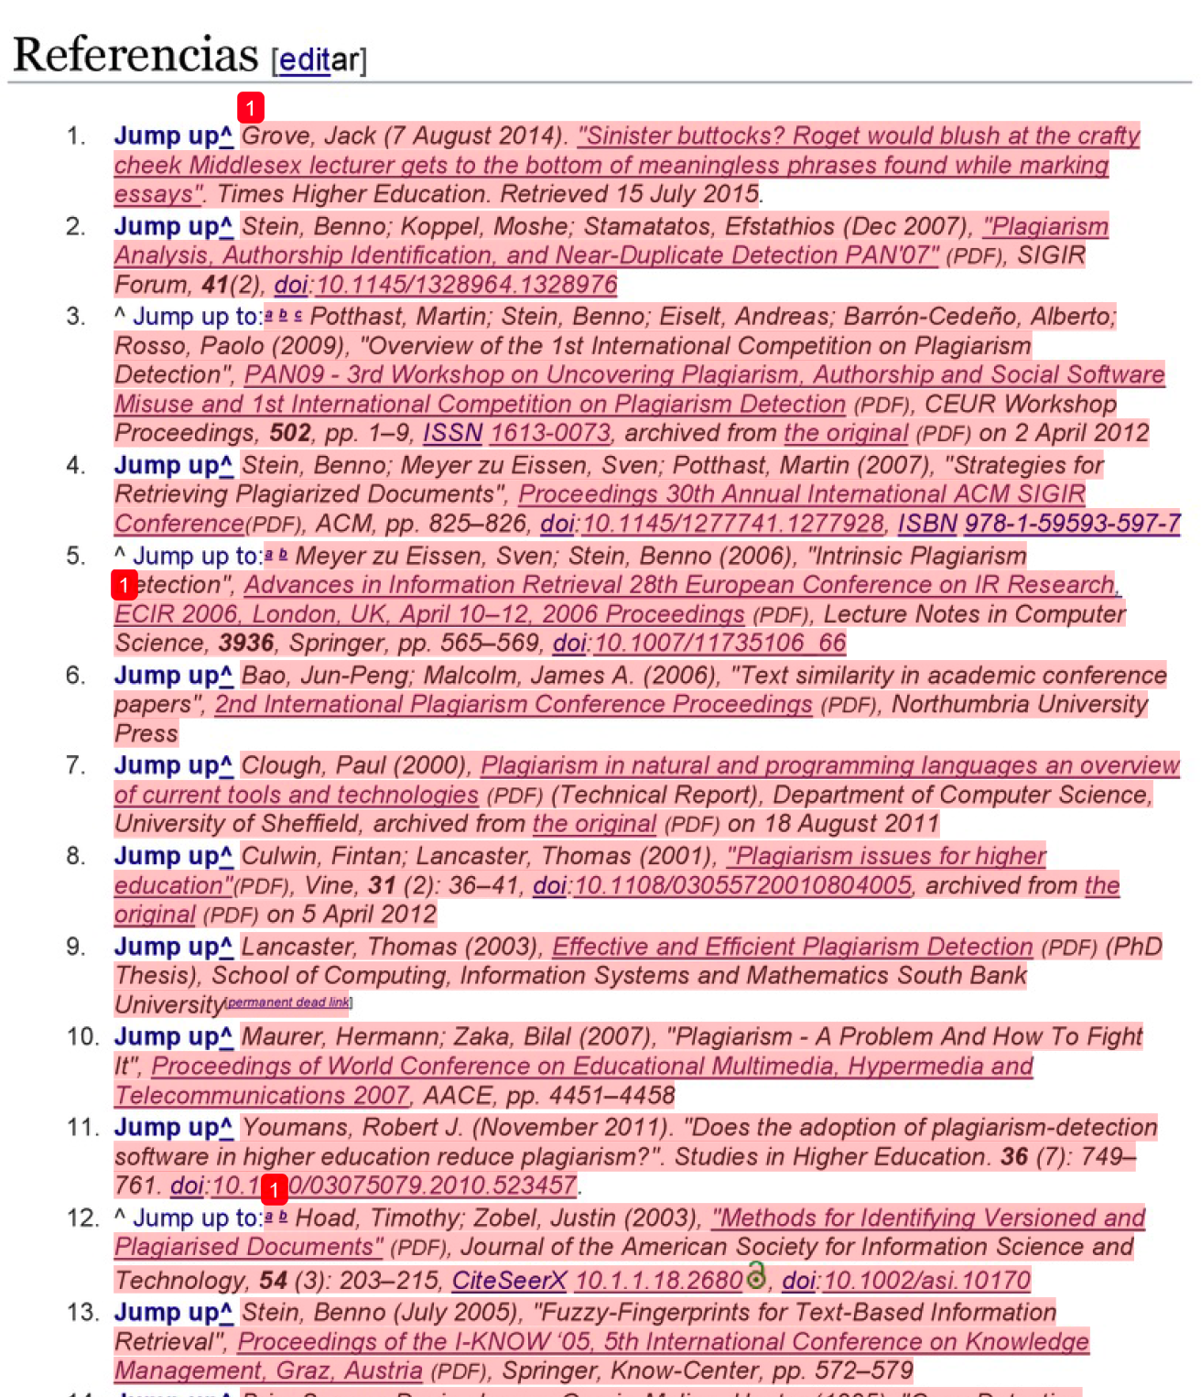
Translation plagiarism
Text match
Accidental strings
(Image captions)
List of references
Very reliable
Similar languages
E.g. Czech – Slovak
Higher text match

Slide 22
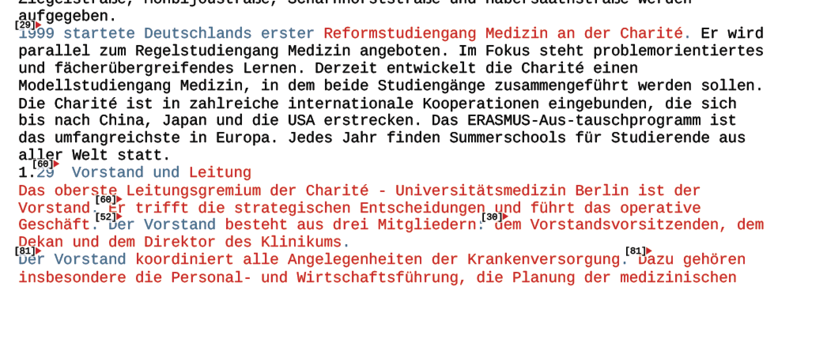
Usability Evaluation
23 objective criteria divided into three groups
Workflow process
Using the system
Presentation of results
Understandability of reports
Other usability aspects
PlagScan Report

Slide 23
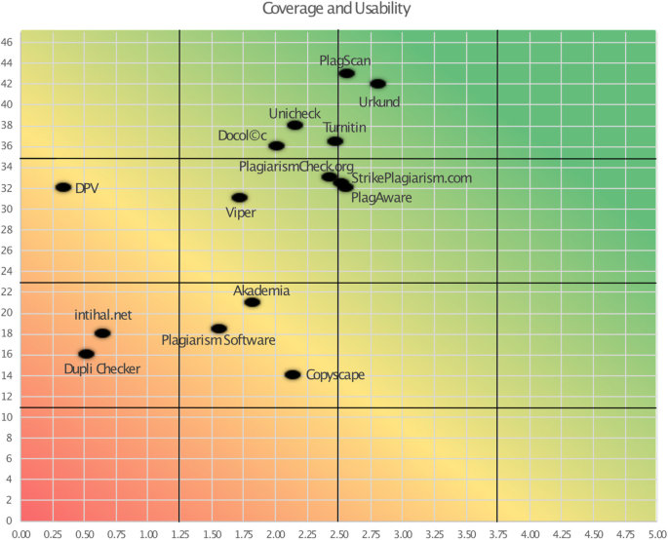
Coverage & Usability
→ Ouriginal
X-Axis: Coverage
Total score (average)
Y-Axis: Usability
Total weighted score
= Turnitin

Slide 24
Point for Educators
Text overlap ≠ plagiarism
“Plagiarism detection tool” does not exist
Translation plagiarism can be found by matches in references
Beware of the “Terms and Conditions”
Some systems may sell your documents
Beware of legal restrictions: GDPR, students’ consent,…
Focus on preventative strategies, not only on detection

Slide 25
Percentages are tricky!
Diploma thesis, Czechia
Overall similarity: 24%
Student copied whole thesis, but paraphrased the text
Percentage corresponds to text-matching only
Student assignment, Australia
Overall similarity: 8%
Whole abstract highlighted and linked to an essay mill
Rest of the essay behind the pay-wall
Diploma thesis, Georgia
Overall similarity: 7%
Whole list of references
Rest of the thesis translated from Russian to Georgian
Bachelor thesis, Czechia
Overall similarity: 89%
Source: Previous version of the same thesis
%

Slide 26
Interpreting Similarity Reports

Slide 27
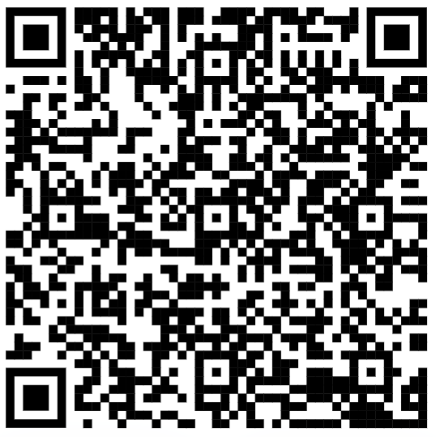
Practical Examples: Text-matching system reports
A warm-up example
Two reports: Is it plagiarism, or not?
The reports are not from a specific tool
Artificial report
Similar to Turnitin/PlagScan/…
Links to sources are real
The text was created just for the purpose of the workshop
Focus on the work with sources

Slide 28
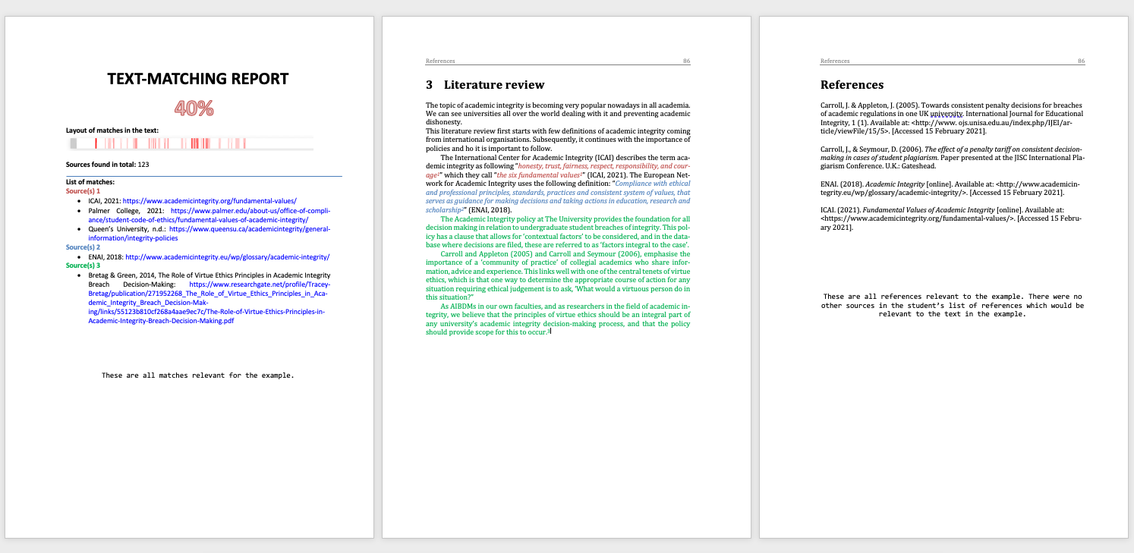
Report 0

Slide 29
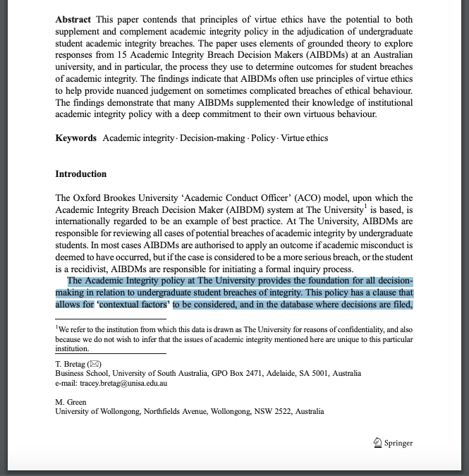
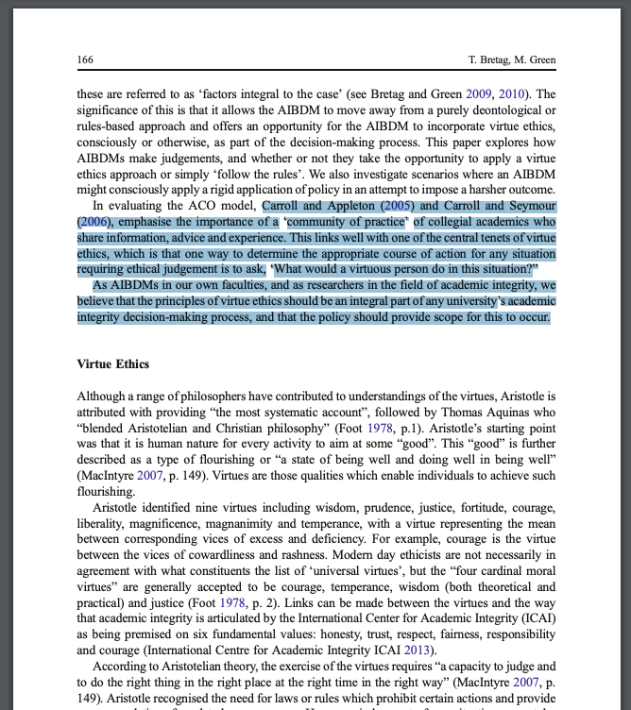
Report 0 – not referenced source

Slide 30
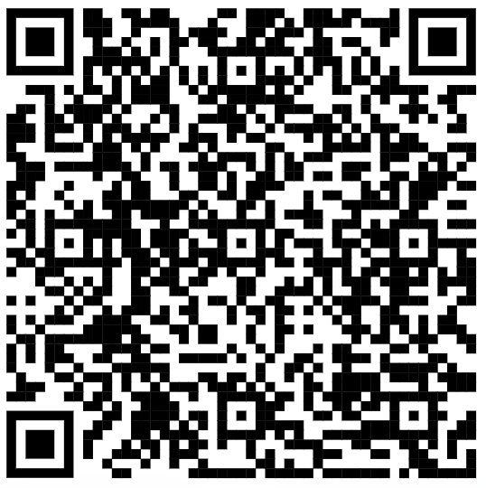
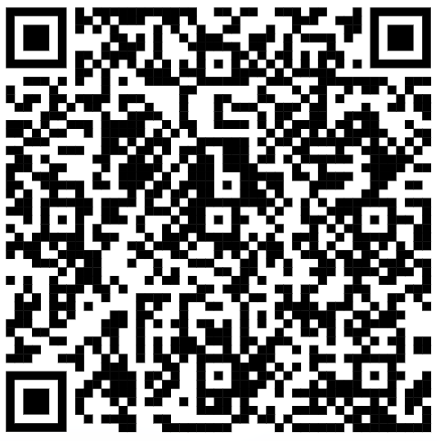
Is it plagiarism, or not? That’s a question!
Reports 1 and 2
Two bachelor theses – the same text match: 19.4%
Examine carefully both reports + sources referenced
Suppose students passed a course on academic writing
Voting in Mentimeter
Plagiarism → Report the case / initiate the disciplinary procedure

Slide 31
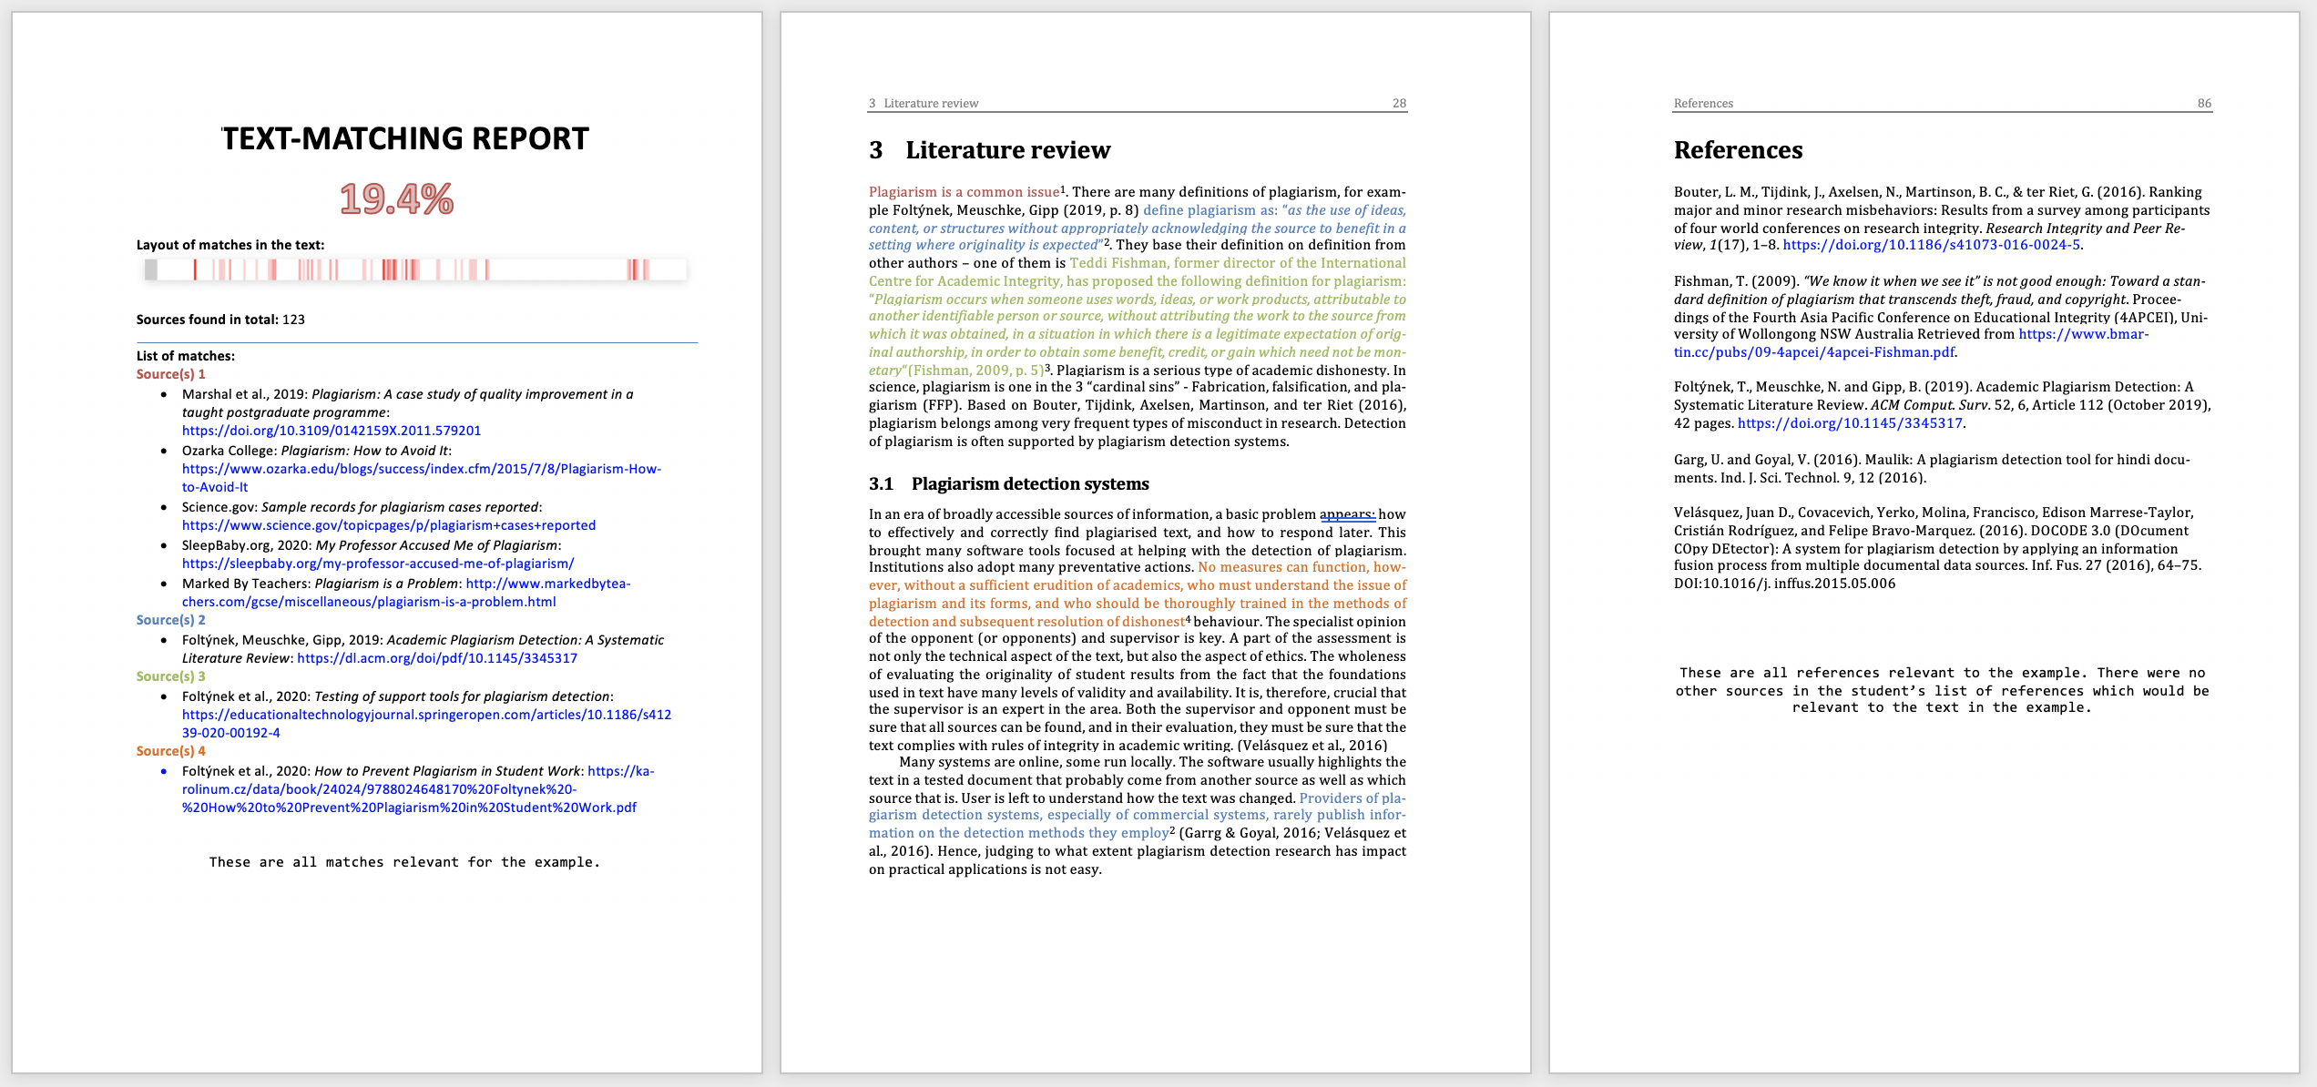
Report 1

Slide 32
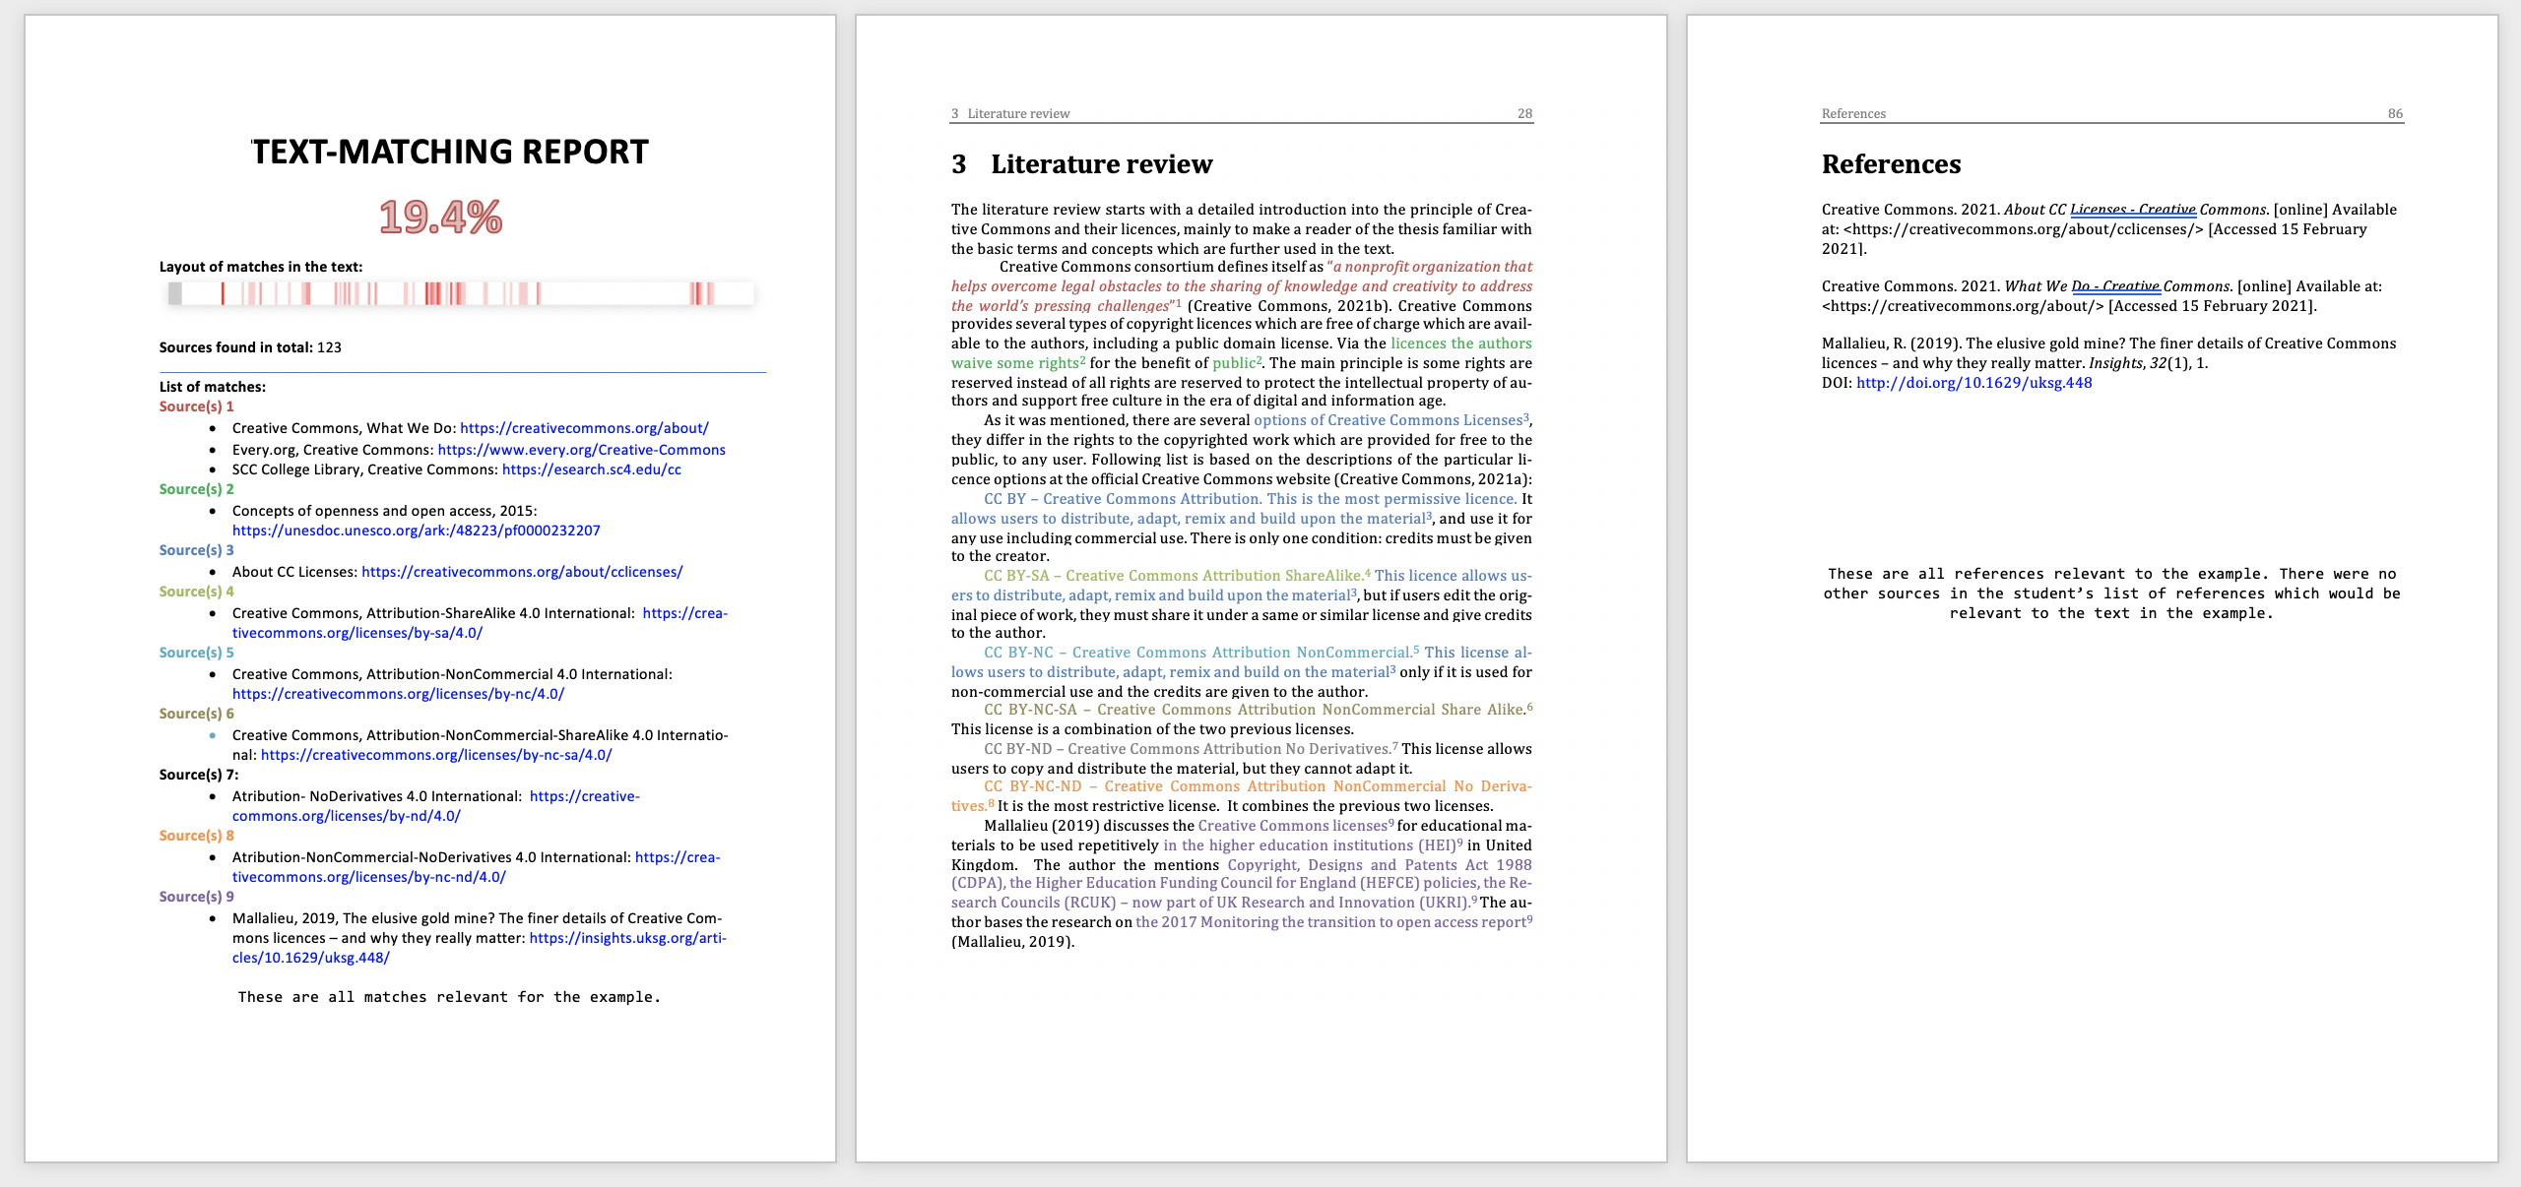
Report 2

Slide 33
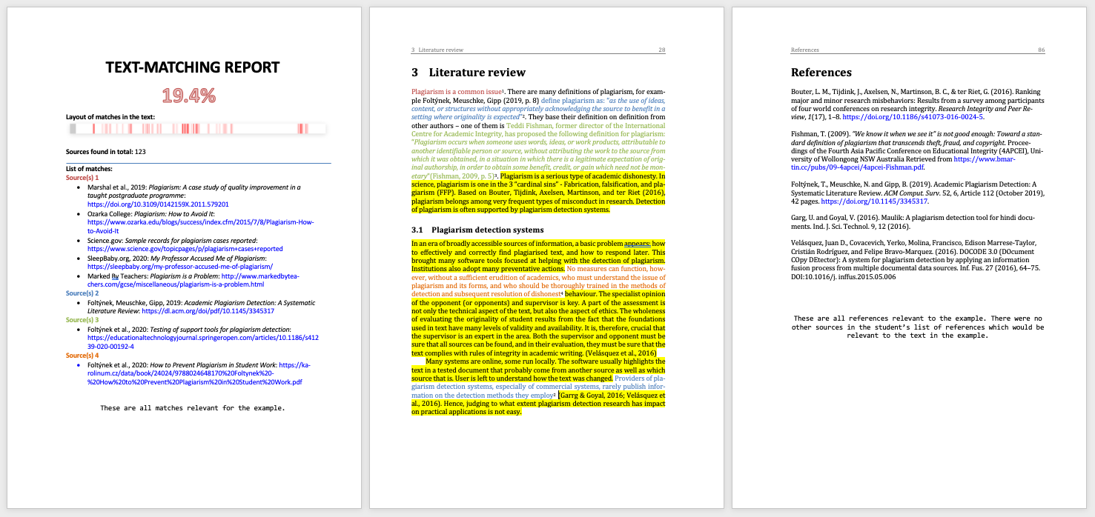
Report 1: Plagiarism

Slide 34
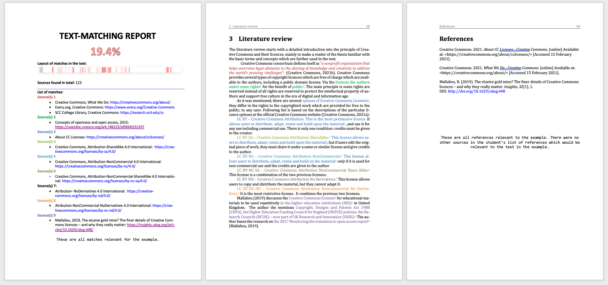
Report 2: “Random” matches in longer phrases

Slide 35
What the Systems Are Useful for
Find text match from easily accessible sources
E.g. sources accessible for students who run out of time
Check for accidental plagiarism
Even low percentage can indicate a source of plagiarism
Synonym replacement, paraphrase, translation

Slide 36
Drawbacks of the Systems
They don’t index everything
Look for oddities in the text
Weird formatting, numbers in the text
Use Google
It is easy to fool the systems
Manual paraphrasing
Translation
Automatic paraphrasing of short passages
Technical disguise

Slide 37
Plagiarism Detection System?
Nothing like this exists
Systems find text match, not plagiarism
Two presumptions
The source document is their database
The text overlap is beyond a threshold

Slide 38
Prevention of Plagiarism

Slide 39
Why do students plagiarize?
Teachers
Students
P
O
It’s easy to cut and paste
They don’t think plagiarism is wrong
Lecturer will not care
Run out of time
Unable to cope with the workload
Their own work is not good enough
P
R
R
R
Data from the IPPHEAE project (2013; N students = 3980; N teachers = 702; 27 EU countries)

Slide 40
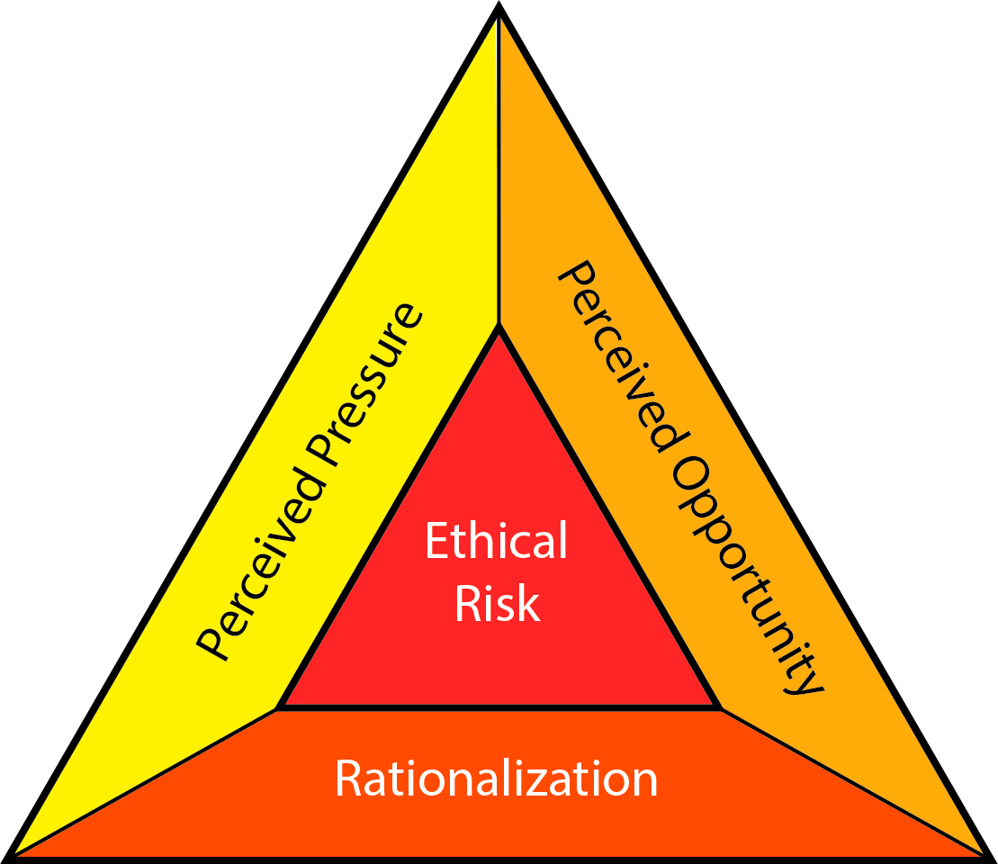
Causes: The Fraud Triangle
Pressure / Motive
Need to pass a course
Need to get a degree
Opportunity
Weak detection
Rationalization
Everybody is doing it
Risk-benefit assessment
DavidBailey [CC BY-SA 4.0]

Slide 41
How Can We Prevent Plagiarism?
Write down your ideas to the Mentimeter

Slide 42
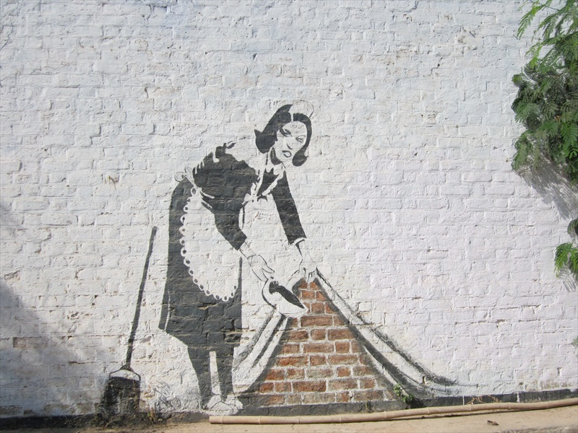
Don’t sweep plagiarism under the carpet!
Image by Banksy Photo byAbhishek.ujoshi (Own work) [CC BY-SA 3.0 (http://creativecommons.org/licenses/by-sa/3.0)], via Wikimedia Commons

Slide 43
Prevention
Lower the Opportunity
Deterrence strategies
SW, cameras, invigilance
Lower the Pressure
Emphasize intrinsic motivation
Treat students as partners
Extend deadlines,…
Lower the Rationalization
Everybody 🡪 Nobody is doing it
Build the Culture of Academic Integrity
DavidBailey [CC BY-SA 4.0]

Slide 44
Prevention: Systemic Effort Works
Curtis & Vardanega, 2016
Owens & White, 2013
10-years study (2004-2014)
New course Academic writing
Started using Turnitin
Introduced criterion and standards-based assessment
Implemented educational changes
All forms of plagiarism DECREASED
except recycling and ghostwriting
5-years study (2007-2011)
PD SW as both deterrent and formative tool
Educational about academic writing and authorship
Self-reported plagiarism DROPPED significantly
Nature of assessment has a central role
Curtis, G. J., & Vardanega, L. (2016). Is plagiarism changing over time? A 10-year time-lag study with three points of measurement. Higher Education Research & Development, 35(6), 1167–1179. https://doi.org/10.1080/07294360.2016.1161602
Owens, C., & White, F. A. (2013). A 5‐year systematic strategy to reduce plagiarism among first‐year psychology university students. Australian Journal of Psychology, 65(1), 14–21. https://doi.org/10.1111/ajpy.12005

Slide 45
General Findings
One-fits-all strategy ineffective
Multilayered, evidence-based, longitudinal strategy works
Lot of effort (and funding!) is needed
Central role of assessment
Address both educational approaches…
to motivate students (remove pressure)
…and deterrence strategies
to prevent and detect misconduct (remove opportunity)
students who cheat tend to cheat repeatedly
Research for gathering evidence and impact evaluation

Slide 46
Culture of Academic Integrity
Academic Integrity = ?
Not cheating
Not plagiarism
Not fabrication, falsification,…
Academic Integrity = Compliance with
ethical and professional principles, standards and practices
by individual or institutions
in education, research and scholarship.
Culture of Academic Integrity = The individual, group and/or institutional
behaviors, values, beliefs, attitudes and characteristics
promoting and following academic integrity.
ENAI Glossary for Academic Integrity

Slide 47
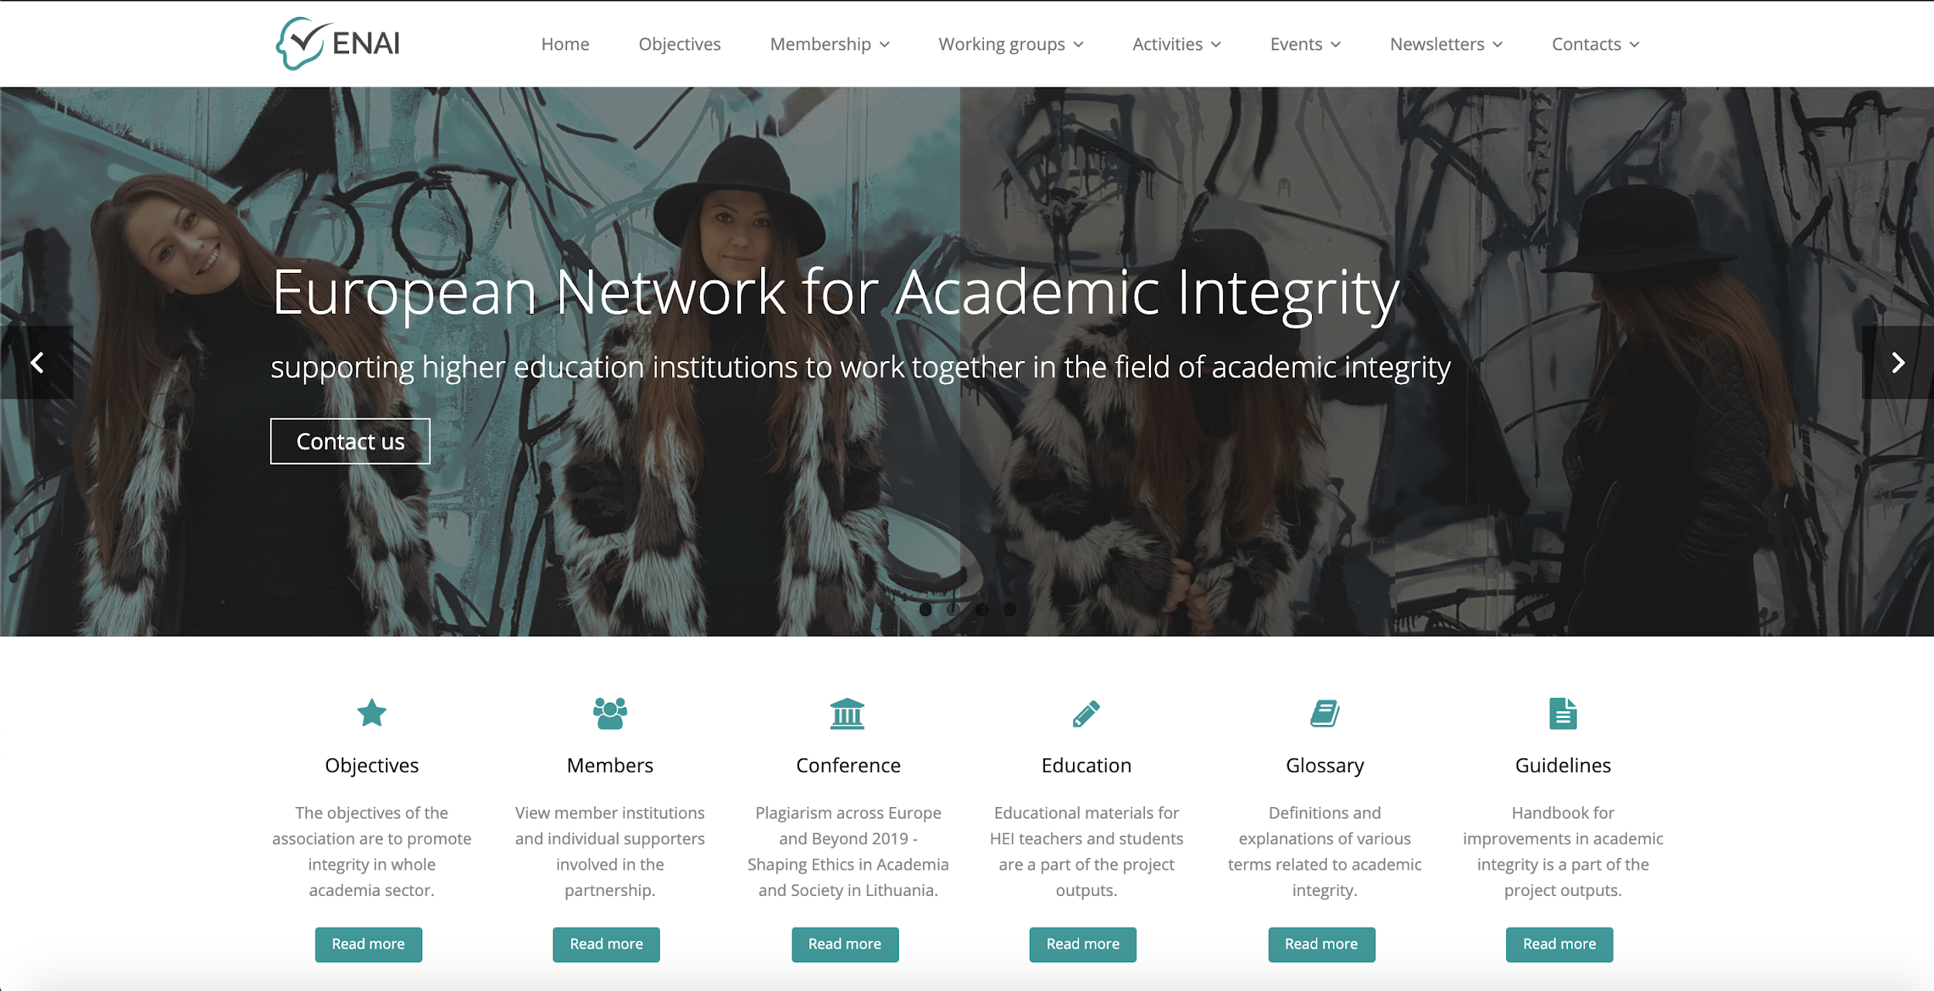
ENAI Resources
Collection of educational materials
Glossary for Academic Integrity
General guidelines for academic integrity
Self-evaluation tools for
students
teachers
researchers
institutions/management
Available from ENAI web page
Announced in the ENAI Newsletter
http://www.academicintegrity.eu/

Slide 48
Sources & Further Reading
Curtis, G. J., & Vardanega, L. (2016). Is plagiarism changing over time? A 10-year time-lag study with three points of measurement. Higher Education Research & Development, 35(6), 1167–1179. https://doi.org/10.1080/07294360.2016.1161602
Foltýnek, T., Dlabolová, D., Anohina-Naumeca, A., Razı, S., Kravjar, J., Kamzola, L., … Weber-Wulff, D. (2020). Testing of support tools for plagiarism detection. International Journal of Educational Technology in Higher Education, 17(1), 46. https://doi.org/10.1186/s41239-020-00192-4
Foltýnek, T., Meuschke, N., & Gipp, B. (2019). Academic Plagiarism Detection: A Systematic Literature Review. ACM Comput. Surv., 52(6), 112:1--112:42. https://doi.org/10.1145/3345317
Impact of Policies for Plagiarism in Higher Education across Europe (IPPHEAE) – projekt LLP/Erasmus, 2010—2013: www.plagiarism.cz/ippheae
Owens, C., & White, F. A. (2013). A 5‐year systematic strategy to reduce plagiarism among first‐year psychology university students. Australian Journal of Psychology, 65(1), 14–21. https://doi.org/10.1111/ajpy.12005
Meuschke, N., & Gipp, B. (2013). State-of-the-art in detecting academic plagiarism. International Journal for Educational Integrity, 9(1): 50-57
Fishman, T. (2009). ‘We Know It When We See It’ Is Not Good Enough: Toward a Standard Definition of Plagiarism That Transcends Theft, Fraud, and Copyright. In Proceedings 4th Asia Pacific Conference on Educational Integrity (4APCEI), 5, 2009.
South East European Project on Policies for Academic Integrity (SEEPPAI) – 2016—2017: www.plagiarism.cz/seeppai

Slide 49
Contacts
dita.dlabolova@academicintegrity.eu
tomas.foltynek@academicintegrity.eu
www.academicintegrity.eu
www.plagiarism.cz

Slide 50
License Information
Title of the work: Interpreting text-matching software similarity reports
Attribute work to names: Henek Dlabolová, D. & Foltýnek, T.,
Licensed under: Creative Commons Attribution-ShareAlike 4.0 International License
Attribute using following text:
Interpreting text-matching software similarity reports by Henek Dlabolová, D. & Foltýnek, T., is licensed under a Creative Commons Attribution-ShareAlike 4.0 International License.

