Slide 1


Data managament life cycle, handling sensitive data in relation to academic integrity
Milan Ojsteršek
University of Maribor
Faculty of Electrical Engineering and Computer Science
Koroška cesta 46, 2000 Maribor, Slovenia
milan.ojstersek@um.si
3rd ENAI Academic Integrity Summer School 2023, 21st – 25th August 2023, Faculty of Electrical Engineering and Computer Science, University of Maribor, Slovenia

Slide 2

Learning objectives
Openscience
FAIR Open data
Open data management
Licensing of open data
Ethics issues
Slovenian Open access infrastructure

Slide 3
Openscience
Michel Nielsen said „Open Science is the idea that scientific knowledge of all kinds should be openly shared as early as is practical in the Discovery process”. Scientific Knowledge of all kinds: journal articles, data, code, online software tools, questions, ideas, speculations, failures, …and anything which can be considered knowledge. ”
Open access to scientific publications
Open Data
Open Software
Open services and workflows
Open Research Infrastructure
Open peer review
Open Learning Materials
Open Research Methods
Open Lab Notes
Citizen Science
Reproducibility of research
Foster: What is Open Science? Introduction. Available at https://www.fosteropenscience.eu/content/what-open-science-introduction

Slide 4
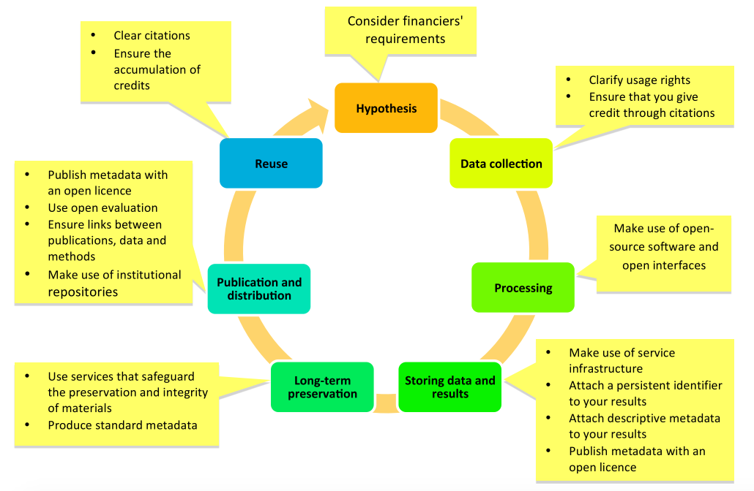
Promoting openness at different stages of the research process
Foster: Open Science and Research Initiative (2014). Open Science and Research Handbook. [English version]. Available at https://www.fosteropenscience.eu/sites/default/files/pdf/3986.pdf

Slide 5
Open Reproducible Research
Open Reproducible Research is based on:
Irreproducibility Studies: The act during which the results of a study or an experiment can be replicated and reproduced.
Open Lab/Notebooks: Laboratory research records, diaries, journals, workbooks etc. offered online free of cost with terms that allow reuse and redistribution of the recorded material.
Open Science Workflows: A sequence of processes scientists make to administer and disseminate convoluted scientific examinations offered online and free of cost allowing the reuse of the material.
Open Source in Open Science: Software where the source code is available free of cost with terms that allow dissemination and adaptation.
Reproducibility Guidelines: Ground rules to assist with the recreation of research experiments and studies.
Reproducibility Testing refers to the process of validating that the reported research results can be obtained in an independent experiment

Slide 6
Open Science Tools
Refers to the tools that can assist in the process of delivering and building on Open Science.
Tools are:
Open archives that host scientific literature, data, software and other research objectcts and make their content freely accessible to everyone in the world.
Open services offered by organisations and institutions which is possible to use free of cost.
Open Workflow Tools (apparatuses and services ) that promote open scientific projects.

Slide 7
Open Data
A piece of data or content is open if anyone is free to use, reuse, and redistribute it — subject only, at most, to the requirement to attribute and/or share-alike” -- opendefinition.org
This means, according to the Open Knowledge Foundation:
Availability and Access: the data must be available as a whole and at no more than a reasonable reproduction cost, preferably by downloading over the internet. The data must also be available in a convenient and modifiable form.
Reuse and Redistribution: the data must be provided under terms that permit reuse and redistribution including the intermixing with other datasets.
Universal Participation: everyone must be able to use, reuse and redistribute - there should be no discrimination against fields of endeavour or against persons or groups. For example, ‘non-commercial’ restrictions that would prevent ‘commercial’ use, or restrictions of use for certain purposes (e.g. only in education), are not allowed
Open knowledge fundation: What is open? https://okfn.org/en/library/what-is-open/

Slide 8
Research Data
Types of data:
Raw / Cleaned or Filtered
Field data
Experimental data
Derived data
Qualitative / Quantitaive
Structured / Semi-structured/ Unstructured
Tabular/ Hierarhical / Graphs
Open access / Restricted access
Linked data
Metadata
Big data
Data sources:
Devices
Instruments
Sensors
Software
People
Observations
Experiments
Simultations
Emulations
Surveys
Interviews
Text analysis
Text mining
Data types:
Numeric (tables, measurement results, counters, sensor data, etc.).
Textual (books, notes, surveys...).
Audio visual data (images, sound recordings, video, animation).
Spatial.
Specific to the scientific discipline.
Specific to the measuring instrument or device.

Slide 9
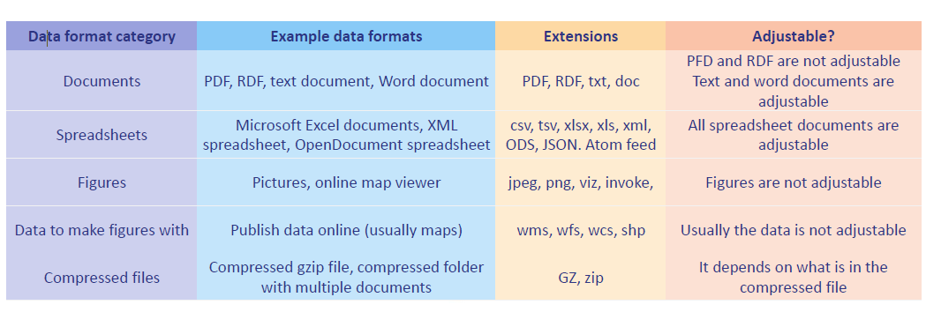
Categorization of the file formats of research data
Multipurpose Internet Mail Extensions (MIME type) standard RFC 6838 - https://www.iana.org/assignments/media-types/media-types.xhtml
Scientific data formats - http://justsolve.archiveteam.org/index.php/Scientific_Data_formats

Slide 10
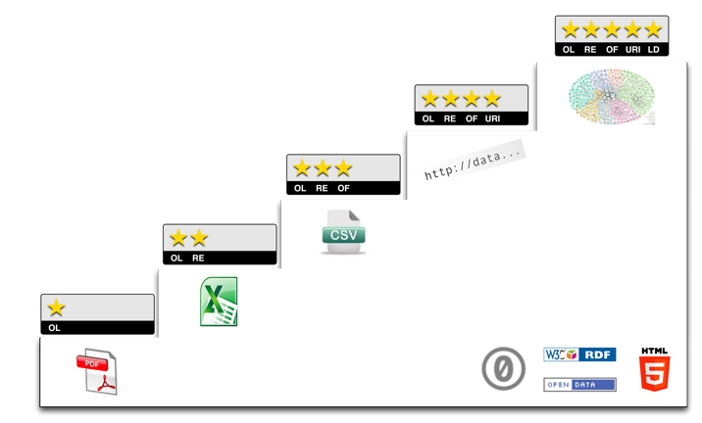
5 Star Open Data
Source: http://5stardata.info/

Slide 11
Problems with academic integrity regarding data publication
Falsification (fitting data to a hypothesis).
Fabrication (generating data without actual measurements). Examples: Rajvir Dahiya, George Laliotis, Ming He
Amputation (elimination of inappropriate or outlier data, which not fitting to a hypothesis ).
Imputation (adding data in place of missing data)
See more on Retraction watch database

Slide 12

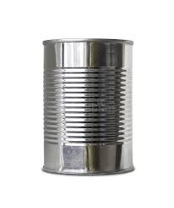

What's in the can?

Slide 13
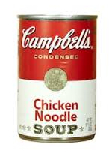
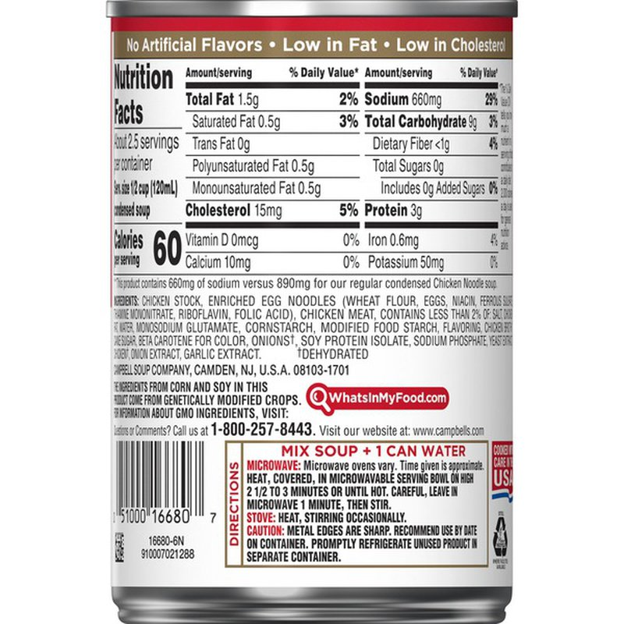
Now you know!

Slide 14
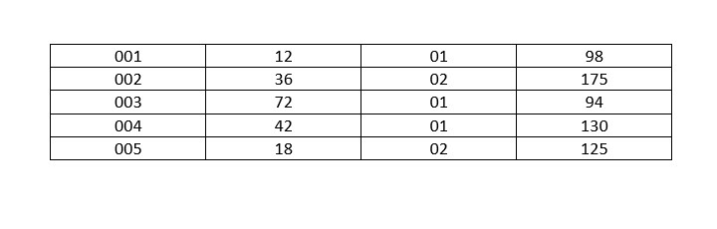
What these numbers mean?

Slide 15
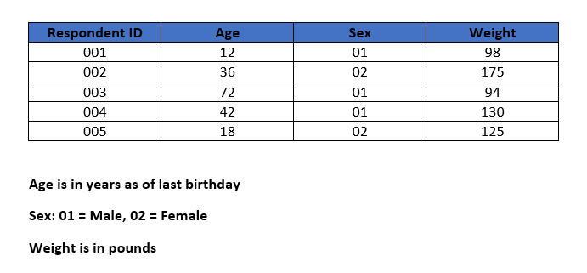
Now you know!
Metadata

Slide 16
Important sources for metadata
RDA Guidelines for publishing structured metadata on the Web
DCC list of metadata standards: https://www.dcc.ac.uk/guidance/standards/metadata/list
RDA metadata standards catalog: http://rd-alliance.github.io/metadata-directory/standards/
Fairsharing: https://fairsharing.org/
DCMI Metadata Terms: https://dublincore.org/specifications/dublin-core/dcmi-terms/
DataCite Metadata Schema 4.3: https://schema.datacite.org/meta/kernel-4.3/
DCAT 3.0: https://www.w3.org/TR/2021/WD-vocab-dcat-3-20210504/
DCAT Application profile for data portals in Europe 2.0.1: https://joinup.ec.europa.eu/collection/semantic-interoperability-community-semic/solution/dcat-application-profile-data-portals-europe
GeoDCAT-AP 1.0.1 https://joinup.ec.europa.eu/solution/geodcat-application-profile-data-portals-europe/distribution/geodcat-ap-101-docx
StatDCAT- AP 1.0.1: https://joinup.ec.europa.eu/collection/semantic-interoperability-community-semic/solution/statdcat-application-profile-data-portals-europe/release/101
DDI Codebook 2.5: https://ddialliance.org/Specification/DDI-Codebook/2.5/XMLSchema/field_level_documentation.html
Bioschemas: https://bioschemas.org/

Slide 17
Research data lifecycle
Planning and searching for data sources.
Collecting and creating.
Processing and analysis.
Publishing and sharing.
Digital preservation.
Re-use of data and other research results.

Slide 18
Planning and searching for data sources
What will we research?
What research data will we collect or generate?
How will the research data be collected or generated?
  Methods of collection, data quality, IPR of re-used data.
Preparation of relevant documents:
  Data management plan.
  Preparation of informed consent form.
  Application for ethical approval of the research study.

Slide 19
What the research data management plan should contain?
Project basic metadata and description.
What research data will you collect or generate?
How will the research data be collected or generated?
What documentation will adequately describe your research data?
Choice of metadata and data standard.
How will you address ethical issues?
How will you deal with copyright and intellectual property rights (IP/IPR) issues?
How will research data be stored and backed up during the research?
How will you manage access and ensure the security of research data?

Slide 20
What the research data management plan should contain - continued?
What research data has long-term value and should be stored, shared and/or preserved?
Choosing an appropriate repository or data archive.
How will you share the research data?
Are there any restrictions on sharing research data?
Who will be responsible for handling the research data?
What resources will you need to implement your plan?
How will potential users find your research data?
How to make research data openly available?
How to make your research data interoperable?
How to ensure reuse of research data.

Slide 21
Sharing sensitive data
Sensitive data that contain potentially identifying information -- whether it be human subject data or other types of sensitive data -- will likely need to be modified prior to sharing these data with the public. It is important that these modifications are made in order to protect participant confidentiality, the location of endangered wildlife, or for other relevant reasons. However, these modifications may affect the data to the point where reproducibility or additional subsequent research by others is no loner possible.
You might consider retaining multiple versions of the data: one that is suitable for public release, and one that is suitable for further research but that is available on a highly restricted basis.

Slide 22
Types of identifying information
Direct identifiers: These data point directly to an individual and are typically removed from data sets before sharing with the public. These may include:name, initials, mailing address, phone number, email address, unique identifying numbers, like Social Security numbers or driver's license numbers, vehicle identifiers, medical device identifiers, web or IP addresses, biometric data, photographs of the person, audio recordings, names of relatives, dates specific to individual, like date of birth, marriage, etc.
Indirect identifiers: These may seem harmless on their own, but can point to an individual when combined with other data. It has been recommended that datasets containing three or more indirect identifiers should be reviewed by an independent researcher or ethics committee to evaluate identification risk. Any indirect information not needed for the analysis should be removed. It may be reasonable to supply some of these types of data in aggregated form (like ranges of annual incomes instead of exact numbers). Indirect identifiers may include: place of medical treatment or doctor's name, gender, rare disease or treatment, sensitive data like illicit drug use or other "risky behaviors„, place of birth, socioeconomic data, like workplace, occupation, annual income, education, etc, general geographic indicators, like postal code of residence, household and family composition, ethnicity. birth year or age, verbatim responses or transcripts

Slide 23
Techniques for data desensitization
Data Masking: This technique involves hiding sensitive data by replacing it with non-sensitive information, such as a random string of characters. This can be done for specific fields or for an entire dataset. For example, credit card numbers can be masked by showing only the last four digits.
Access Control: Access control involves limiting who can view or access sensitive data. This can be done through user authentication, permissions management, or other security measures.
Data Encryption: This technique involves converting data into a code that can only be read with a key or password. This makes the data unreadable to anyone without the proper authorization. Encryption can be applied to entire datasets or specific fields containing sensitive information.
Data Perturbation: This technique involves modifying the data to make it less sensitive while still retaining its statistical characteristics. This can be done by adding random noise to the data or by rounding values. For example, a patient's birthdate can be perturbed by adding or subtracting a few days.
Data Aggregation: This technique involves combining data from multiple sources to obscure specific details while still providing useful insights. For example, instead of providing individual sales figures for each store, the data can be aggregated to show total sales by region.
Pseudonymization: Pseudonymization is the process of replacing personally identifiable information with a pseudonym, or a unique identifier that cannot be used to directly identify the individual.
Data Obfuscation: This technique involves replacing sensitive data with nonsensitive data that still preserves the structure and format of the original data. For example, a person's name can be obfuscated by replacing it with a random name that has the same number of characters.
Data Redaction: Redaction involves permanently removing sensitive information from a document or record, either by blacking it out or completely deleting it. This is often used in legal or regulatory contexts to protect privacy or security.

Slide 24
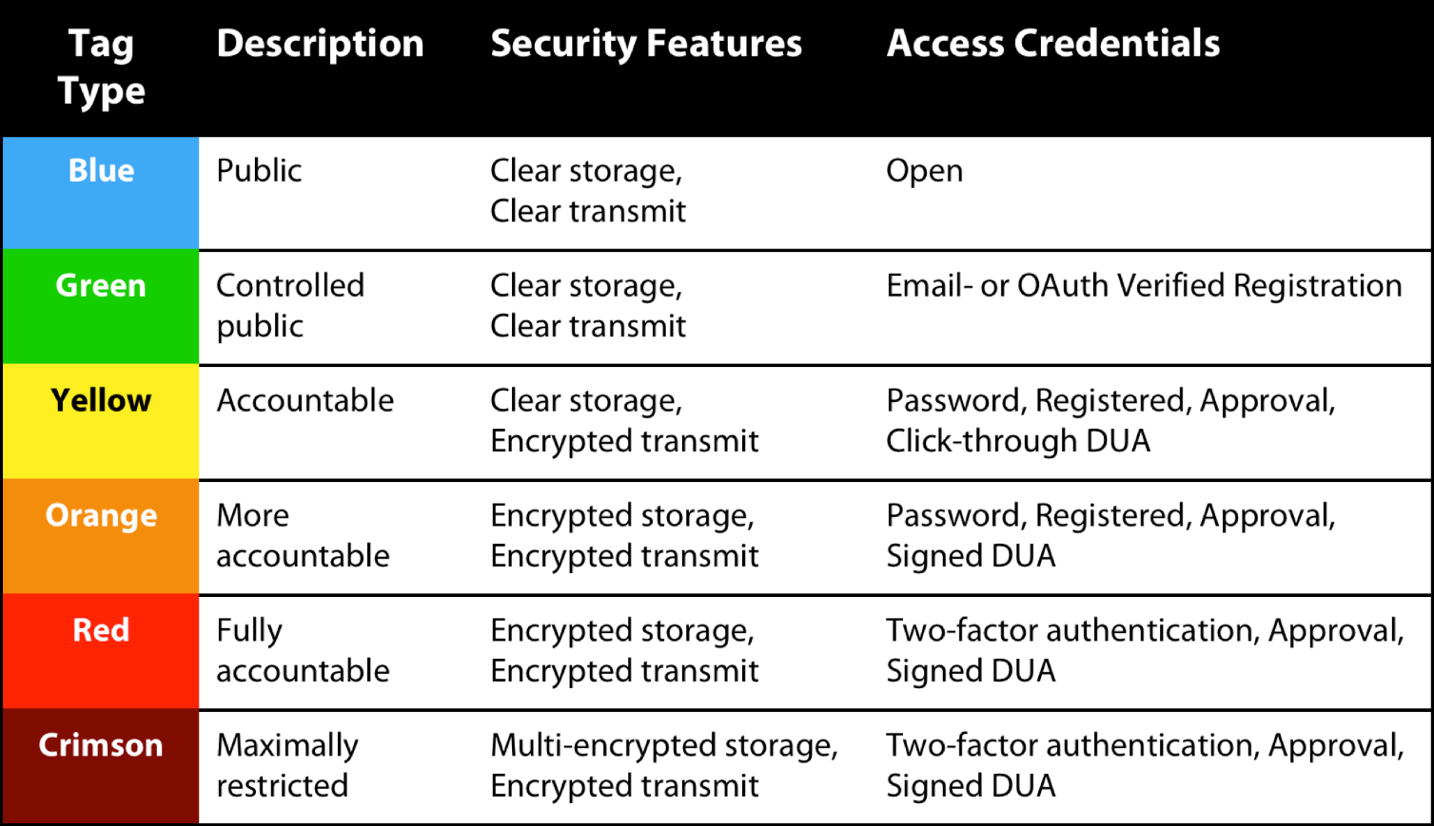
Sharing Sensitive Data with Confidence: The Datatags System
Non-confidental information
Non-confidential information
Potentially harmful personal information
Sensitive personal information
Very sensitive personal information
Maximum sensitive personal information

Slide 25
Informed consent
Description of the study, methods of data collection, description of the data collected.
Obligations of the research participant.
Scope of commitment and compensation for participation.
Risks and dangers of participation.
Procedure for withdrawing from participation in the study.
Benefits of participation.
Voluntary nature of participation.
Protection of personal data, publication of results, archiving and sharing of data.
Contact details of the researcher, funding sources.
Additional consents and clarifications on GDPR if personal data of research participants are collected (protection of personal data, retention period of personal data, anonymisation, confidentiality).

Slide 26
Informed consent - continued
The informed consent form must be written in easy understandable language. The research participant must be given a clear opportunity to make the following points:
  that he/she has read and understood the information about the project,
  that he/she has had the opportunity to obtain additional information,
  that he/she voluntarily agrees to participate in the project,
  that he/she understands that he/she can stop participating without giving a reason and without penalty,
  that confidentiality procedures (use of names, pseudonyms, anonymisation of data, etc.) have been explained; and
  that the ways in which research data can be used for publication, sharing and archiving are explained.
  The form should include signatures and signature dates for both the participant and the researchers.
The research participant should be informed that after the project is completed, the research data will be stored and made available to other researchers for secondary analysis for research and educational purposes.

Slide 27
Application for ethical approval
Applicant's contact details.
Description of the research (purpose, duration, description of the data collected, methods of collection, ethical aspects, benefits, risks and burdens of the participants involved, information on the financial compensation of the participants, safety of the participants, insurance in case of possible damage to health).
The funder and the costs of the research.
Statements by the principal investigator, and his bosses.
Informed consent form for the participant.
In the case of children and other vulnerable groups, a consent form from parents/guardians.
Information regarding the collection, security and storage of personal data.
Signature of the applicant.

Slide 28
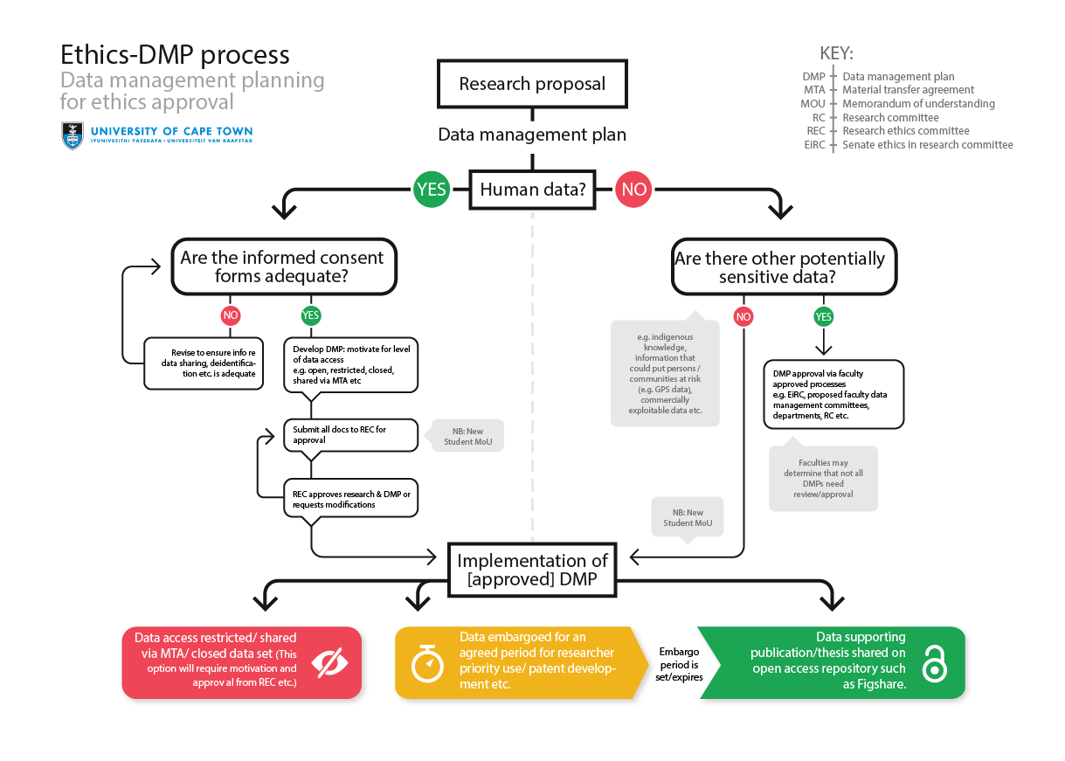
Ethics and research data management
Source: Ethics and research data managament. Available at: http://www.researchsupport.uct.ac.za/ethics-and-research-data-management

Slide 29
Data processing and analysis
Data insertion, digitisation, transcription, translation.
Verification, validation, cleaning, anonymisation of data where necessary.
Data description, structuring and documentation.
Data analysis.
Interpretation of results.
Data management and storage ( backups: 3-2-1 backup rule).

Slide 30
Clear license information is important because...
It tells users and reusers exactly what they can do with your data and metadata.
It encourages the use and reuse of your data and metadata the way you want them to be used and reused.
It creates visibility of your efforts downstream (if you ask for attribution).
If no explicit licence is provided, a user does not know what can be done with the data/metadata – the default legal position is that nothing can be done without contacting the owner on a case-by-case basis.

Slide 31
Four key tips when publishing information about the licence
Make sure your licensing information is easy to find.
Include information about the license in the metadata of each data set.
Use simple licenses to ensure they are easy to understand by re-users.
Check spelling, typos and spacing to ensure consistency in the names of the licenses used.

Slide 32
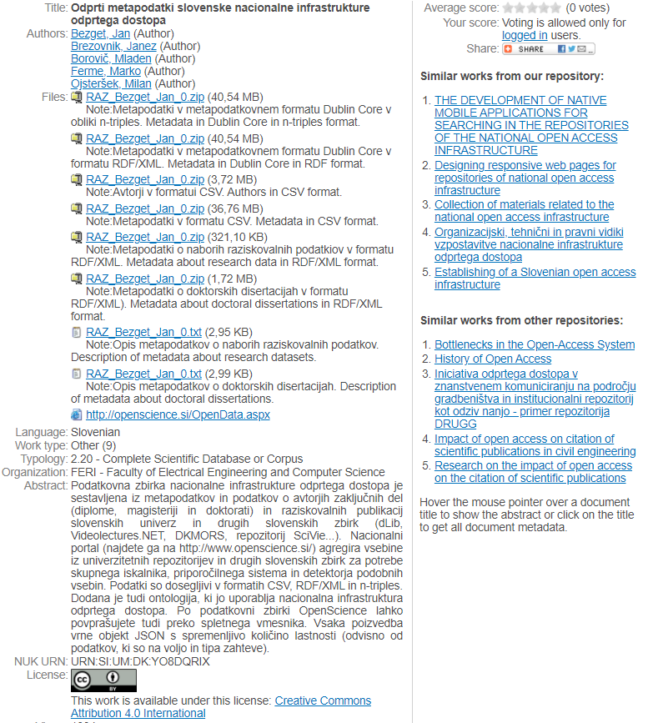
Clear licence information - example

Slide 33
Different data have different licensing needs
Some data(sets) may be required to be openly available (e.g. subject to a Constitution of the Republic of Slovenia).
Some data(sets) may be subject to restrictions (e.g. privacy, national security, third party rights).
Some data(sets) may be available for reuse but not for modification (e.g. legal texts, public budgets (if modifications are made, it must be made clear that the data is not the actual authentic version).
Some data(sets) may be published allowing derivations with attribution of authoritative source (e.g. legal commentary, translations).

Slide 34
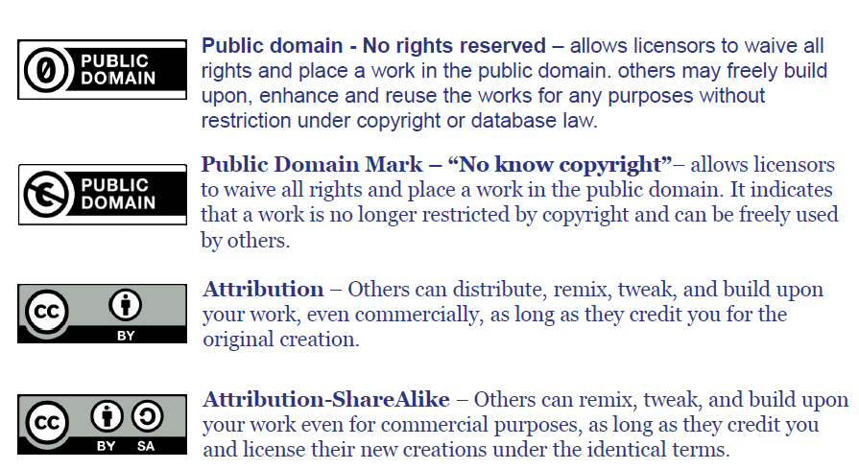
Licensing approaches: Creative Commons (1)

Slide 35
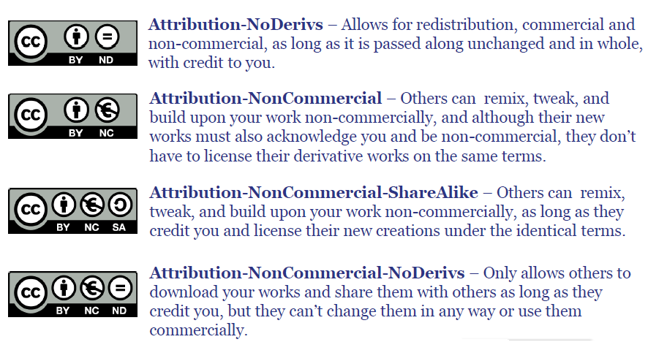
Licensing approaches: Creative Commons (2)

Slide 36
Good practices for licensing your data
Good practices:
If the original data is in the public domain (e.g. by law), keep it there – use for example the Creative Commons Zero Public Domain Dedication or the Open Data Commons Public Domain Dedication and License (PDDL)
For some documentation integrity needs to be protected – use a No- Derivatives licence, for example Creative Commons Attribution- NoDerivs, but only if really necessary
Avoid Non-Commercial licences if at all possible, as these seriously restrict reuse.
Licenses for data should provide appropriate security and control (but not more than that).

Slide 37
Using an open and unrestricting license for your data
Whenever data is licensed for open and unrestricted access, reusers can create new knowledge from combining it.
For example:
Cross-referencing public spending with geographic data to visualise which regions are better funded.
Matching public transport timetables with GPS data to be able to give real time information on delays.
Measuring performance of public services based on transaction counters and waiting times.
Deriving recommendations for prevention policies relating accident statistics with weather data and road maps.

Slide 38
Good practices for licensing your metadata
What you need to think about:
Metadata helps people to discover your data.
The wider your metadata is distributed, the higher your visibility is.
Others may want to add to it, enhance it, link to other resources.
Good practices:
Licences for metadata should be as open as possible.
A public domain licence allows the widest reuse.
An attribution licence ensures you get credit downstream, but may cause problems if data is shared multiple times (attribution stacking).

Slide 39
Machine readability of licenses – use Open Digital Right Language
The Open Digital Rights Language (ODRL) is a policy expression language that provides a flexible and interoperable information model, vocabulary, and encoding mechanisms for representing statements about the usage of content and services. The ODRL Information Model describes the underlying concepts, entities, and relationships that form the foundational basis for the semantics of the ODRL policies.
Policies are used to represent permitted and prohibited actions over a certain asset, as well as the obligations required to be meet by stakeholders. In addition, policies may be limited by constraints (e.g., temporal or spatial constraints) and duties (e.g. payments) may be imposed on permissions.
Please see examples of machine readable licenses on http://licentia.inria.fr/

Slide 40
Publishing and sharing data
resolution of copyright,
preparation of metadata for »searching« and documentation for users,
publication and sharing of data (possibly in a data archive),
control over data access,
promotion of data,

Slide 41
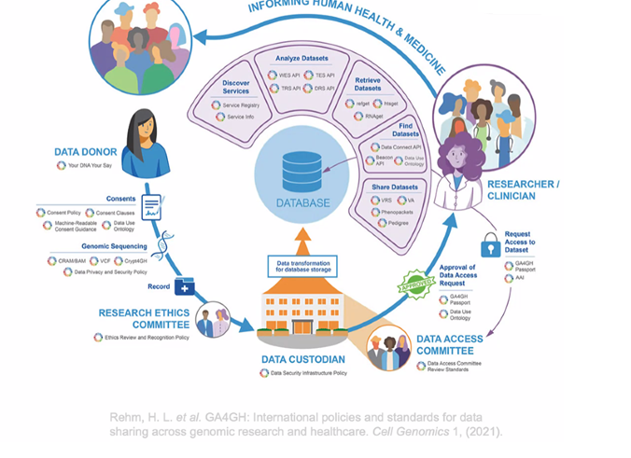
Data sharing in genomic research

Slide 42
Long term managament
Which data has long-term value and should be kept?
Transfer data into a format that is independent of current technology.
Ensuring data archival according to the 3-2-1 backup rule.
What data needs to be stored or destroyed due to contractual relationships with data providers?
How long should the data be stored or retained?
How will access and security be ensured?

Slide 43
Citing data
The citation of the data source in the publication should generally include the following information:
the author(s) of the research data,
the name of the dataset,
the producer (the institution under whose auspices the data were produced),
the place and year of production of the dataset,
the version of the dataset,
distribution,
series,
place and year of publication of the research data in the data repository,
the data repository where the data can be accessed,
persistent identifier.

Slide 44

Persistent identifiers
Resolvable links independent of data locations
Common technologies:
  DOI, PURL, URNs, ARKs, PMID…
Site A
Resolver
doi:10.1594/PANGAEA.667386
Site B

Slide 45
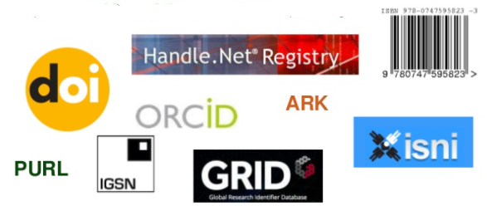
Persistent identifiers
https://doi.org/10.13140/2.1.2889.8561
https://arxiv.org/abs/2011.10574
http://hdl.handle.net/11356/1244
PMID: 32389849
PMCID: PMC7204709
http://purl.org/coar/resource_type/c_5ce6
URN:NBN:SI:DOC-ZCQPLPGX
https://orcid.org/0000-0003-1743-8300
https://viaf.org/viaf/118892012/
http://www.isni.org/isni/0000000114559647
https://ror.org/01d5jce07
grid.17063.33

Slide 46
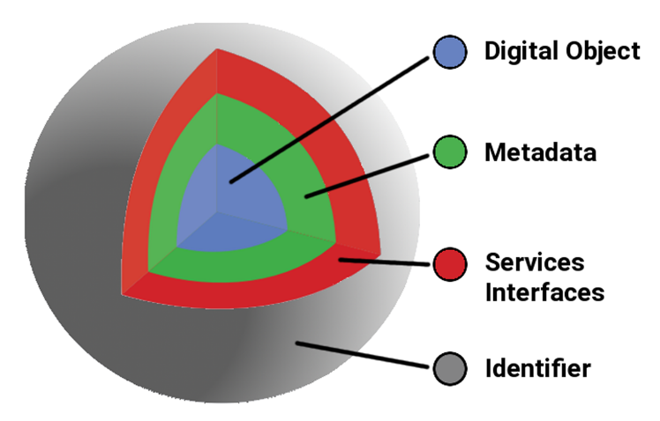
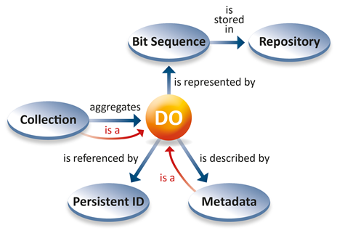
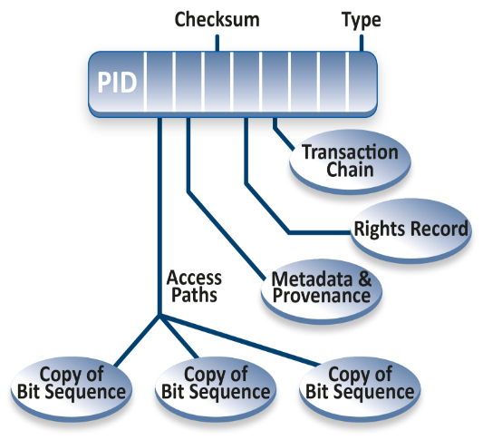
FAIR digital object
Digital Object Interface Protocol
Source: RDA's Data Foundation & Terminology Group (DFT) 2014: Core Model
Source: Schwardmann, U., 2020. Digital Objects – FAIR Digital Objects: Which Services Are Required?. Data Science Journal, 19(1), p.15. DOI: http://doi.org/10.5334/dsj-2020-015

Slide 47
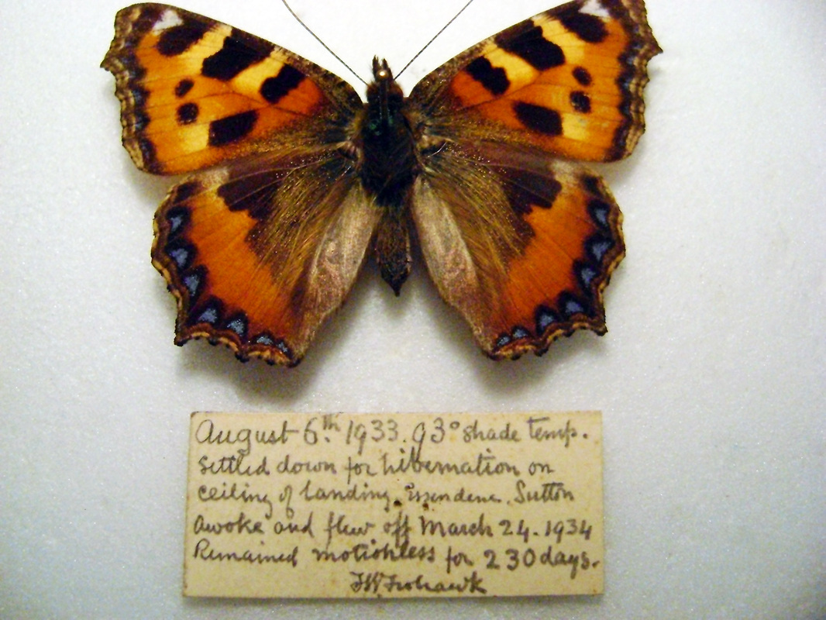
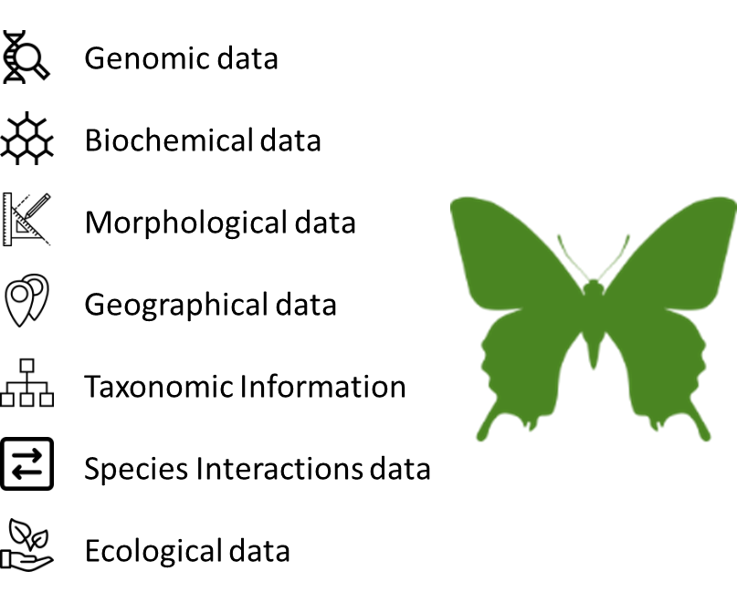
Physical Object
Digital Surrogate
FAIR Digital Object
Source: Alex Hardisty FAIR Digital Objects as Basic Design Choice and the Need for PIDs
An machine actionable knowledge unit

Slide 48



Structure of a Digital Specimen Digital Object (DSDO)
DO, = An envelope
PID
Kernel information
(metadata about specimen DO)
metadata₂
… … … … … … …
… … … … … … …
metadata_{N}
… … … … … … …
content_{N}
… … … … … … …
… … … … … … …
… … … … … … …
… … … … … … …
… … … … … … …
PID₁
PID₂
PID…
PID_{N}
Bit sequence
PIDs are pointers that resolve to location of the item e.g., DO itself, physical specimen, hi-res images, label information, tissue sample, DNA sequence, etc.
Source: Alex Hardisty FAIR Digital Objects as Basic Design Choice and the Need for PIDs

Slide 49
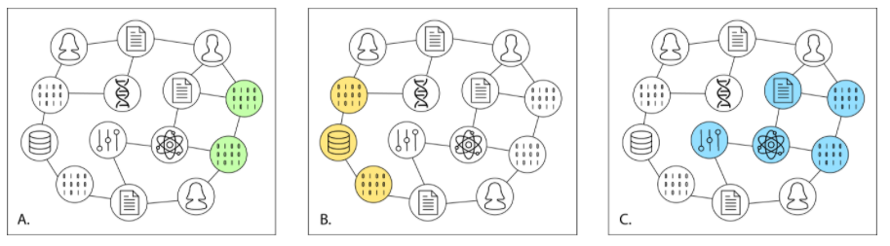
PID graph
A – linkage of different version of software
B – datasets stored in the repository
C – linkage of different digital objects of the research project
Source: Martin Fenner and Amir Aryani. Introducing the PID Graph, Datacite blog - https://doi.org/10.5438/jwvf-8a66
Manghi, P., et al.: Openaire research graph dump (2019). https://doi.org/10.5281/zenodo.3516918 and https://graph.openaire.eu/

Slide 50

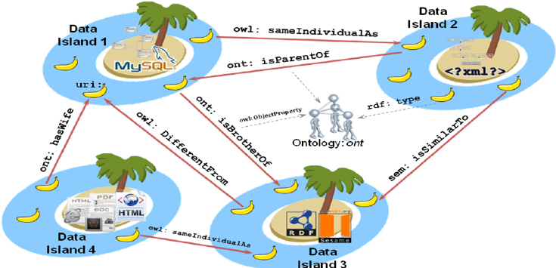
How to achieve interoperability between data islands?
Meta)data Interoperability principles:
(Meta)data use a formal, accessible, shared, and broadly applicable language for knowledge representation.
(Meta)data use vocabularies that follow FAIR principles.
(Meta)data include qualified references to other (meta)data.
Source: Wilkinson, M. D. et al. The FAIR Guiding Principles for scientific data management and stewardship. Sci. Data 3:160018 doi:10.1038/sdata.2016.18 (2016)
Source: https://commons.wikimedia.org/wiki/File:Islands_Of_Data.svg
Source: https://www.researchgate.net/publication/267692879_Towards_Executable_Reality_Business_Intelligence_on_Top_of_Linked_Data/figures?lo=1

Slide 51
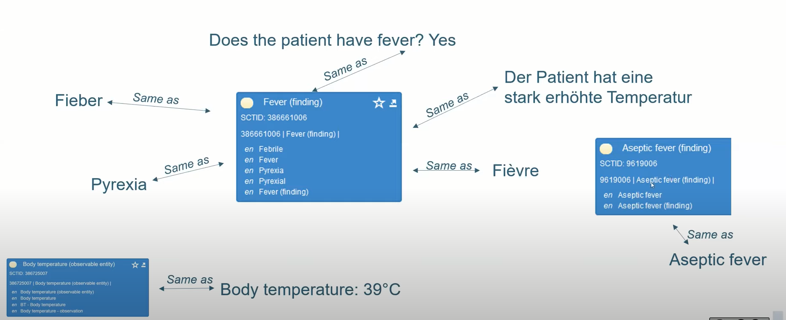
Example of a semantic description of a patient's fever
Vir: Sabine Osterle. SPHN Data Ecosystem for FAIR Data. Dosegljivo na https://www.youtube.com/watch?v=pqV0qp4oisM [22. 5. 2022]

Slide 52
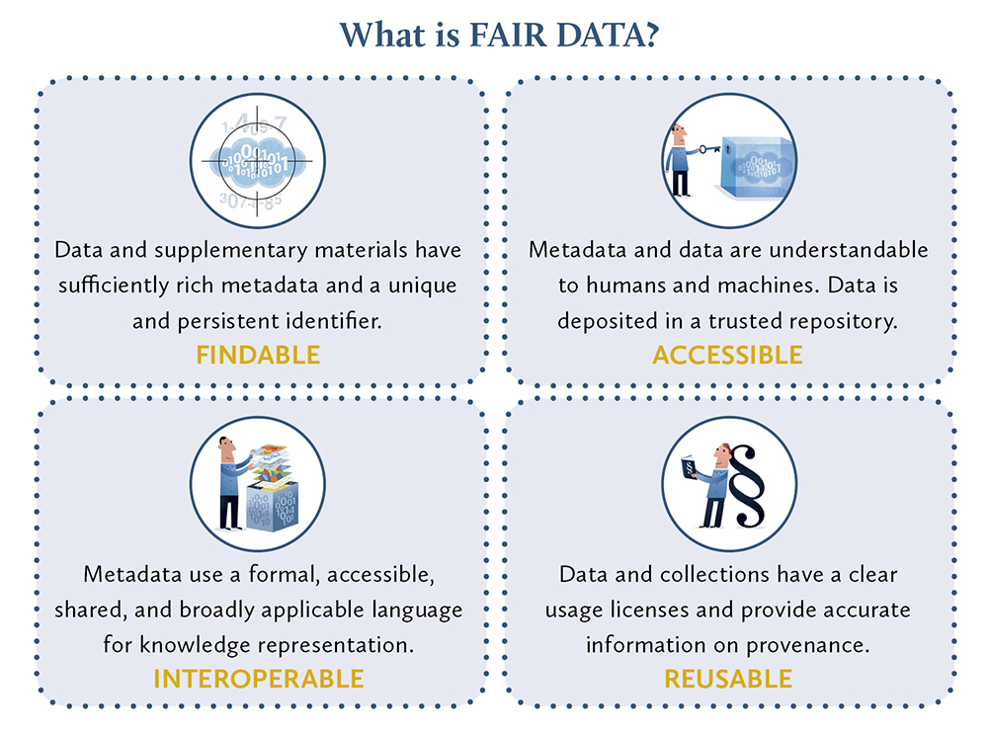
FAIR (Findable, Accessible, Interoperable, Reusable)
To be Findable:
F1. (meta)data are assigned a globally unique and eternally persistent identifier.
F2. data are described with rich metadata.
F3. (meta)data are registered or indexed in a searchable resource.
F4. metadata specify the data identifier.
TO BE ACCESSIBLE:
A1 (meta)data are retrievable by their identifier using a standardized communications protocol.
A1.1 the protocol is open, free, and universally implementable.
A1.2 the protocol allows for an authentication and authorization procedure, where necessary.
A2 metadata are accessible, even when the data are no longer available.
TO BE INTEROPERABLE:
I1. (meta)data use a formal, accessible, shared, and broadly applicable language for knowledge representation.
I2. (meta)data use vocabularies that follow FAIR principles.
I3. (meta)data include qualified references to other (meta)data.
TO BE RE-USABLE:
R1. meta(data) have a plurality of accurate and relevant attributes.
R1.1. (meta)data are released with a clear and accessible data usage license.
R1.2. (meta)data are associated with their provenance.
R1.3. (meta)data meet domain-relevant community standards.
Source: https://www.force11.org/group/fairgroup/fairprinciples
Source: https://libereurope.eu/blog/2018/07/13/fairdataconsultation/liber-fair-data-2/

Slide 53
Links related to the research data managament
CESSDA Data Management Expert Guide
Data Management Skillbuilding Hub
UK data service youtube channel
Funders’ data plan requirements
DMPOnline
Checklist for a Data Management Plan
Consent for data sharing
DMP Assistant

Slide 54


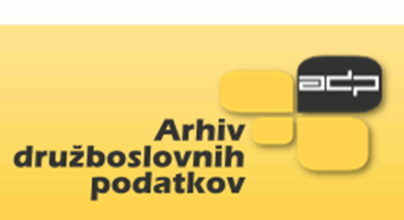


Structure diagram of Slovenian national open access infrastructure
Nationalni portal (http://www.openscience.si)
      search engine and digital objects agregator,
      recommender system,
      similar content detection,
      digatal objects deduplication.
Big research data archive
SLING
PID service
Common services
RUL
DKUM
RUP
RUNG
DIRROS
REVIS
Other digital archives
ePrints.FRI
CLARIN.SI
DKMORS
Journals and monographs
ELIXIR node Slovenia
Slovenian COVID 19 national portal is available on http://covid19dataportal.si/

Slide 55
Achievements
A national approach to building of open science infrastructure and FAIR digital objects.
National PID service.
National big data archive.
Templates for amendments to the policies about a mandatory copy of research publications, research data, final theses and other research results ( software, workflows, lab notebooks, online courses…) is developped for all partner institutions.
Development of adapted processes for filling publications, research data sets and other research results from students and employments on all partner institutions.
Open Aire compatibility is established to facilitate in registration, discovery, access and re-use of research publications and research data, in particular in the context of funded projects across European countries.
Integration with COBISS, SICRIS, higher education information system, university information systems and university autethication systems.
Plagiarism detection software is developed and included into processes for filling publications from students and employments.
Recommendation system of similar works within repositories and between repositories and other is implemented.

Slide 56
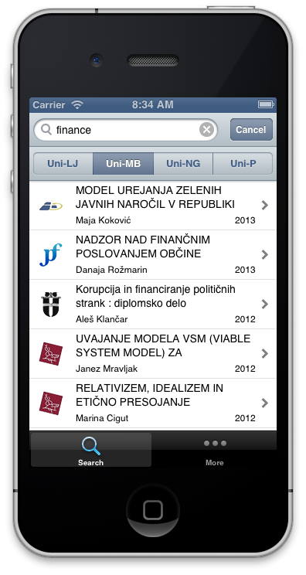





Structure diagram of repository infrastructure
HPC
EUDAT
Open access analytics
Instituional web servers
Social networks
Digital preservation of digital objects
ARNES AAI or institutional authentication system
Repository
OpenAIRE,
B2Find
DART-Europe,
BASE,
ROAR,
OpenDOAR
re3data
….
Institutional information system
Common services
PID service
Open Science Slovenia

Slide 57
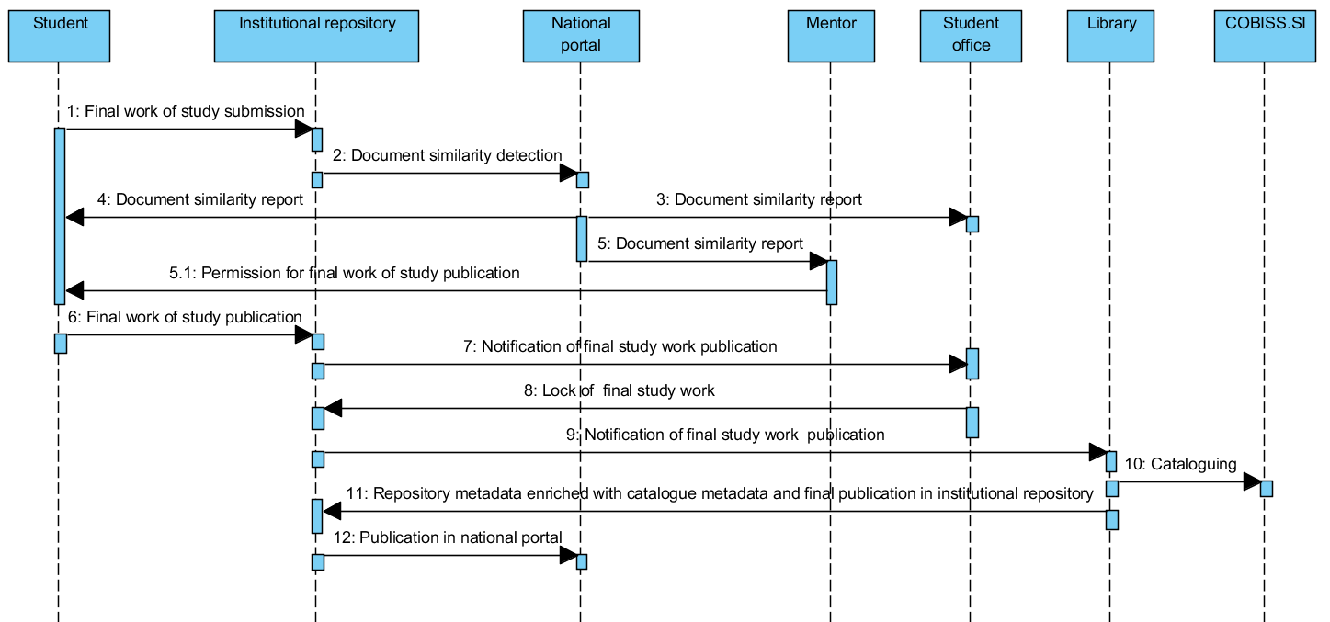
A sequence diagram of final study work submission and publication at the universities of Maribor and of Nova Gorica
Notes:
The process, which was established at universities, allows authors to submit their work into the institutional repository. After which, the submission is reviewed and catalogued into COBISS.SI by a librarian. Based on the experiences accumulated since 2008, it was found that a manual review of metadata is mandatory as in many cases the submissions are incomplete or contain spelling errors. In addition, only librarians can normalise those authors using the CONOR.SI authority file. After the publication metadata have been successfully catalogued within the COBISS.SI, they can be transferred to the institutional repository via SRU/SRW services.
The working group, which consisted of librarians, legal experts and IT professionals from all four Slovenian universities, suggested the submission processes of the final study works. Slovenia lacks a common university academic information system (UAIS), therefore each university provided its own variation of this process. Students at the universities of Maribor and of Nova Gorica submit their final study works into university repository, which is filled with some metadata from university academic information system. A sequence diagram of the final study work publications of the universities of Maribor and of Nova Gorica is presented in slide. The submissions at the universities of Ljubljana and Primorska take place at university academic information system, the sequence of operations is otherwise the same as described for the universities of Maribor and of Nova Gorica.

Slide 59
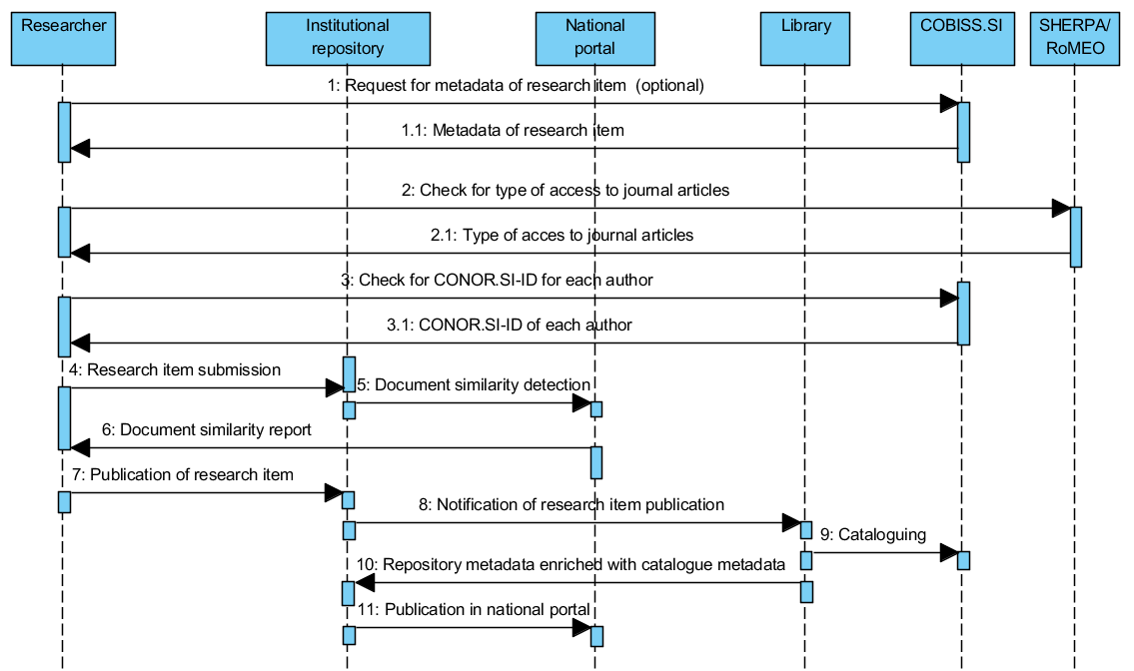
A sequence diagram of research item submission and publication
Notes:
All four institutions have established the same process for submission of research publications, which is presented the sequence diagram in the slide. Researchers can submit articles, monographic chapters, monographs, conference papers, e-lectures, publications about patents, research data, and other types of publications. The types of publications are adapted according to the COBISS.SI typology (http://home.izum.si/COBISS/bibliografije/Tipologija_eng.pdf), which is used by the Slovenian Research Agency for researchers’ bibliographies evaluation. Once researchers are logged into the institutional repository, they can submit new content as a whole, or they can use metadata from the catalogued record in COBISS.SI (optional request and reply on the beginning of the process). In the latter case, the institutional repository takes care of the metadata transfer from COBISS.SI using the SRU/SRW protocol. In this case, researchers only need to provide the electronic version of their publications. A link to the SHERPA/RoMEO portal is also enabled to the publication authors, so they can check what type of access they can use depending on the publisher's copyright transfer agreement. During the insertions of names and surnames, suggestions from the CONOR.SI authoritative file are provided. These suggestions include the year of birth, if available in CONOR.SI, and researcher identifier from SICRIS, which simplifies the determination of the correct author. This can greatly simplify the librarian’s work of cataloguing the publication in COBISS.SI. Authors can also determine the copyright holder and the type of access to the full-text publication. They can choose between immediate publication, closed access or delayed publication with embargo (these metadata are part of OpenAIRE compliance).

Slide 60
Establishing processes to support the handling of research data in the national open access infrastructure
Pre-publication activities.
Publication in the repository or data archive.
Digital preservation.

Slide 61
Phase before publication of research data and required documentation
Phase before publication of research data:
  Planning and finding data sources.
  Preparation of a research data managament plan, applications for the ethics commission and proposals for informed consent, proposals for declarations by data providers.
  Obtaining relevant statements and opinions.
  Data collection and creation.
  Data Processing and analysis.
  Preparation of files in appropriate formats.
  Preparation of documentation.
Before a researcher applies for the publication of a research dataset in the national open access infrastructure, he must have:
  a data managament plan (if requested by the funder or the organization in which he is employed),
  metadata about the research dataset,
  documentation that is necessary for understanding and using the data,
  data files in appropriate formats,
  ethical approval if the research study involves humans, animals or environmental data,
  statements of data providers and signed informed consents of research participants,
  defined licenses for the use of research data,
  the software, containers, workflows that was used to generate or process the data, if he created it himself,
  research notes and other research results, if any.

Slide 62
Publication phase
The researcher inserts the research data set and other research results into the repository or data archive himself or his librarian inserts them .
The librarian checks the adequacy of the metadata and whether the appropriate documentation is available.
The librarian informs the appropriate authority within the institution, which is in charge of checking the appropriateness of data publication and other research results, that the data set and other research results have been uploaded. They are accessible in closed access and are only available via a link that requires a password provided by the librarian.
The appropriate body within the institution, which is in charge of checking the adequacy of the data publication, checks the adequacy of the content of the data set and other research results. If the content is appropriate, inform the librarian that the data set and other research results can be published.
The librarian, after a positive response from the body within the institution, which is in charge of checking the appropriateness of data publication, publishes the data set and other research results in the repository and performs cataloging in COBISS.
Central specialised information centre of the scientific field, established by Slovenian research and inovation agency checks the adequacy of the typology, metadata and documentation of the research data set and other research results.

Slide 63
Digital preservation phase
Data can be stored in different formats and in several versions. For digital preservation of research data, we must ensure the independence of the data from the technology. We will establish processes for digital preservation according to the OAIS reference model ( ISO 14721 ) using metadata according to the PREMIS meta data standard.

Slide 64
?

