Slide 1
Where is the borderline of plagiarism?
Tomáš Foltýnek
3rd ENAI Academic Integrity Summer School 2023, 21st – 25th August 2023, Faculty of Electrical Engineering and Computer Science, University of Maribor, Slovenia

Slide 2
Acknowledgement of Authors
EU funded project “Impact of Policies for Plagiarism in Higher Education across Europe”
Irene Glendinning, Coventry University, UK
Tomáš Foltýnek, Mendel University in Brno / Masaryk University, Czechia
Dita Dlabolová, Mendel University in Brno / ENAI, Czechia
Ansgar Schäfer, University of Konstanz, Germany

Slide 3
Structure of the Workshop
Examples of plagiarism
Definitions of plagiarism
Where is the borderline? Judgment of cases
Reasons for plagiarism
Prevention of plagiarism
Discussion

Slide 4
Example no. 1 (MENDELU, 2017)

Slide 5
Example no. 1 (MENDELU, 2017)

Slide 6
Example no. 1 (MENDELU, 2017)

Slide 7
Example no. 2 (MENDELU, 2017)

Slide 8
Definition of Plagiarism
What do you understand by plagiarism?

Slide 9
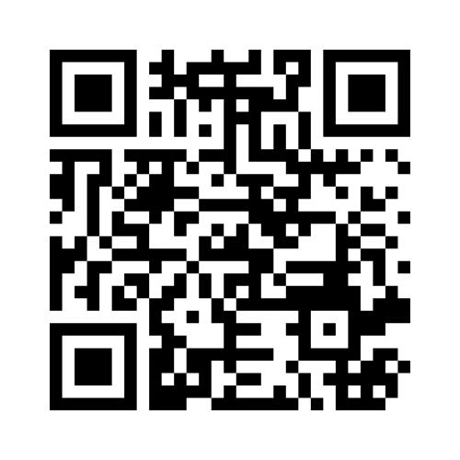
What is plagiarism?
Go to
www.menti.com
Enter code
32 20 84 6

Slide 10
What is the problem?
Why should be universities dealing with plagiarism?
Why should politicians – plagiarisers resign?
Who is harmed by plagiarism?

Slide 11
Definition
What do you understand by plagiarism?
the use of ideas, content, or structures
without appropriately acknowledging the source
to benefit in a setting where originality is expected
Published in: Foltýnek, T., Meuschke, N., & Gipp, B. (2019). Academic Plagiarism Detection: A Systematic Literature Review. ACM Comput. Surv., 52(6), 112:1--112:42. https://doi.org/10.1145/3345317
Based on:
Meuschke, N., & Gipp, B. (2013). State-of-the-art in detecting academic plagiarism. International Journal for Educational Integrity, 9(1): 50-57
Fishman, T. (2009). ‘We Know It When We See It’ Is Not Good Enough: Toward a Standard Definition of Plagiarism That Transcends Theft, Fraud, and Copyright. In Proceedings 4th Asia Pacific Conference on Educational Integrity (4APCEI), 5, 2009.

Slide 12
Plagiarism includes…
Using the work of someone else and presenting it as your own
Presenting translation or paraphrase of another work as original
Using your own previously published work without proper acknowledgement
Failing to correctly cite and reference another source
Not giving due credit for the contribution of someone else to your work

Slide 13
What is NOT plagiarism
You don’t have to provide the source of
General knowledge
General knowledge of your field
Someone else’s contribution not influencing content
Proofreading
Typographic corrections
Formatting

Slide 14
Where is the borderline?

Slide 15
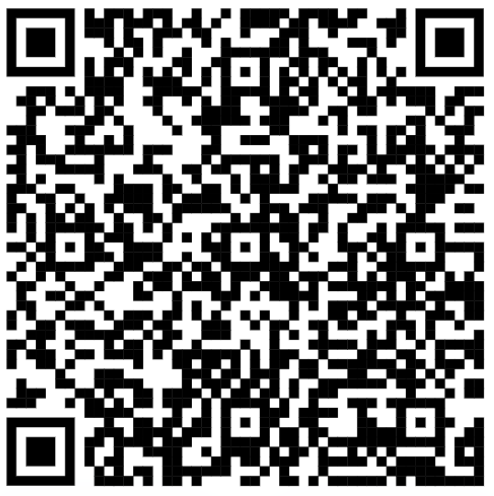
Where is the borderline?
We will go through 8 scenarios
In each scenario, 40 % of student work is taken from other sources
For each case, decide whether you consider it
Serious plagiarism
Plagiarism
Not sure
Not plagiarism
Worksheet

Slide 16
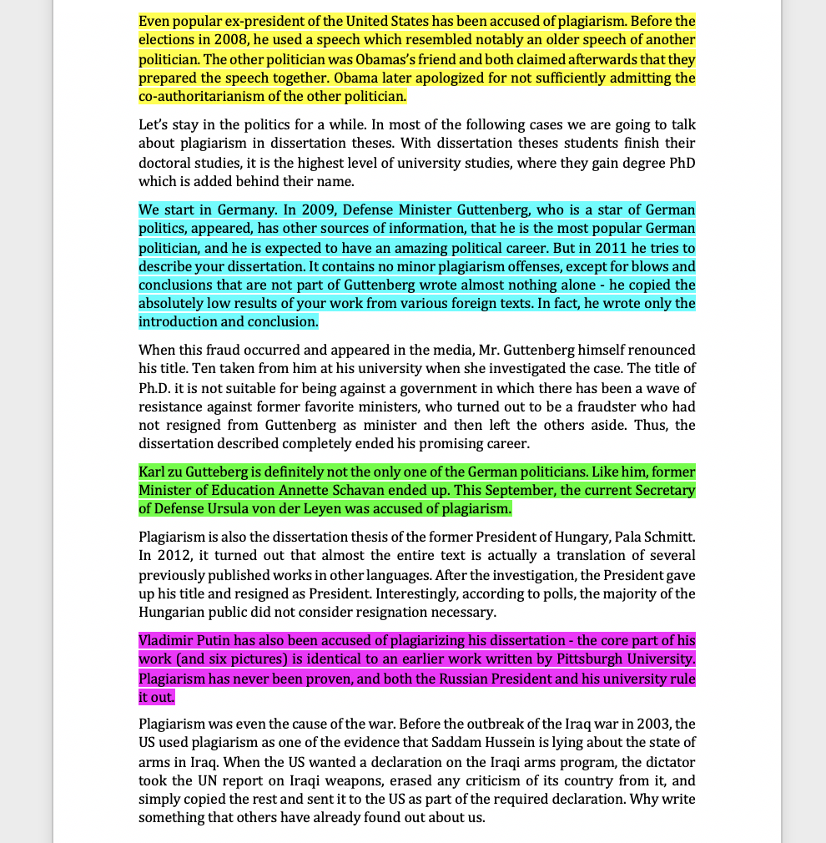
Scenario no. 1
40 %

Slide 17
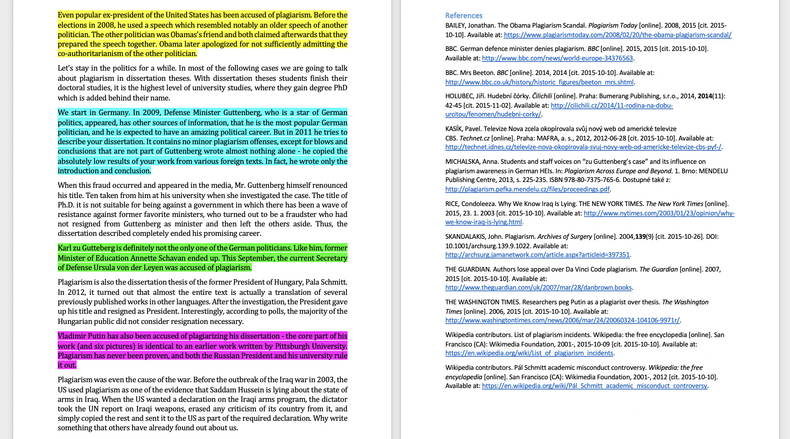
Scenario no. 2
40 %

Slide 18
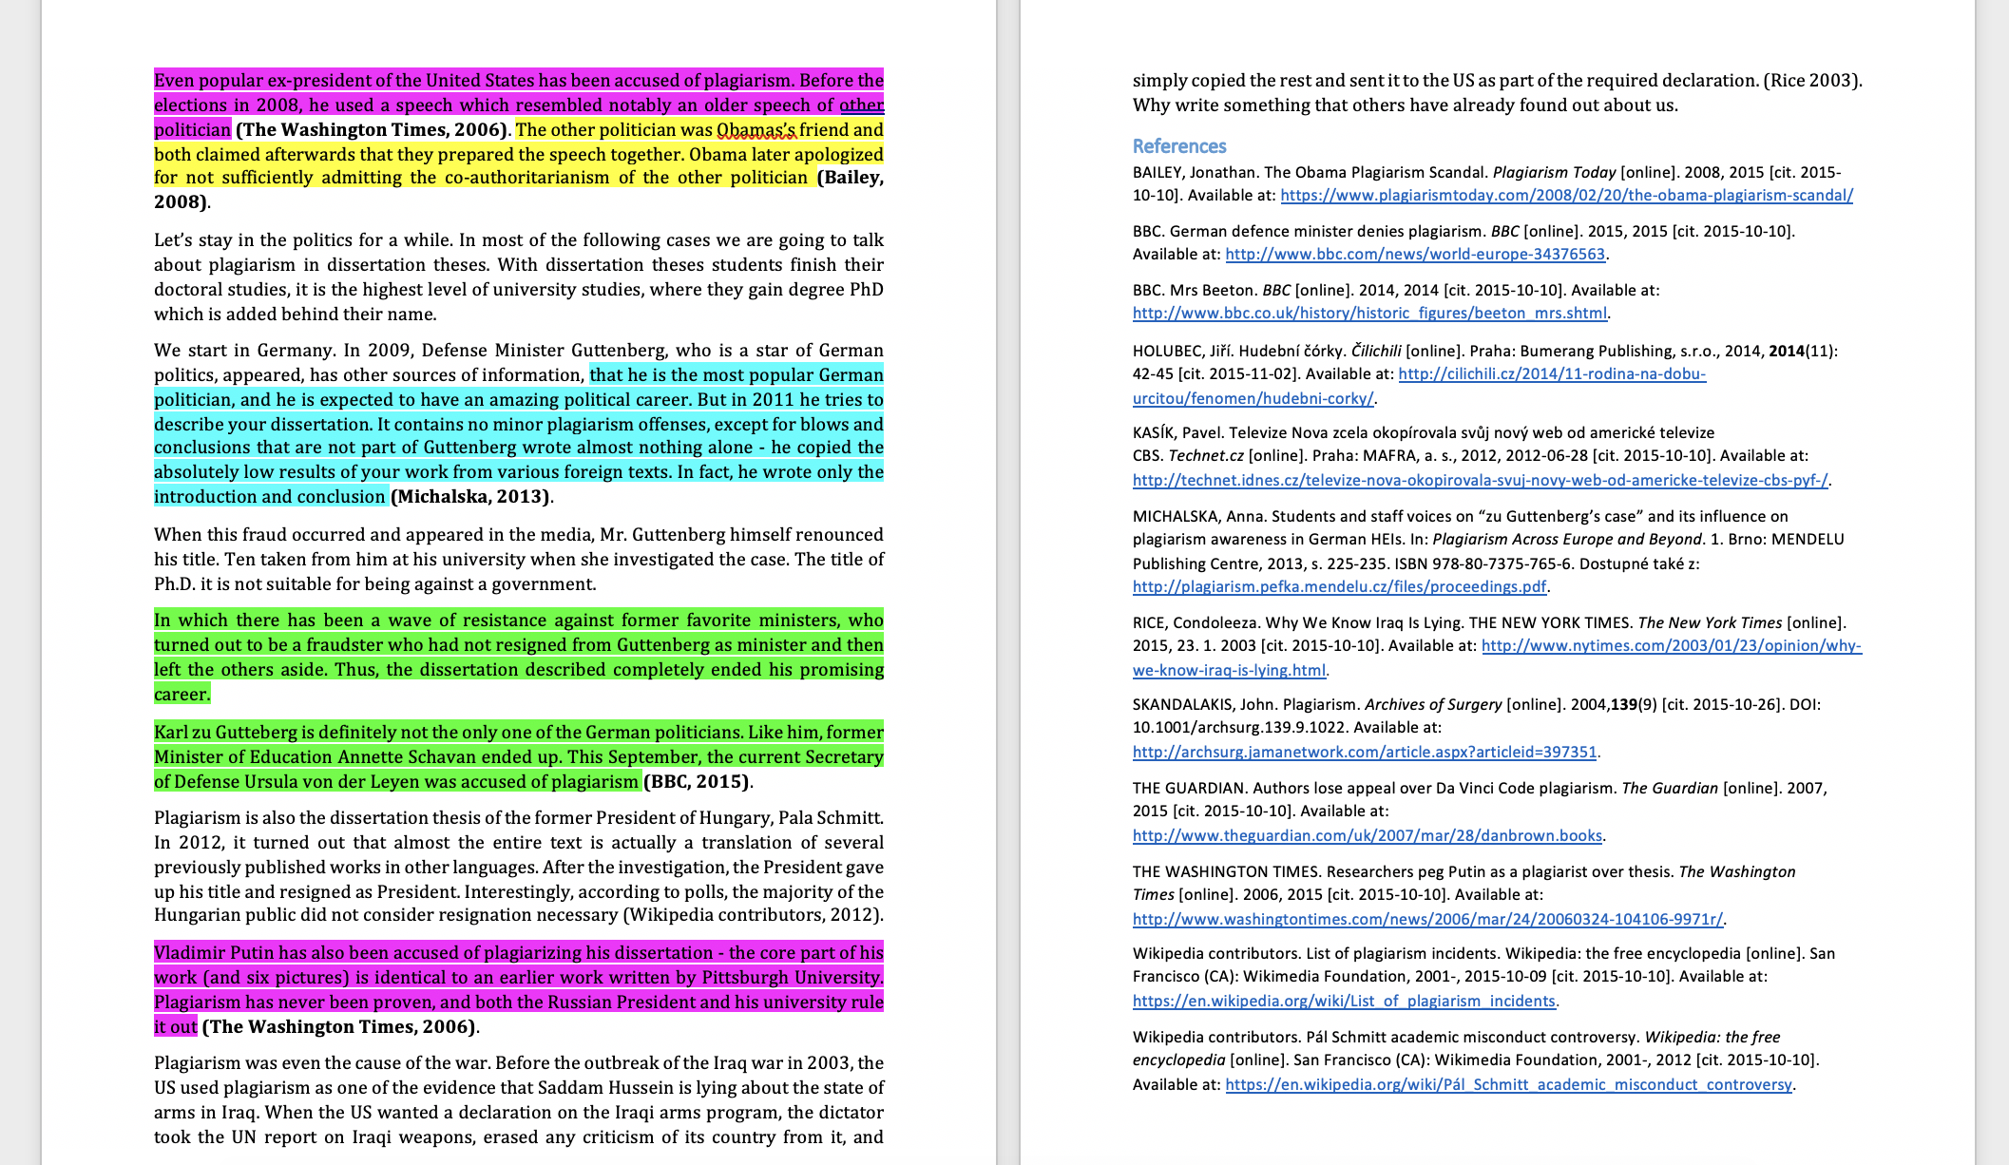
Scenario no. 3
40 %

Slide 19
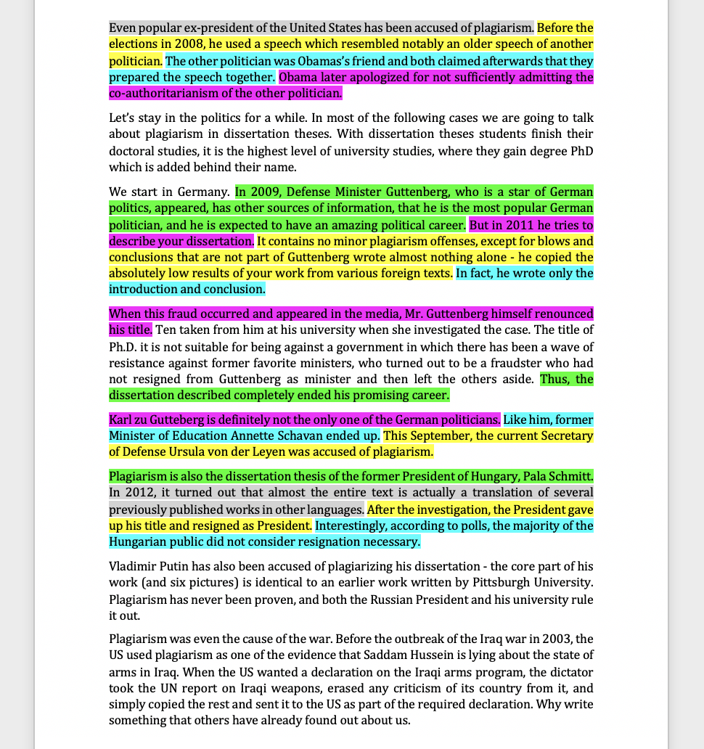
Scenario no. 4
40 %

Slide 20
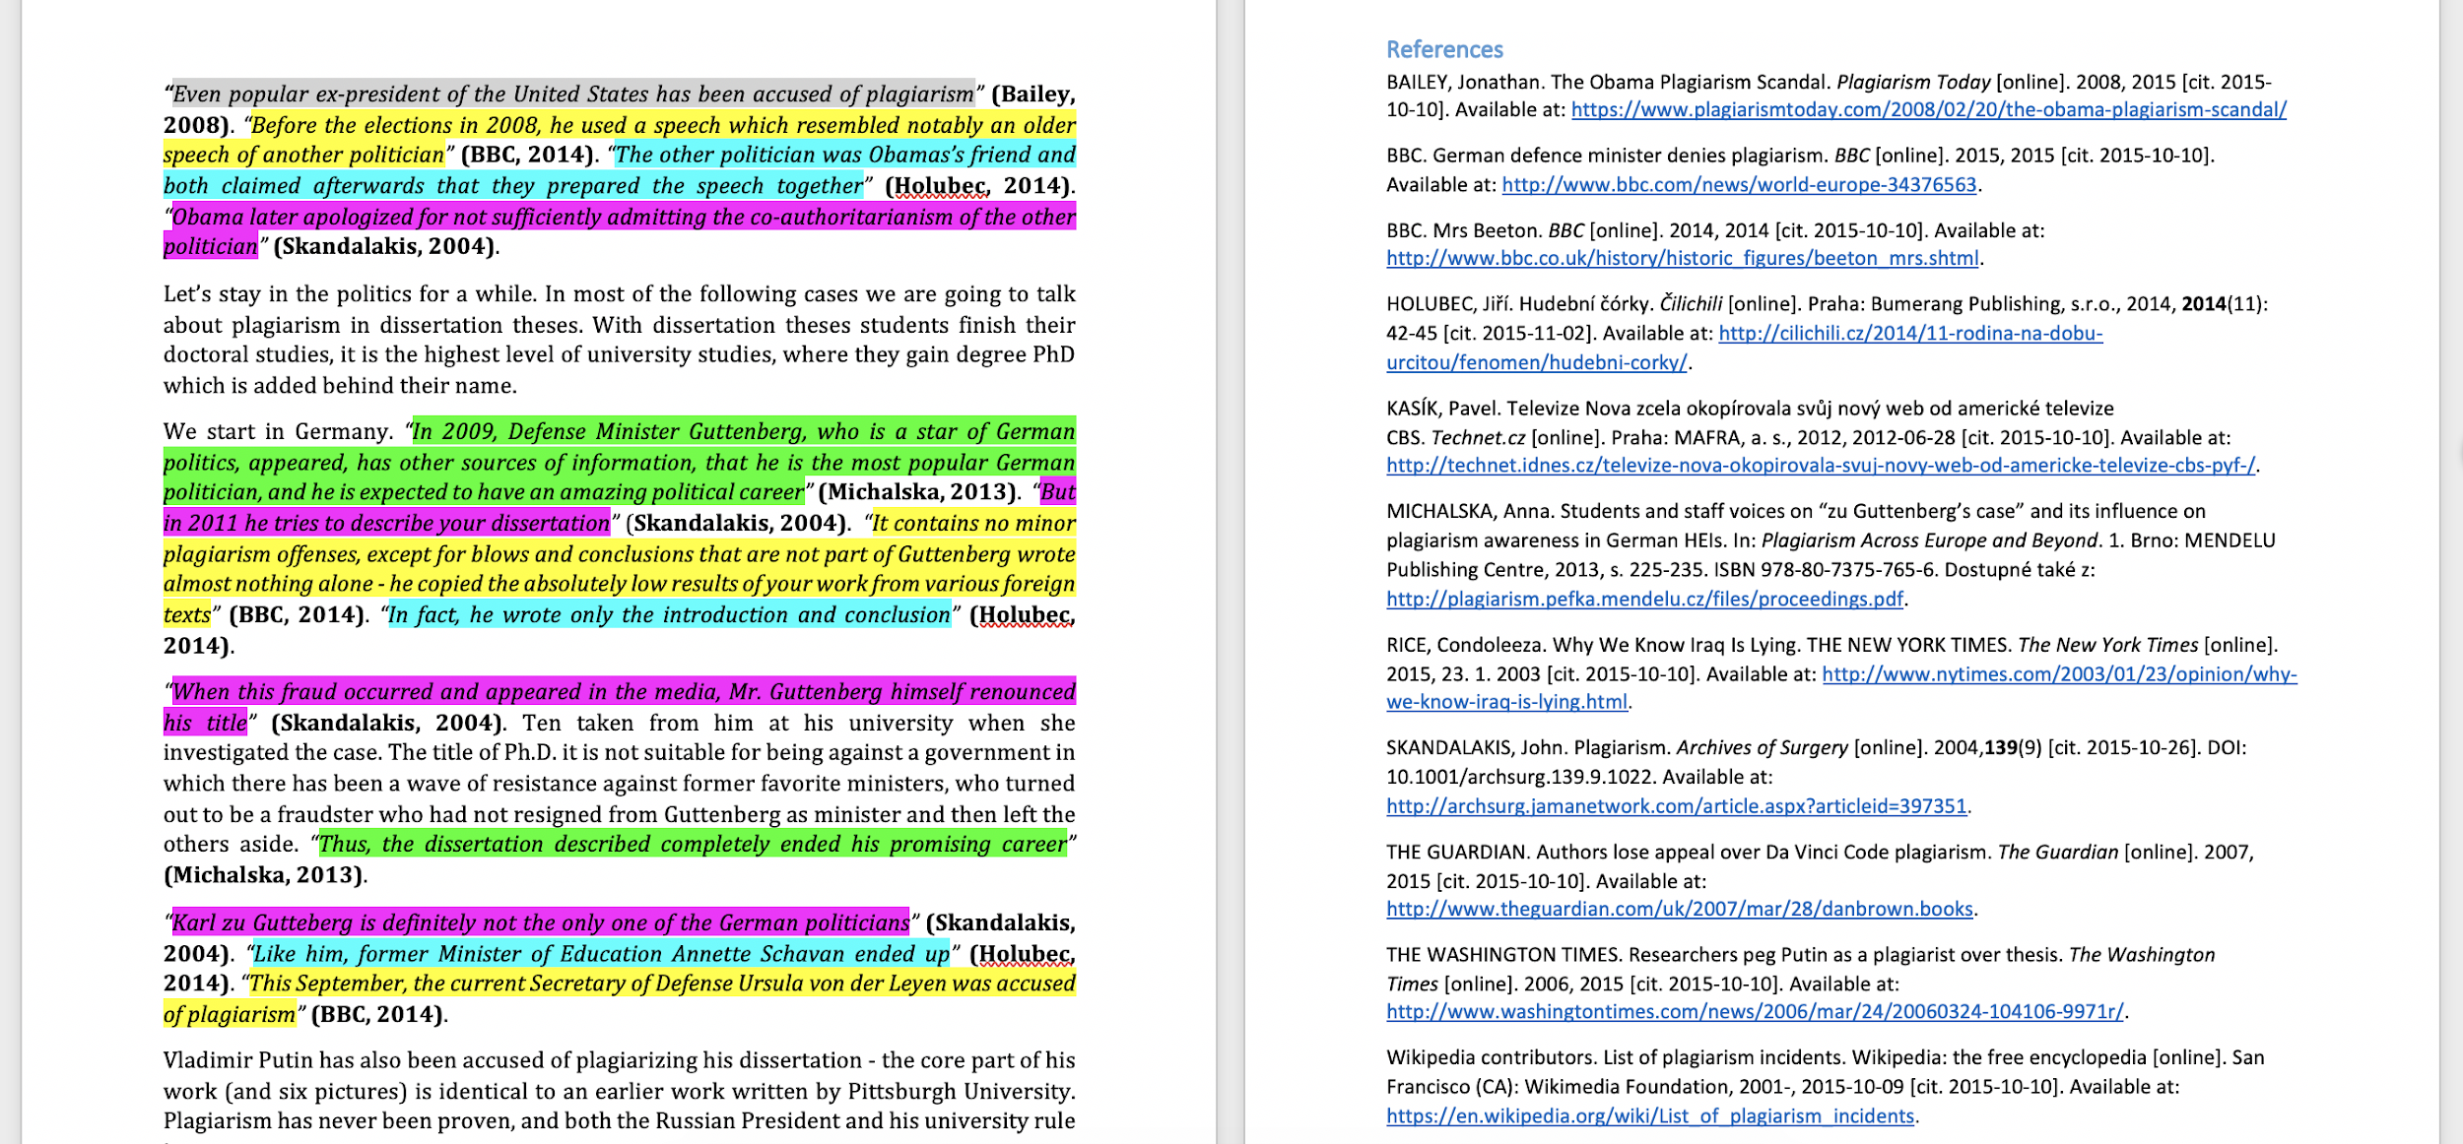
Scenario no. 5
40 %

Slide 21
Some words changed (6, 7, 8)
Student’s submission
The original source
40 %
Notes:
Source of the text: https://en.wikipedia.org/wiki/Plagiarism

Slide 22
What Do You Think?
 | 40 % of a student work is taken from other sources…
1 | word for word with no quotations, no references and no in-text citations
2 | word for word with no quotations, has references, no in-text citations
3 | word for word with no quotations, has references and in-text citations
4 | consisting of many short phrases throughout from many sources with no quotations, no references or in-text citations
5 | consisting of many short phrases throughout from many sources with quotations, references and in-text citations
6 | some words changed with no quotations, no references and no in-text citations
7 | some words changed with no quotations, has references, no in-text citations
8 | some words changed with no quotations, has references and in-text citations

Slide 23
Voting
Go to
www.menti.com
Enter code
32 20 84 6

Slide 24
Scenario no. 1
40 %

Slide 25
Scenario no. 2
40 %

Slide 26
Scenario no. 3
40 %

Slide 27
Example from Mr. Apple‘s blog:
Ms. Carrot says about Mr. Lemon: Mr. Lemon is yellow. She also adds about him that he is a citrus. Then Ms. Carrot mentioned that Mr. Lemon is sour. And he is also salty. Ms. Carrot also revealed a very surprising fact that Mr. Lemon grows on trees!

Slide 28
Example from Mr. Apple‘s blog:
Ms. Carrot says about Mr. Lemon: Mr. Lemon is yellow. She also adds about him that he is a citrus. Then Ms. Carrot mentioned that Mr. Lemon is sour. And he is also salty. Ms. Carrot also revealed a very surprising fact that Mr. Lemon grows on trees!

Slide 29
Example from Mr. Apple‘s blog:
Ms. Carrot says about Mr. Lemon: Mr. Lemon is yellow. She also adds about him that he is a citrus. Then Ms. Carrot mentioned that Mr. Lemon is sour. And he is also salty. Ms. Carrot also revealed a very surprising fact that Mr. Lemon grows on trees!

Slide 30
Scenario no. 4
40 %

Slide 31
Scenario no. 5
40 %

Slide 32
Some words changed (6, 7, 8)
Student’s submission
The original source
40 %
Notes:
Source of the text: https://en.wikipedia.org/wiki/Plagiarism

Slide 33
Where is the borderline?
Focus on scenarios 1 and 6
Which of them is worse?
What do European students think about these cases?

Slide 34
40% of student’s work copied word for word with no quotation, references or citations (1)
Sources: IPPHEAE 2013, SEEPPAI 2018

Slide 35
40% of student’s work copied, some words changed, no quotations, ref. or citations (6)
Sources: IPPHEAE 2013, SEEPPAI 2018

Slide 36
Looking for reasons
Why do students plagiarise?
Write down three most important reasons

Slide 37
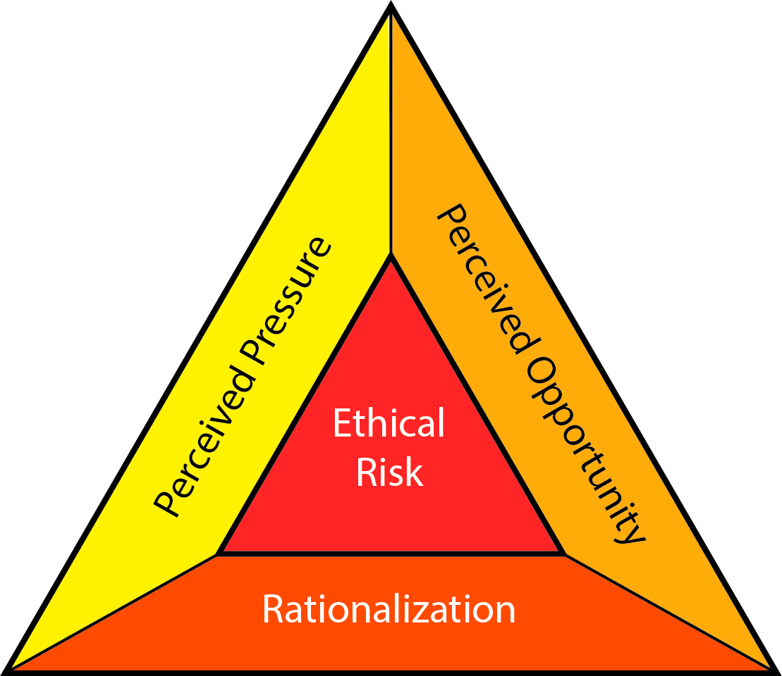
Causes: The Fraud Triangle
Pressure / Motive
Need to pass a course
Need to get a degree
Opportunity
Weak detection
Rationalization
Everybody is doing it
Risk-benefit assessment
DavidBailey [CC BY-SA 4.0]

Slide 38
Why do students plagiarize?
Teachers
Students
P
O
It’s easy to cut and paste
They don’t think plagiarism is wrong
Lecturer will not care
Run out of time
Unable to cope with the workload
Their own work is not good enough
P
R
R
R
Data from the IPPHEAE project (2013; N students = 3980; N teachers = 702; 27 EU countries)

Slide 39
Students vs. teachers
How students get to know about plagiarism?
Teachers: Class/workshop
Students: Web pages
What is difficult on academic writing?
Teachers: Referencing formats, citing and referencing
Students: Finding good sources, paraphrasing

Slide 40
Students vs. teachers, scenarios 6, 7, 8: 40% copied, some words changed. Is it plagiarism?
Source: IPPHEAE 2013

Slide 41
How Can We Prevent Plagiarism?
Write down your ideas to chat

Slide 42
How Can We Prevent Plagiarism?
consistent approach
policies
clear instructions for students
awareness of consequences
training for staff
education and support for students
Notes:
45
Do students understand your expectations?
Training, guidance and support for students.
Testing to see whether students understand
Awareness of consequences and penalties
Staff training and development
Consistent approach and actions by staff
Use of tools – policy, training
What more could be done?

Slide 43
Prevention: Systemic Effort Works
Curtis & Vardanega, 2016
Owens & White, 2013
10-years study (2004-2014)
New course Academic writing
Started using Turnitin
Introduced criterion and standards-based assessment
Implemented educational changes
All forms of plagiarism DECREASED
except recycling and ghostwriting
5-years study (2007-2011)
PD SW as both deterrent and formative tool
Educational about academic writing and authorship
Self-reported plagiarism DROPPED significantly
Nature of assessment has a central role
Curtis, G. J., & Vardanega, L. (2016). Is plagiarism changing over time? A 10-year time-lag study with three points of measurement. Higher Education Research & Development, 35(6), 1167–1179. https://doi.org/10.1080/07294360.2016.1161602
Owens, C., & White, F. A. (2013). A 5‐year systematic strategy to reduce plagiarism among first‐year psychology university students. Australian Journal of Psychology, 65(1), 14–21. https://doi.org/10.1111/ajpy.12005

Slide 44
Percentages are tricky!
Diploma thesis, Czechia
Overall similarity: 24%
Student copied whole thesis, but paraphrased the text
Percentage corresponds to text-matching only
Student assignment, Australia
Overall similarity: 8%
Whole abstract highlighted and linked to an essay mill
Rest of the essay behind the pay-wall
Diploma thesis, Georgia
Overall similarity: 7%
Whole list of references
Rest of the thesis translated from Russian to Georgian
Bachelor thesis, Czechia
Overall similarity: 89%
Source: Previous version of the same thesis
%

Slide 45
Sources & Further Reading
Curtis, G. J., & Vardanega, L. (2016). Is plagiarism changing over time? A 10-year time-lag study with three points of measurement. Higher Education Research & Development, 35(6), 1167–1179. https://doi.org/10.1080/07294360.2016.1161602
Foltýnek, T., Dlabolová, D., Anohina-Naumeca, A., Razı, S., Kravjar, J., Kamzola, L., … Weber-Wulff, D. (2020). Testing of support tools for plagiarism detection. International Journal of Educational Technology in Higher Education, 17(1), 46. https://doi.org/10.1186/s41239-020-00192-4
Foltýnek, T., Meuschke, N., & Gipp, B. (2019). Academic Plagiarism Detection: A Systematic Literature Review. ACM Comput. Surv., 52(6), 112:1--112:42. https://doi.org/10.1145/3345317
Impact of Policies for Plagiarism in Higher Education across Europe (IPPHEAE) – projekt LLP/Erasmus, 2010—2013: www.plagiarism.cz/ippheae
Owens, C., & White, F. A. (2013). A 5‐year systematic strategy to reduce plagiarism among first‐year psychology university students. Australian Journal of Psychology, 65(1), 14–21. https://doi.org/10.1111/ajpy.12005
Meuschke, N., & Gipp, B. (2013). State-of-the-art in detecting academic plagiarism. International Journal for Educational Integrity, 9(1): 50-57
Fishman, T. (2009). ‘We Know It When We See It’ Is Not Good Enough: Toward a Standard Definition of Plagiarism That Transcends Theft, Fraud, and Copyright. In Proceedings 4th Asia Pacific Conference on Educational Integrity (4APCEI), 5, 2009.
South East European Project on Policies for Academic Integrity (SEEPPAI) – 2016—2017: www.plagiarism.cz/seeppai

Slide 46
Contacts
tomas.foltynek@academicintegrity.eu
dita.dlabolova@academicintegrity.eu
www.academicintegrity.eu
www.plagiarism.cz

Slide 47
License Information
Title of the work: Where is the borderline of plagiarism?
Attribute work to names: Glendinning, I., Foltýnek, T., Dlabolová, D., Schäfer, A.
Licensed under: Creative Commons Attribution-ShareAlike 4.0 International License
Attribute using following text:
Where is the borderline of plagiarism?
by Glendinning, I., Foltýnek, T., Dlabolová, D., Schäfer, A. is licensed under a Creative Commons Attribution-ShareAlike 4.0 International License.

